Slide 1
The Hungry Tide
A discussion on:
by Amitav Ghosh

Slide 2
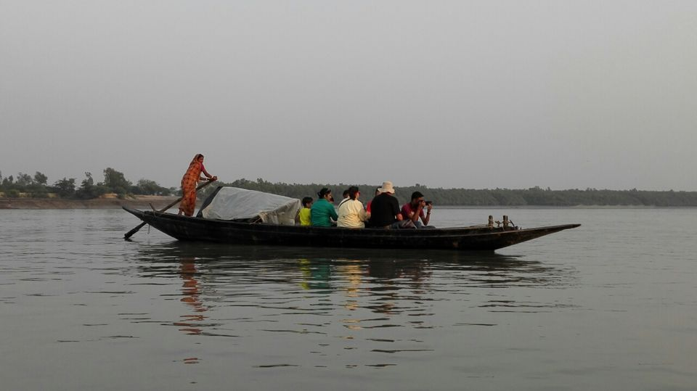
Geographical Setting/History
Where did it happen?
Historical context?
Sundarbans
Between Bangladesh and West Bengal
Lusibari
“Tide country”
Filled with predators
1757 - English East India Company
1857 - Anti-colonial riots
1858 - British colonization
1920 - First settlers arrive in Lusibari
1947 - Indian Independence Act
1979 - Marichjhapi Massacre
2004 - Indian Ocean Tsunami
2005 - Novel takes place
Notes:
Image: https://www.researchgate.net/figure/Map-showing-the-extent-of-the-Bangladesh-Sundarbans-study-area_fig1_325438693
https://www.tripoto.com/west-bengal/trips/countryside-sunderbans-56752f4c3b019

Slide 3
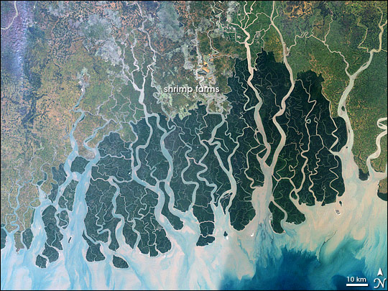
The Sundarbans and Myth
Pg. 6 - In our legends it is said that the goddess Ganga’s descent from the heavens would have split the earth had Lord Shiva not tamed her torrent by tying it into his ash-smeared locks. To hear this story is to see the river in a certain way: as a heavenly braid, for instance, an immense rope of water, unfurling through a wide and thirsty plain. That there is a further twist to the tale becomes apparent only in the final stages of the river’s journey – and this part of the story always comes as a surprise, because it is never told and thus never imagined. It is this: there is a point at which the brain comes undone; where Lord Shiva’s matted hair is washed apart into a vast, knotted tangle. Once past that point the river throws off its binding and separates into hundreds, maybe thousands, of tangled strands.

Slide 4
The Land and its Connection to Myth
What properties of myth and story are interwoven between the setting of the novel? Where do we see the setting intertwine with myth and why is that significant? What does myth teach us about the land?
Pg. 150 “Tell me children,” I would begin, “what do our old myths have in common with geology?” …
“Think about it,” I would say, “and you’ll see. It’s not just the goddesses – there’s a lot more in common between myth and geology. Look at the size of their heroes, how immense they are – heavenly deities on the one hand, and on the other the titanic stirrings of the earth itself – both equally otherworldly, equally remote from us.

Slide 5
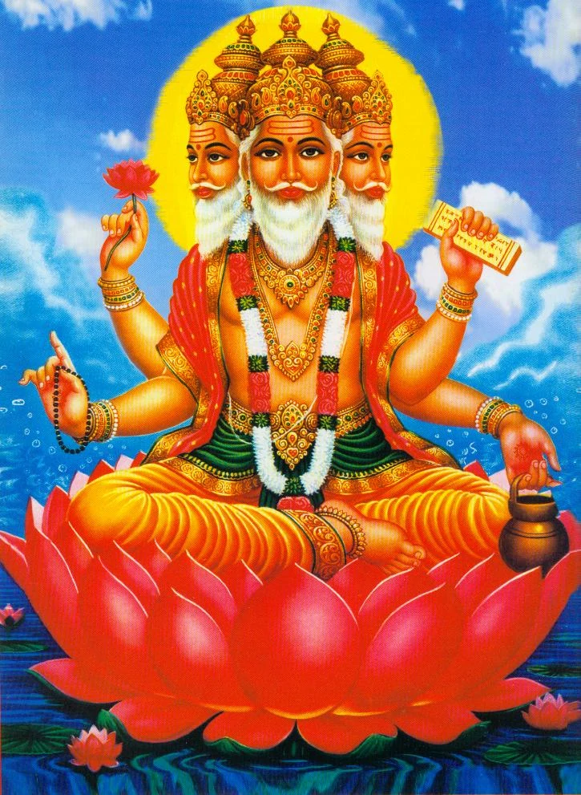
Hinduism
Religion
Culture
Panthesitic Religion - there is one divine being that manifests itself in our reality
“Each of the individual personal gods is considered to be an aspect of the Divine One”
Brahma is the divine oneness that is omniscient and omnipotent with an infinite number of forms
Atma is the individual ‘soul’; divine consciousness manifested in all living beings
Sanatana Dharma - the Eternal Truth
Namaste/Nomoshkar - “I acknowledge the divine in you, that which is also in me.”
Varnas (as stated in the Vedas) - Braahman, Kshatriyas, Vaishyas, Shudras
Vedic duties evolved into determiner of societal value
Notes:
Notes:
Sources: https://www.newworldencyclopedia.org/entry/Pantheism#:~:text=Pantheistic%20Concepts%20in%20Religion%20and%20Philosophy%201%20Ancient,apart%20from%20the%20world%20in%20heaven%2C%20while%20
https://iskconeducationalservices.org/HoH/practice/dharma/the-four-varnas/

Slide 6
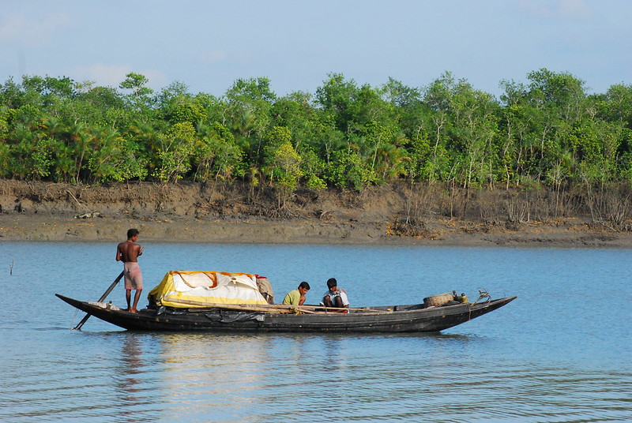
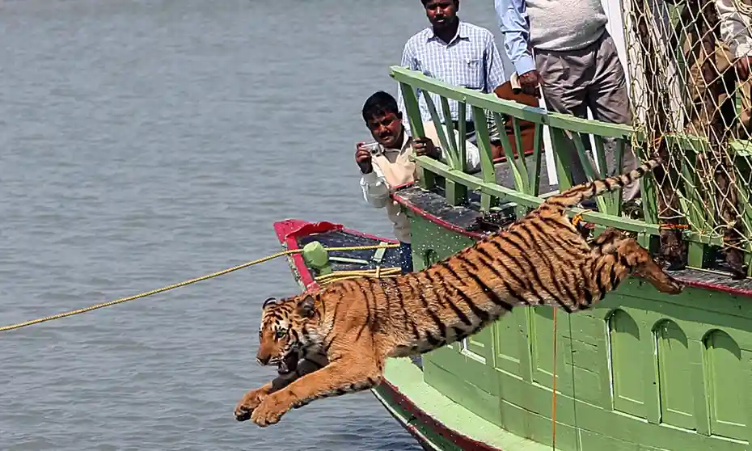
Religion and Culture
Significance of Nature
Notable Passages
Brahman manifests itself in all creation equally, including nature
“very strong environmental conscience”
Humans must learn to coexist with nature - non-violence
Pg. 150-152 - ”Love flows deep in the rivers.”
Love as a divine emotion
Pg. 168-172 - “Untold multitudes of crabs are burrowing into our badh [...] Because the animals ‘already know by instinct we’re not comfortably at home in our translated world.”
Pg 194 - Dolphins are “Bon Bibi’s messengers”
Notes:
Sources: https://www.newworldencyclopedia.org/entry/Pantheism#:~:text=Pantheistic%20Concepts%20in%20Religion%20and%20Philosophy%201%20Ancient,apart%20from%20the%20world%20in%20heaven%2C%20while%20

Slide 7
Religion/Spirituality and the Land
In our previous slide of religion and culture, we noted connections to spirituality and the environment.
How does this influence the way you observe religion/spirituality? How do you connect to the novel’s exploration of religion/spirituality?
Gangetic Dolphin
Irrawaddy Dolphin

Slide 8
Main Characters
Piya
Kanai
Fokir
Moyna
Young American Cetologist
Daughter of Indian immigrants
Only knows English and travels alone
Middle Aged Indian translator
From New Delhi, spent a few years in Sundarbans as a child
In love with Piya
Young impoverished crabber
Knows no English and illiterate
Extensive knowledge of the land
Husband of Moyna, father of Tutul, son of Kussum, and ‘son’ of Horen
Intelligent young Nurse
Works for Nilima
Mother of Tutul and wife of Fokir

Slide 9
‘Side’ Characters
Nilima/Mashima
Nirmal/Saar
Horen
Kusum
Founded Babadon Trust and built the hospital
Wife of Nirmal/Saar and aunt (Mashima) to Kanai
School Professor and wannabe revolutionary
Husband of Nilima and uncle to Kanai
Witnessed the Morichjhapi massacre
Established boatman
Raised Fokir
Kusum’s Lover?
Mother of Fokir, childhood friend of Kanai
Killed in Morichjhapi massacre

Slide 10
Religious Characters
Bon Bibi
Shah Jongoli
Dokkhin Rai
Guardian spirit of the forest
Emphasis on nurturing
Sister to Shah Jongoli
Guardian spirit of the forest
Emphasis on defending
Brother to Bon Bibi
Demon of the Forest
Emphasis on attacking/killing
Often appears as a Tiger

Slide 11
Storyline #1: Nirmal’s Notebook
Storyline #2: Present Day
Piya meets Kanai on a train
Fokir saves Piya from an unfortunate expedition → work well together
Go to Lusibari → finds Kanai
Expedition with Fokir, Kanai, & Horen
Kanai’s jungle experience with Fokir, love confession to Piya, and return to Lusibari with Horen.
Fokir & Piya stranded during cyclone. Fokir dies → serious trauma for Piya
Piya returns to Lusibari with new research plans. Kanai returns to New Delhi.
Explains events before Nirmal’s death
Nirmal & Horen are caught in a storm → reunited with Kusum
Nirmal offers to help Marichjhapi
Nilima does not approve Marichjhapi cause → “seed of our mistrust” p. 158
Nirmal not significant enough in revolution → ‘madness’?
Nirmal and Horen go to warn Kusum about rumoured attack → Nirmal and Kusum stay, Horen leaves with Fokir
Kusum presumably dies, Nirmal lives but suffers mental decay
Horen revealed he and Nirmal loved Kusum.

Slide 12
Discussion Questions
What are your thoughts on the village tiger killing? Do you connect with Piya, the village, or Kanai? Why?
Was it right for Fokir to leave Kanai in the woods? What was his point in conducting that event?
What is the significance of Fokir’s death?

Slide 13
Themes
Ecology, nature, and the tides
Religion, culture, and myth
Dichotomies and confluence
Notes:
-Right vs. wrong (kanai and fokir in the woods), insider vs outsider (kanai- indian and piya- american)

Slide 14
Discussion Questions
What is the significance of the tides throughout the novel? What does it mean for the tide to be "hungry"?
Notes:
Question 3: Lead in = Throughout the novel, we see characters using a variety of communication methods (i.e. verbal, non-verbal, and written communication).

Slide 15
Discussion Questions
Though none of the main characters directly express religious beliefs, in what ways do we see them express devotion to ideas and/or personal beliefs?
Notes:
Question 3: Lead in = Throughout the novel, we see characters using a variety of communication methods (i.e. verbal, non-verbal, and written communication).

Slide 16
Discussion Questions
What is the importance of communication in the novel?
Does the novel suggest that language is an effective means of communication or an insufficient one?
Notes:
Lead in = Throughout the novel, we see characters using a variety of communication methods (i.e. verbal, non-verbal, and written communication).

Slide 17
Other thoughts?

