Slide 1
Alif the Unseen

Slide 2
Alif and Intisar break up
Leads to acquisition of Alf Yeom and Creation of ‘Tin Sari’
The Hand hacks Alif’s computer
Alif and Dina now on the run
They seek out the help of Vikram the Vampire
Introduction to Jinn world
They seek out information on Alf Yeom
Introduction of the Convert/the hidden alley
Big Police Chase
Siege on major mosque → lots of things
Alif in Prison (3 months)
Battle between good and evil
Adventure into Empty Quarter
Reunited with old friends
Final Battle against the Hand
Hand is defeated by Alif/Alf Yeom and revolution begins
Summary

Slide 3
History and Culture

Slide 4
A Brief History of The Middle East
600 - 900s CE
1919
1936 - 1980s
The Thousand and One Nights is told and compiled. The stories are rooted in Arabic, Egyptian, Indian, Persian, and more cultures.
The League of Nations led by President Woodrow Wilson mandates boundaries in the Middle East.
Oil is discovered in the Middle East and the U.S. gets involved to acquire it and stop communism.
1973 - 1974
1990 - 1991
2010 - 2012
OPEC places an oil embargo on the U.S. for its actions in the Arab-Israeli war.
The Gulf War begins as the U.S. and Saddam Hussein battle for oil.
The Arab Spring occurs throughout many countries in the Middle East.
Notes:
Focuses largely on the U.S.’s actions there. Does not touch on Israel/Palestine
The Organization of the Petroleum Exporting Countries
http://www.pbs.org/wgbh/globalconnections/mideast/questions/uspolicy/

Slide 5
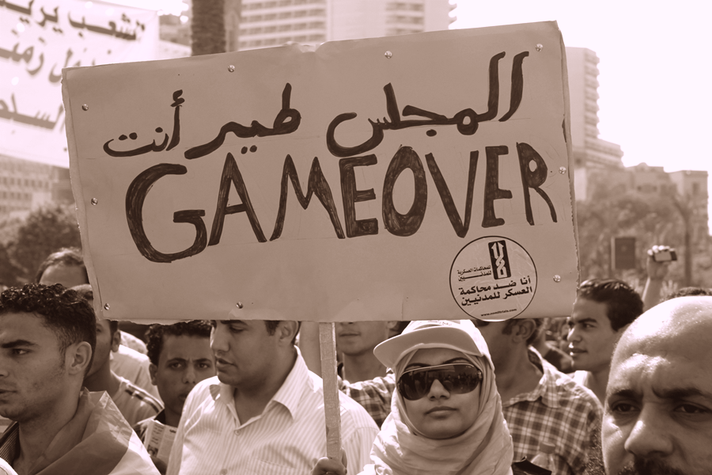
The Arab Spring
Events
Tunisia
Protests sparked after a young man sets himself on fire to protest police brutality and the President’s regime. The President is ousted 10 days later.
Protests spread to several other countries:
The Egyptian president resigns.
Protests lead to civil war in Libya and Syria.
Tunisia holds their first free election.
Yemen’s president relinquishes power after years of protests.
Alif the Unseen
The story leads up to the events of the Arab Spring.
Notes:
Very limited recap of events. Not all positive outcomes - often more violence and instability, and sometimes new leaders took over who were just as dictatorial.
Alif: “I wanted Alif to be right. I had a terrible feeling the Hand was right. But I was going to write the happy ending anyway. I cannot tell you what a joy it was to have the happy ending turn out to be right in the real world.” - G.W.W
https://www.aljazeera.com/news/2020/12/17/what-is-the-arab-spring-and-how-did-it-start
https://archive.thinkprogress.org/alif-the-unseen-author-g-willow-wilson-on-fantasy-in-dictatorships-cross-cultural-understanding-and-4011790ade68/
https://www.brookings.edu/blog/future-development/2016/03/18/middle-class-dynamics-and-the-arab-spring/

Slide 6
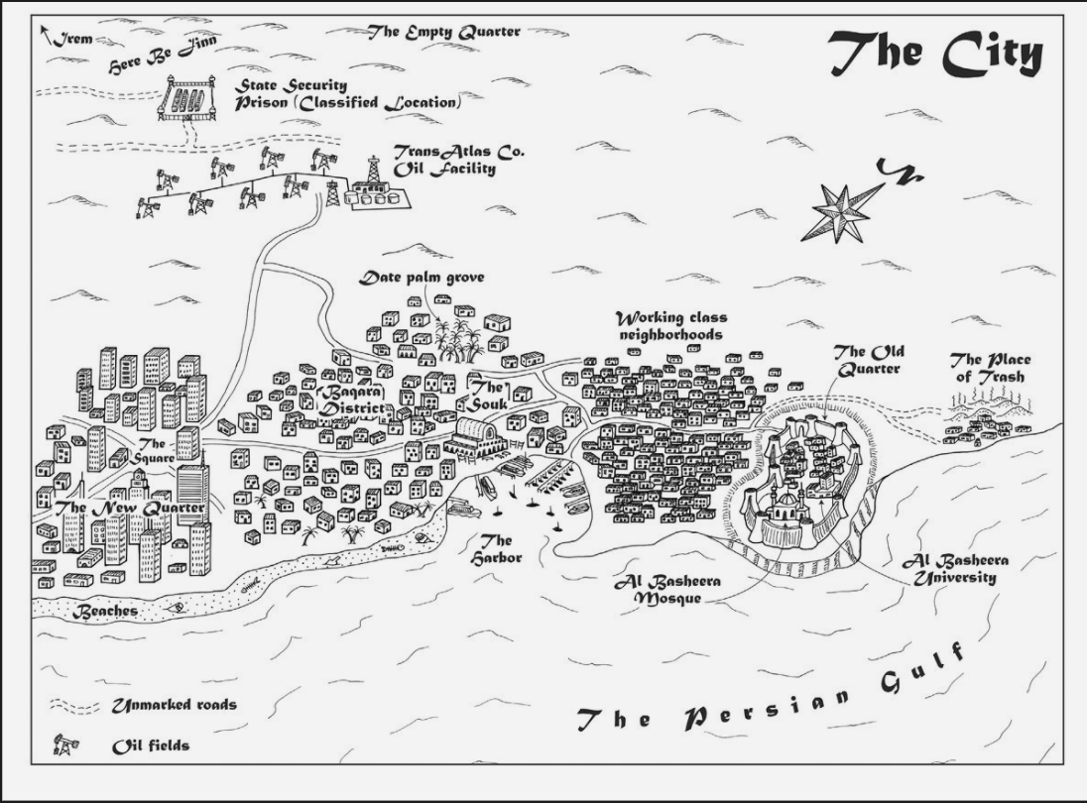
Culture in the Middle East
Class
Race
In the Middle East
The middle class in Arab Spring countries are important in instigating protests.
In Alif the Unseen
Alif is from the Lower to Middle Class Area, known as the Baqara District. Other parts of town include the Old Quarter, New Quarter, and working class neighborhoods.
Divisions within classes exist in the book as well.
In the Middle East
The Middle East has the largest number of Indian immigrants.
Oil boom created job opportunities. Migrants came from countries with large populations of unskilled workers
Prejudice exists against non-Arab migrants.
In Alif the Unseen
Alif is half Indian and half Arab, and experiences tension because of his racial and religious differences.
Notes:
Emphasize that the Middle East is not a monolith
Division within middle class - despite the fact that some countries had growing middle classes and some didn’t, all people in the middle classes were dissatisfied in some way. And most had divisions in political and social views within the middle class itself, such as in Tunisia and Syria.
Class in Alif - people become disunified eventually, someone rips off Intisar’s headscarf.
Abdullah said, “the City “is divided into three parts: old money, new money, and no money”’
Race: India, Pakistan, Bangladesh. ME countries had smaller populations/fewer workers. Created divide between these races and the Arab races in terms of class (and race).
Race: In April 2020, an Emirati online celebrity, Tariq al Meyhas, sparked controversy when he posted a video arguing that the term “migrant workers” refers only to Asians (Indians and Bengalis) and not Arabs (Egyptians and Sudanese) who should be treated like “brothers.”
Race in Alif: Alif says to Dina: “You know what I meant. Gulf Arabs and all that. Egyptians aren’t really Arabs, not in the same way. You’re imported labor, just like us.”
https://www.brookings.edu/blog/future-development/2016/03/18/middle-class-dynamics-and-the-arab-spring/
https://www.indiatimes.com/explainers/news/indians-migrants-in-gulf-countries-551901.html
https://merip.org/2021/06/who-is-indian-in-the-gulf-race-labor-and-citizenship/

Slide 7
Discussion Question:
The American Convert is described as being half-in and half-out of the Jinn world. What is the significance of Alif being half-in and half-out, racially, of the Arab world?
Why does the book focus on Alif, who is not particularly religious and seems to have few political convictions, rather than someone like Dina (who is religious) or New Quarter (who acts out of strong political convictions)?
Notes:
What do we think about Wilson’s characterization of Americans as being half-in and half-out? What would Vikram say about Indigenous Americans/Voodoo culture (is Wilson’s bias as a White woman making Americans seem like a White monolith?)

Slide 8
Jinn

Slide 9
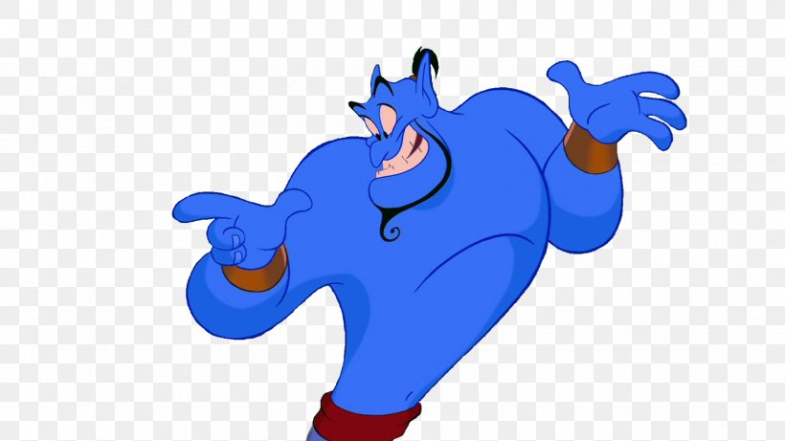
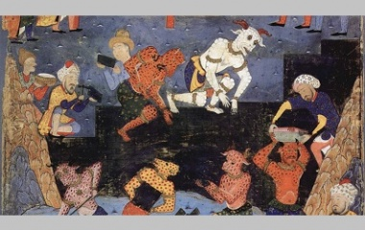
What is a jinn?
“Hidden ones”
Neither good nor evil
Made out of fire
Have free will
Associated with trickery
Notes:
Lead with quote from Quran

Slide 10
Types of Jinn
Effrit
Cunning, intelligent
Changeable
Marid
Most powerful
Often male
Vetala
semi-evil
In Indian folklore
Possess human corpses
Ghoul
Demonic
Incapable of goodness
Sila
Shape-shifters
Often female
Notes:
Marid- genie from Aladdin
Vetala-Vikram

Slide 11
Discussion Question
What is the role of the jinn in the novel? Why do you think G. Willow Wilson decided to portray jinn the way she did in the novel? How would the novel have changed without the jinn?

Slide 12
Genre

Slide 13
Cyberpunk
Quantum Fiction
Subgenre of science fiction
Advanced technology
Dystopian future
Private security forces vs. low-life “underworld”
Political and social corruption
Protagonist is typically an outsider, criminal, or misfit
Any story that witnesses life and the human experience on a subatomic level
Perception of reality as a “spectrum of realness”
Duality, contrasting binaries are entangled and develop character identity
Character authorship
Uncertainty and ambiguity
Notes:
https://www.neondystopia.com/what-is-cyberpunk/
“Who Wrote It”

Slide 14
Discussion Question:
Why does G. Willow Wilson choose to write a fantasy, cyberpunk story?
What function does the fantasy genre serve?
How does the genre influence our engagement with the novel?
Notes:
Metaphors: from real life to religion (multiple layers of meaning in cyberspace and in the Qur’an) and from religion to real life (ideas of unseen in the Jinn/God and in real life in Alif/Dina)

Slide 15
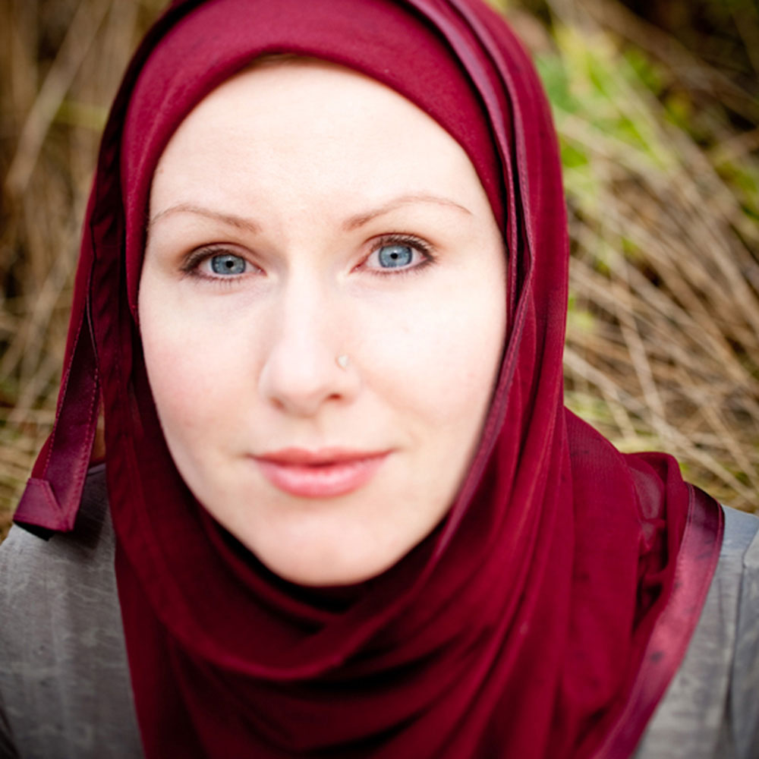
Excerpt from An Interview with the Author
“In many countries in the Middle East… for a long time censorship of books and film was a very big deal. There were books you couldn’t buy, things with political content would be censored, but there were some genres of books and film that the censors just didn’t understand. They didn’t understand that below these fantasy themes, which they thought to be very childish, were these powerful political messages… All they see is the surface metaphor. They don’t really get what these books are saying.” (451)
Notes:
This manifests through genre and the theme of veiling
Uses genre to accomplish

Slide 16
Veiling
What preconceptions do you have about veiling?

Slide 17
He could not have guessed the world she had created for herself. Sewn into the underside of her long outer cloak were patches of bright silk, patterned, beaded, spangled with points of light.

Slide 18
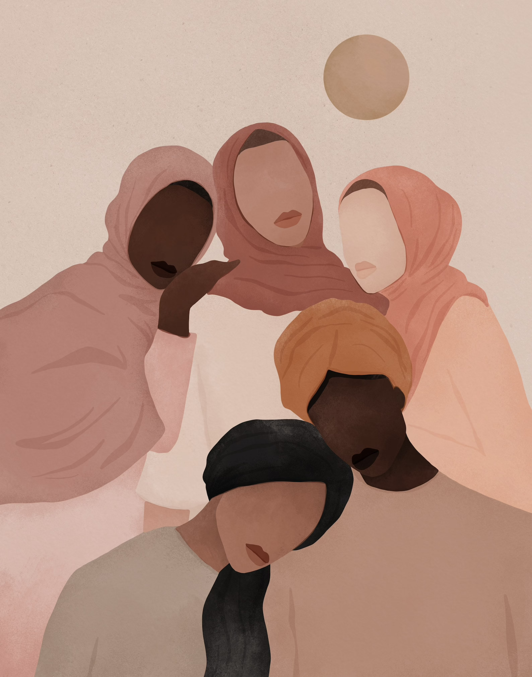
Types of Muslim veils
There are four different types of headscarves:
The Hijab-covers the head & neck
*The Niqab*-covers entire body, neck, & face- only eyes are showing
The Chador– body length shawl
The Burqa– full body veil. One sees through a mesh screen.

Slide 19
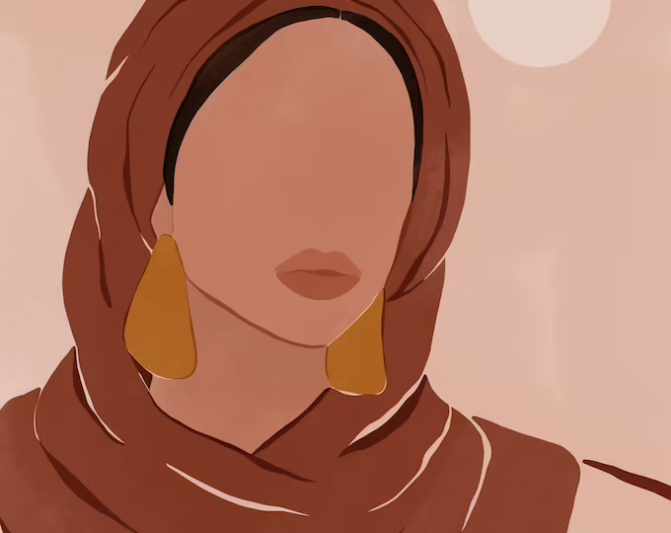
Veiling
Although typically muslim veils have been stereotyped as oppressive, they can also be a symbol of empowerment.
Dina’s relationship with veiling
The significance of Dina letting Alif underneath her veil.

Slide 20
Discussion Question:
How did Alif’s perspective on veiling shift over the course of the book?
Did your perception shift?

Slide 21
Other Discussion Questions
How do the “unseen” elements of the novel relate to each other?
Cyberspace
Dina’s veil
The Jinn world
Knowledge
Language
God
Notes:
Cyberspace allows people to operate unseen. When Alif creates Tin Sari he says, “A hijab…I am hanging a curtain between us” (39).
People have opinions on Dina’s choice to veil.
The Jinn world: Vikram says, “You are seen and we are hidden” (108).
Consider unseen knowledge: Abbas means Meteor (used to keep Jinn from gates of heaven and gaining knowledge), what you CAN know depends on who you are (jinn knowledge vs human - days vs nights (significance of Iren?), censors can’t understand fantasy books)
Language: The Qur’an has never been translated, yet its meaning has changed over time, Alif tries to translate the Alf Yeom into code but even the original translation was difficult (ch. 0), God is communicating in translation.

Slide 22
Other Discussion Questions
Dina says that metaphors are dangerous. Does she still believe this at the end of the novel?
In Ch. 0, the jinn says of the Alf Yeom, “When you hear it, you will become someone else” (7). How are we different after we read this novel?
Notes:
Metaphors/false names are dangerous (but do they also provide protection? - Jinn can use your name against you, Alif was protected by his handle), Dina has no false name
Follow-up: Do metaphors hide things or do they point to that which is unseeable?
“Metaphors are dangerous. Calling something by a false name changes it, and metaphor is just a fancy way of calling something by a false name.”

Slide 23
Thanks!
Any questions?

