Slide 1
Delaware County Incarceration
Christian Terrell
Benjamin Cohen Peace Conference 2021

Slide 2
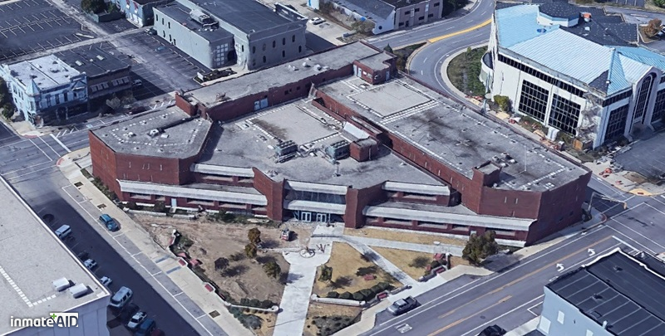
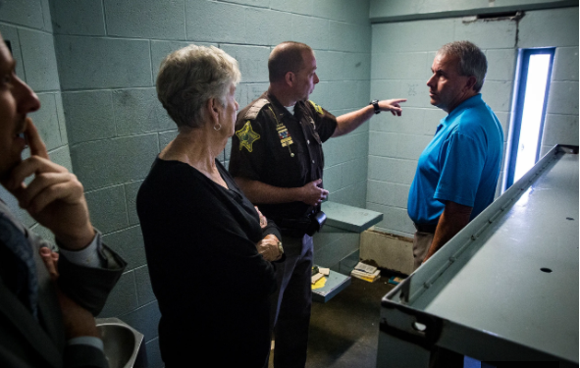
Delaware County Justice Center
The jail could house up to 220 inmates but frequently housed over 300. The highest number being 340.
The jail was originally designed for less than 150 inmates
The jail is technologically outdated, overcrowded, and in need of maintenance

Slide 3
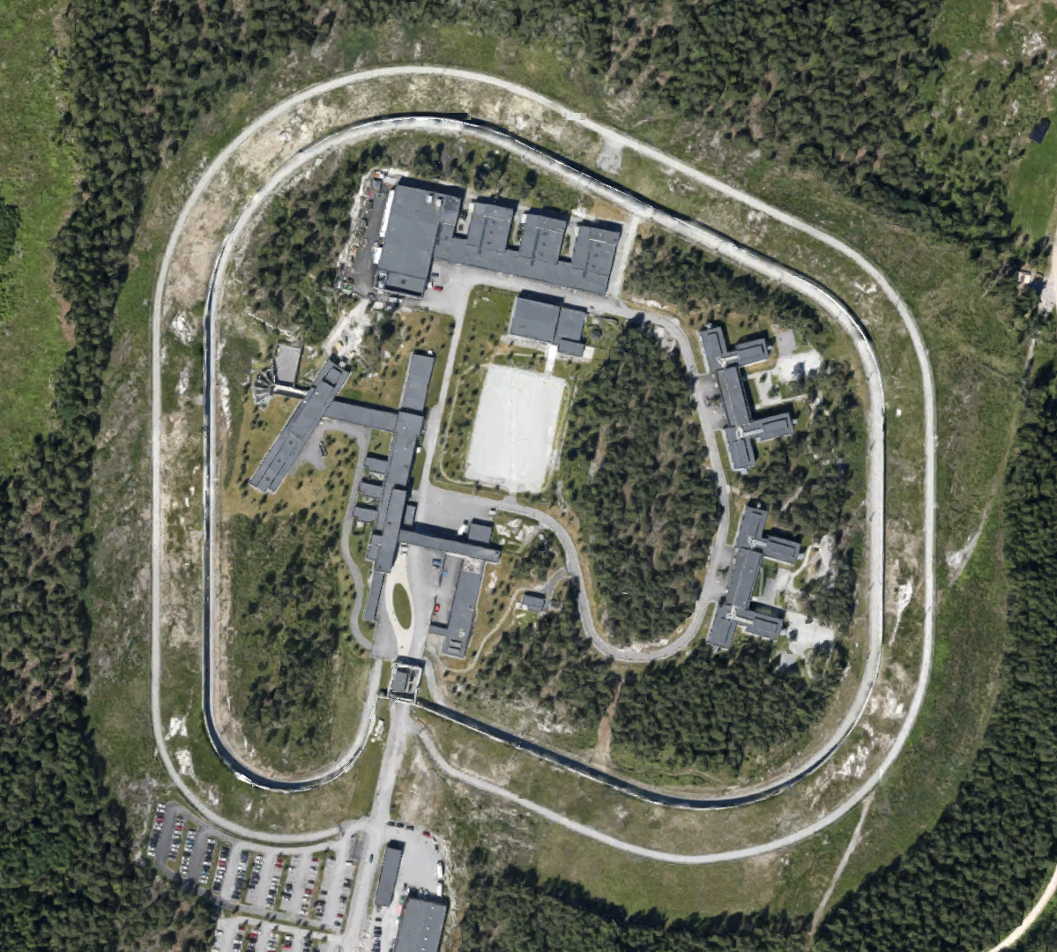
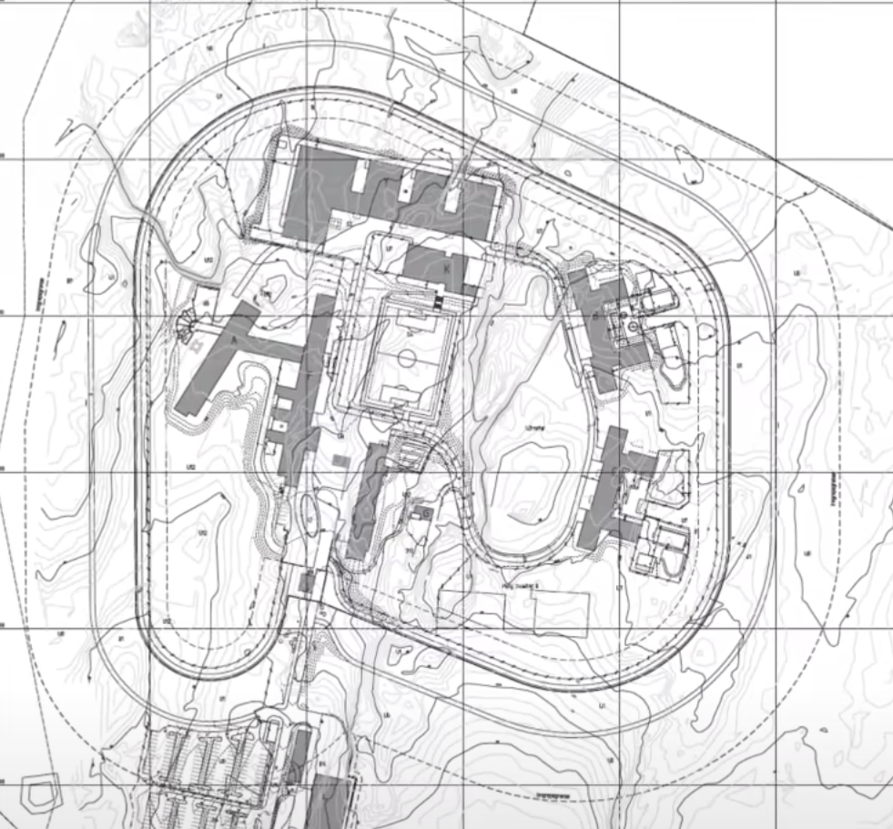
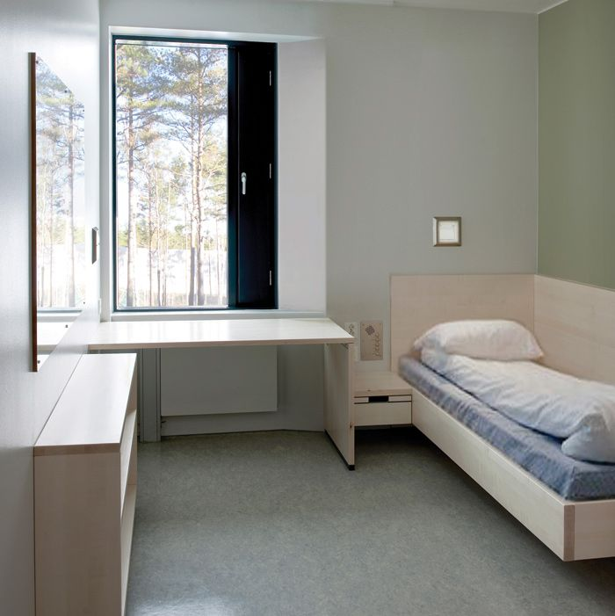
Halden Prison & The Humane Prison
Cost: 1.3B Norwegian kroner ($154,202,230)
Every Halden cell has a toilet and a shower. Prisoners have huge, unbarred windows overlooking mossy forest scenery.
The prison is hidden behind silver birch trees.
Staff are encouraged to mingle with inmates.

Slide 4
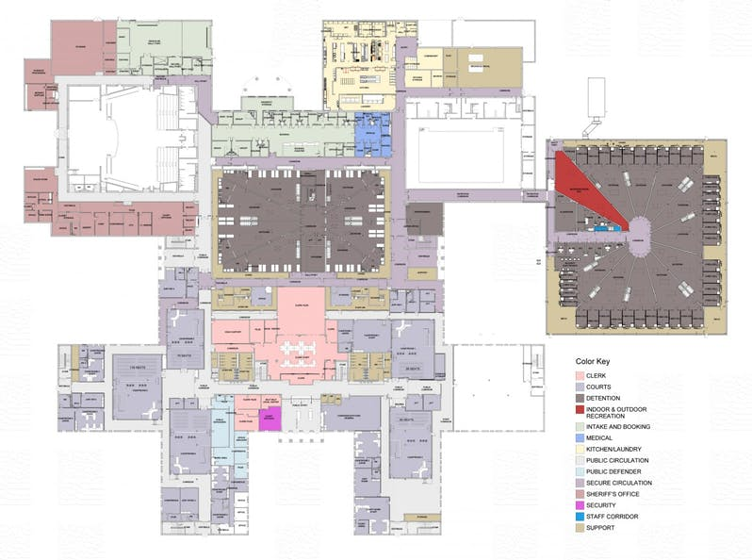
New Delaware County Jail
Renovations cost $45 million
The jail will house 500-750 inmates, 6 court rooms, and the justice department.
Expanding the current Justice Center would cost a minimum of $65 million.

Slide 5
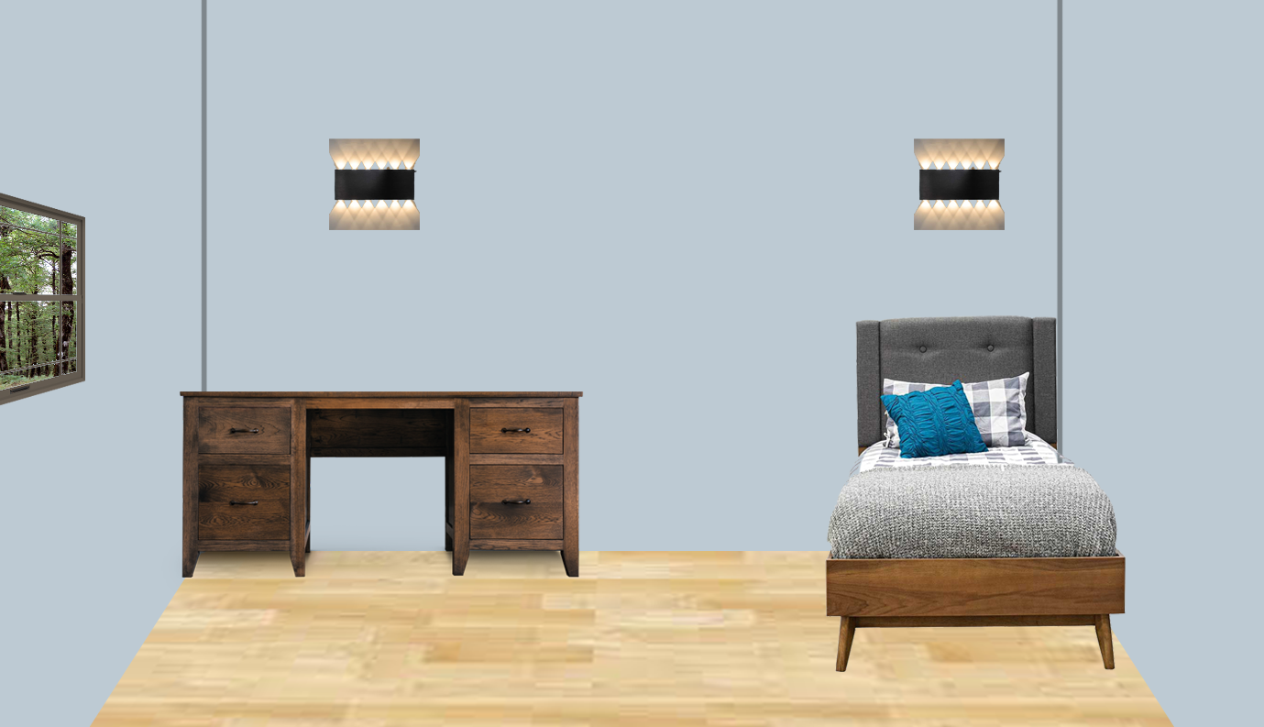
A New Vision for Delaware County’s Jail

