Slide 1
COVID-19 and Mask Wearing Support: Using a Moral Psychological Framework to Influence Persuasion
Joseph t. Trentadue
Advisor: Dr. Andrew Luttrell

Slide 2
Introduction

Slide 3
Background
Political Ideology (Tetlock & Mitchell, 1993)
Liberal: more likely to “understand structural limits on upward mobility”, more likely to show cognitive empathy, less likely to succumb to fundamental attribution error
Conservative: believe that individual “resourcefulness” can solve individual poverty, belief in “invisible hand of free market competition”, more likely to fall prey to fundamental attribution error

Slide 4
Background
Moral Foundations Theory (Graham et al., 2013)
Care/harm avoidance: promote kindness and care to one another
Fairness/cheating: focuses on reciprocity between individuals
Loyalty/betrayal: kinship towards those in our group
Authority/subversion: obedience to authority
Purity/degradation: practicing healthy habits

Slide 5
Background
Ideology, Moral Foundations, and Persuasion (Day, Fiske, Downing, & Trail, 2014; Feinberg & Willer, 2015; Graham, Haidt, & Nosek, 2009)
Liberals more attracted to arguments about harm and fairness.
Conservatives more attracted to arguments about authority, purity, and loyalty
Feinberg and Willer (2015)
Conservatives were more likely to endorse national healthcare when framed in terms of “purity.” Liberals were more likely to support higher military spending when framed in terms of fairness.

Slide 6
Hypothesis
Moral re-framing will be used to test for increased persuasion among liberals and conservatives
Participants will be asked to complete shortened versions of the RWA and SDO scale in order to test for effects on persuasion and mask-wearing behaviors
Conservatives shown a “loyalty and purity” message will exhibit higher persuasion and increased mask wearing behavior
Liberals shown a “harm avoidance and fairness” message will exhibit higher persuasion and increased mask wearing behavior

Slide 7
Methods

Slide 8
Participants
Participants (N = 232) were recruited virtually through Prolific.
Majority of participants were liberal (N=174), compared to conservatives (N = 64).
Majority of participants were female (N = 141), with 93 males and 4 non-binary individuals participating.
Average age of participants was 33.8 years of age.

Slide 9
Materials
Demographics
Age
Gender
Political ideology 7 point scale (Very liberal = 1, very conservative = 7)
Right Wing Authoritarianism Scale (Zakrisson, 2005)
Social Dominance Orientation Scale (Ho, et al 2015)
Mask wearing messages
Control
Harm avoidance/fairness
Loyalty/purity
Message evaluation

Slide 10
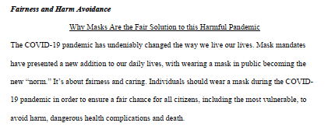
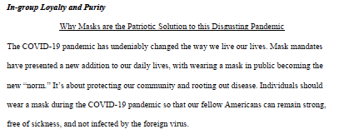

Slide 11
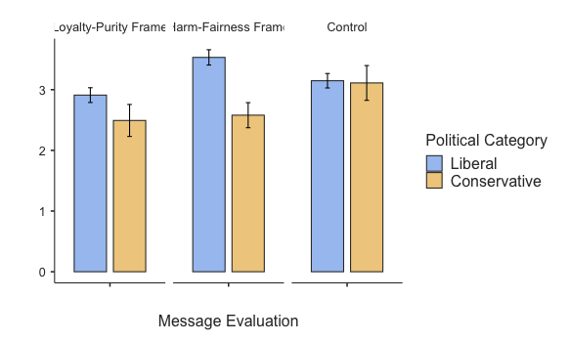
Results
Main effect of political ideology (p = .002)
Interaction between political ideology and message type (p = .04)

Slide 12
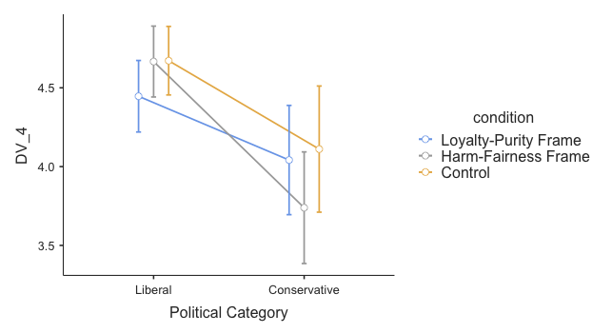
Results cont.
Liberals (M = 4.60, SD = 0.704) intended to wear a mask in public more than their conservative counterparts did (M = 3.95, SD = 1.19), F(232) = 25..063, p < .001.

Slide 13
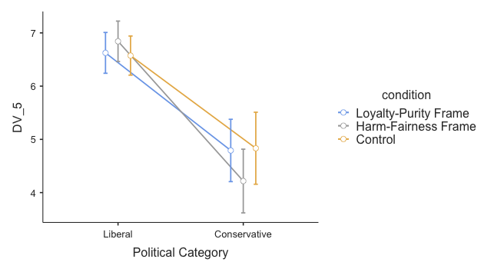
Results cont.
Liberals (M = 6.68, SD = 0.819) were more likely to support nationwide mandates than conservatives, (M = 4.60, SD = 2.45), F(232) = 94.143, p < .001.

Slide 14
Discussion
Why was conservative data not significant?
Perceived persuasion for liberals was increased through moral re-framing, but individual intent and support for a nationwide mandate were not. Why?
Limitations?
Future research?

Slide 15
References
Day, M. V., Fiske, S. T., Downing, E. L., & Trail, T. E. (2014). Shifting liberal and conservative
attitudes using moral foundations theory. Personality and Social Psychology Bulletin, 40(12), 1559-1573.
Graham, J., Haidt, J., & Nosek, B. A. (2009). Liberals and conservatives rely on different sets of moral foundations.
Journal of Personality and Social Psychology, 96(5), 1029- 1046.
Graham, J., Haidt, J., Koleva, S., Motyl, M., Iyer, R., Wojcik, S. P., & Ditto, P. H. (2013).
Moral foundations theory: The pragmatic validity of moral pluralism. Advances in Experimental Social Psychology, 47, 55-130.
Ho, A. K. Sidanius, J., Kteily, N., Sheehy-Skeffington, J., Pratto, F., Henkel, K. E., Foels, R., & Stewart, A. L.
(2015). The nature of social dominance orientation: Theorizing and measuring preferences for intergroup inequality using the new SDO7 scale. Journal of Personality and Social Psychology, 109(6), 1003-1028.
Feinberg, M., & Willer, R. (2015). From gulf to bridge: When do moral arguments facilitate
political influence? Personality and Social Psychology Bulletin, 41(12), 1665-1681.

Slide 16
Whitley, B. E. (1999). Right-wing authoritarianism, social dominance orientation, and
prejudice. Journal of Personality and Social Psychology, 77(1), 126-134
Pratto, F., Sidanius, J., Stallworth, L. M., & Malle, B. F. (1994). Social dominance orientation: A personality variable predicting social and political attitudes. Journal of Personality and Social Psychology, 67, 741-763.
Tetlock, P. E., & Mitchell, G. (1993). Liberal and conservative approaches to justice: Conflicting psychological portraits. In B. A. Mellers & J. Barron. (Eds). Psychological perspectives on justice: Theory and applications. (p. 324-355). Cambridge University Press.

