Slide 1
The Effects of agreeableness and political orientation on perceptions of aggression in media
Alijah Forbes
Ball State University
Dr. Thomas Holtgraves

Slide 2
Research Question:
How does one’s Agreeableness rating and political orientation affect how they perceive aggression in politically charged media?

Slide 3
Introduction:
Selective Perception is a documented process that has been shown to influence how one perceives stimuli in their environment. Along with this is Ingroup Bias which affects a person’s perception of an event if they are involved with a perceived group. When an individual was involved with a perceived group, participants showed more favorable perceptions to their group and less favorable perceptions of the opposing group(Hastorf & Cantril, 1954) (Ross & Lepper, 1985)
The personality trait of agreeableness has been found to influence a person’s preference to positive and negative media, affecting a person’s ability to watch varying media for a certain length of time. It had been shown that those with a higher agreeableness trait had a shorter viewing time for negative media than those with a lower agreeableness. (Bresin & Robinson, 2014)

Slide 4
Current Research
The present study researches how differences in political ideology can affect how an individual views aggression in political charged media, specifically aggression between police and protestors during a Black Lives Matter Protest
Ingroup Bias
The present study also researches how differences in the trait of Agreeableness can affect the individual’s overall perception of the aggression in the situation that is present.

Slide 5
Hypothesis
Those who self-report as Liberal will rate Police as more aggressive, less justified and more out of control than the Protestors
Those who self-report as Conservative will rate Protestors as more aggressive, less justified and more out of control than the Police
Those with a High Agreeableness will rate the entire situation and both Protestors and Police as aggressive
Those with a Low Agreeableness will rate the entire situation and both Protestors and Police as less aggressive

Slide 6
Methods

Slide 7
Participants
54 Participants (74.1 % Female, 83.3% White, mean age = 28.08) completed this survey
Majority of participants were Liberal (N = 30, 55.6%), compared to Moderate (N = 14, 25.9%) and Conservative (N = 10, 18.5%)
Participants were gathered through an anonymous link posted through the Ball State Comm center via email and social media sites
Facebook, Twitter, Reddit
All participants must have been 18 years old to take the survey and had completed 80% of the survey.
Participants who had not completed a significant amount of the study (80%) or the questions of aggression were eliminated from data collection
Participants were not compensated for the participation

Slide 8
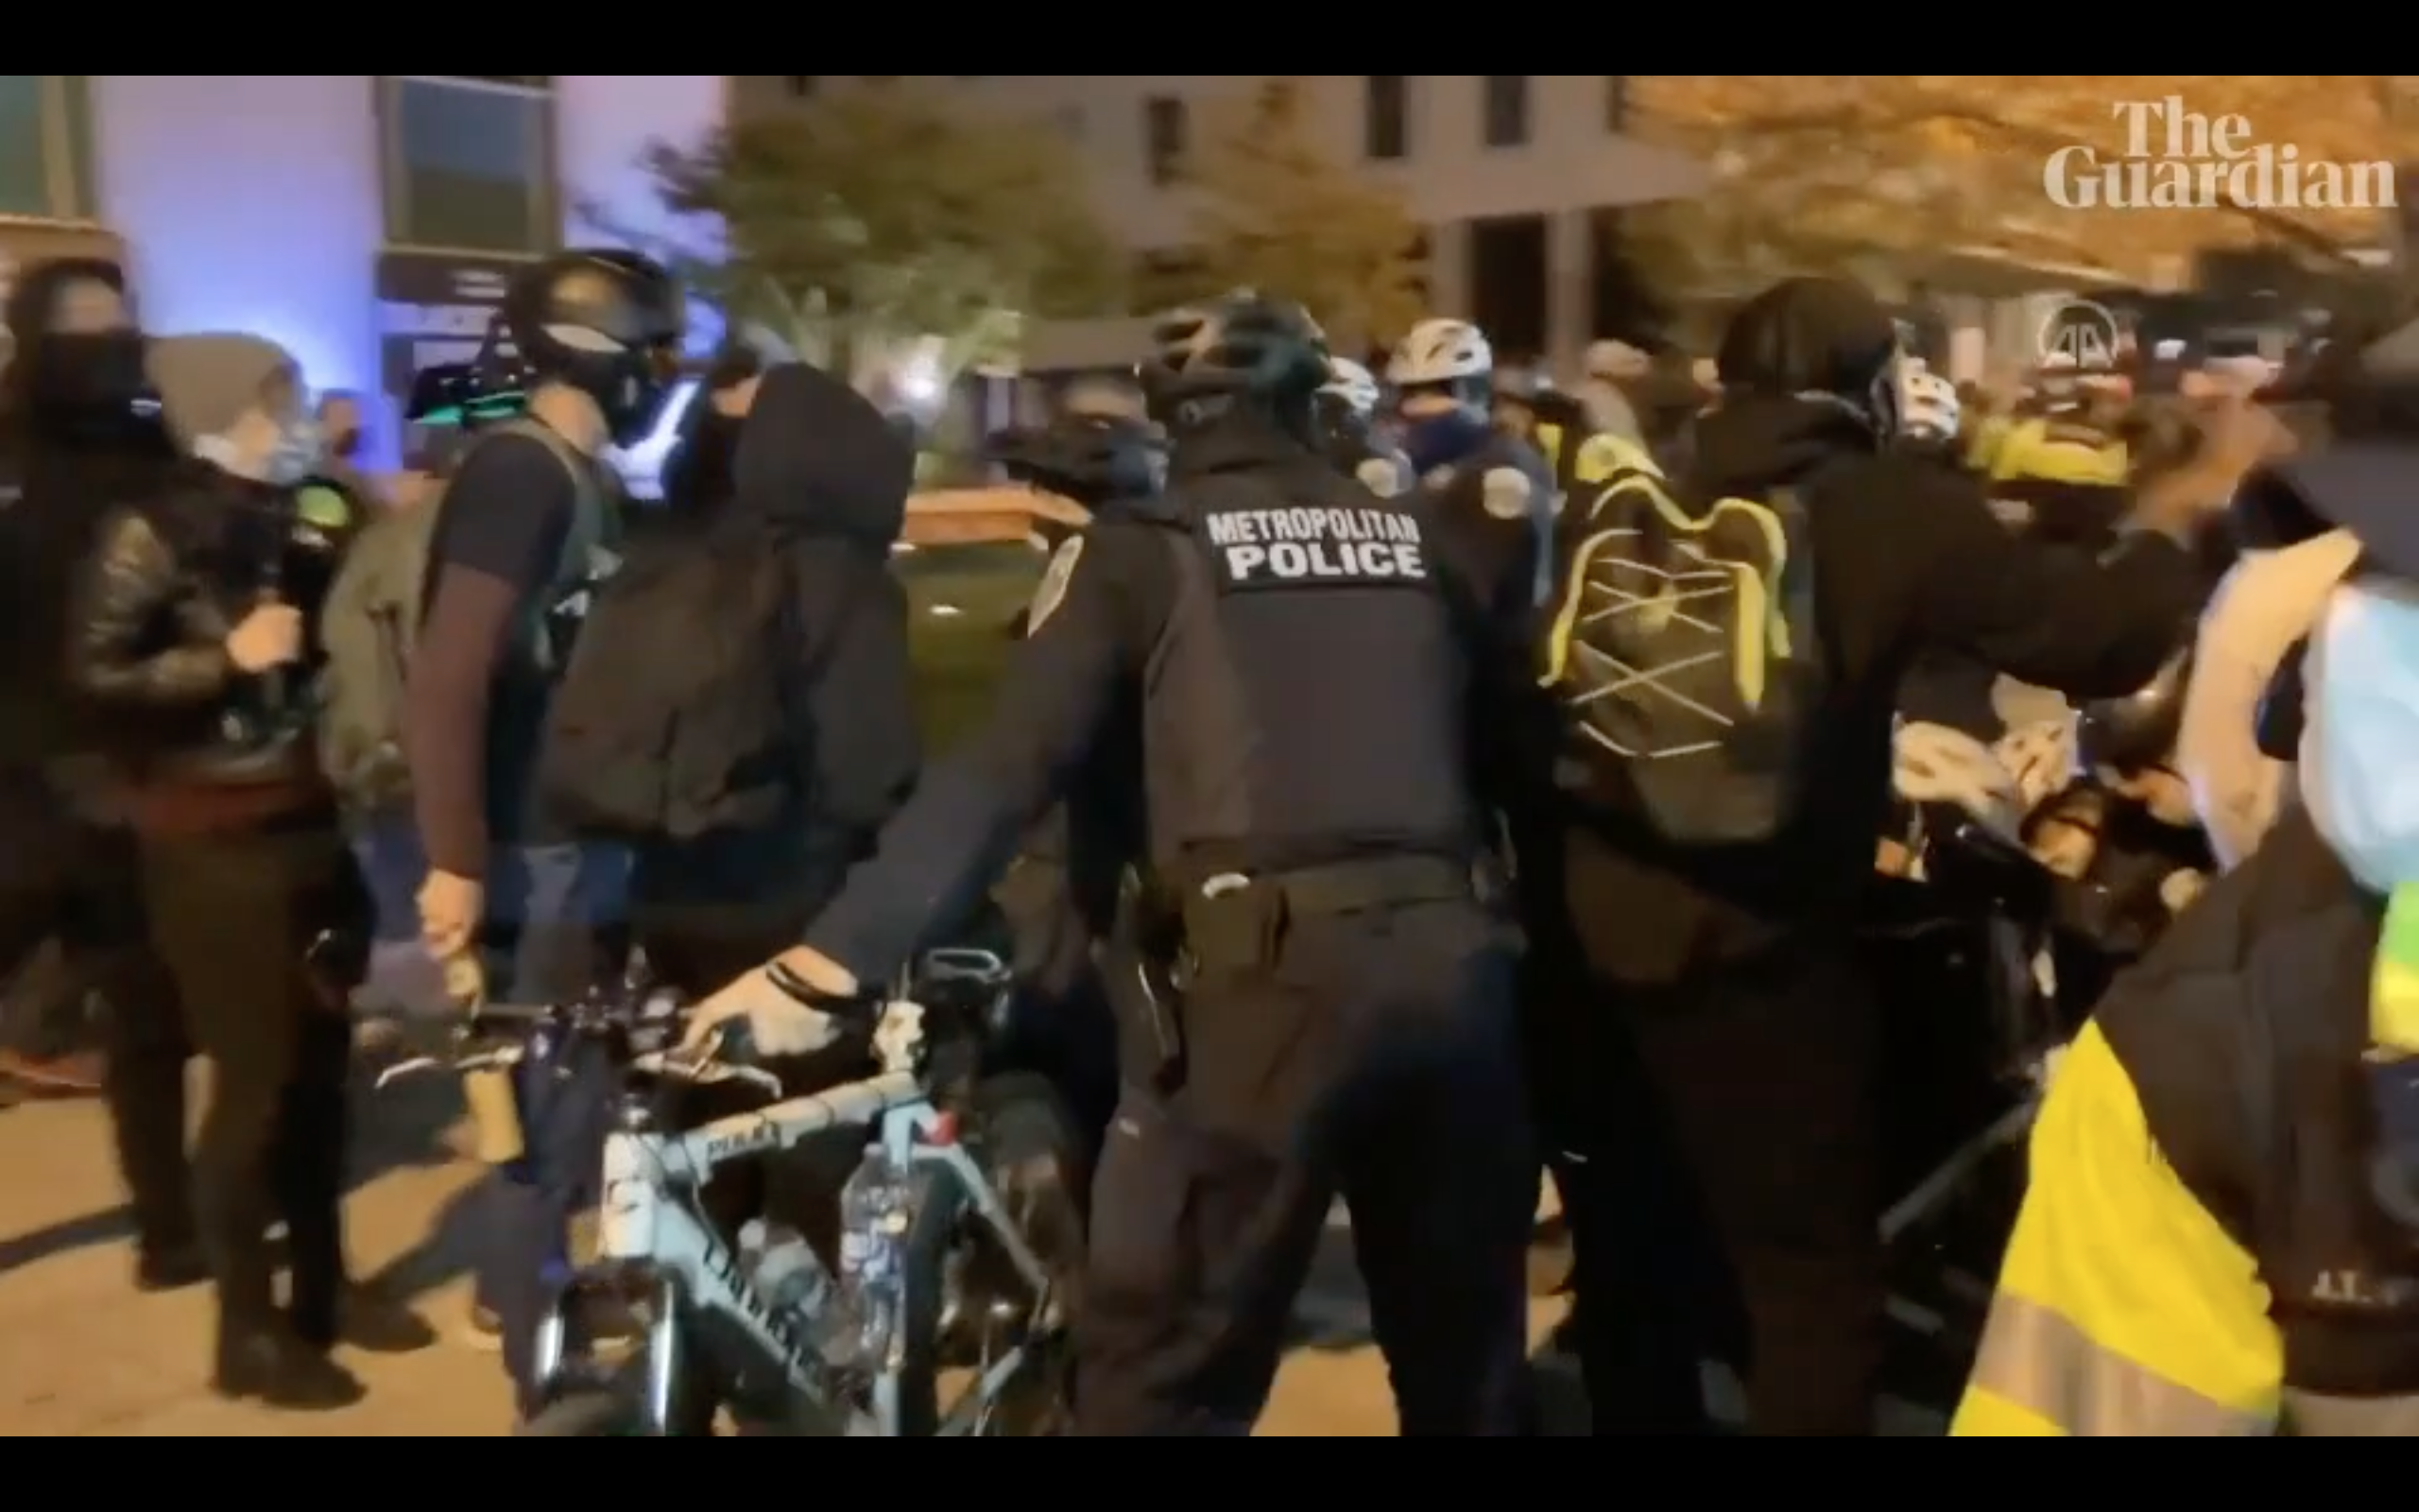
Materials
Demographics:
Basic demographic questions including Age, Gender, and Race
Self-report of political ideology
(1= Very Liberal, 4= Neither Liberal or Conservative, 7= Very Conservative)
Big Five Inventory (BFI) (John &Srivastava,1999)
Shortened personality test with focus on questions concerning Agreeableness
9 questions (1-5)
Perceived Aggression Questionnaire
Meant to find perceived Aggression of police and protestors in the video
Also used to gather justification and control measures
7 total questions (1= Low, 4= Neutral, 7=High)
Compilation Video
Formed from Youtube videos of aggressive interactions between police and protestors at a Black Lives Matter protest

Slide 9
Procedure
After providing consent, participants will answer sets of questions in a randomized order
Demographics
Viewing and answering questions concerning the Aggression video compilation
BFI Agreeableness personality questionnaire
Tasks ordered in this manner to reduce priming effect

Slide 10
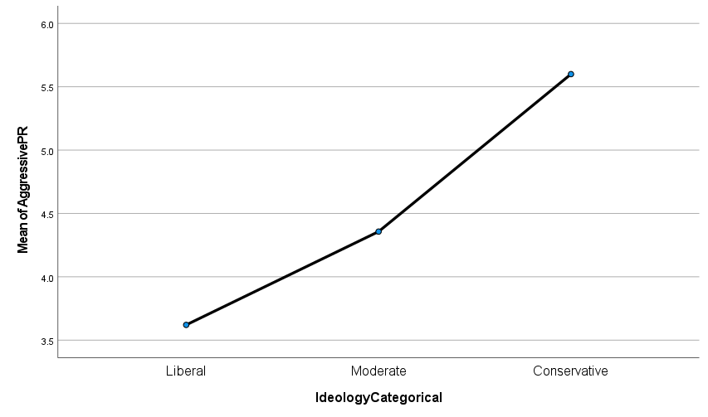
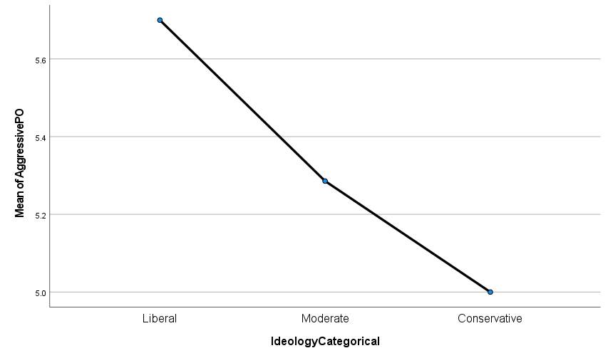
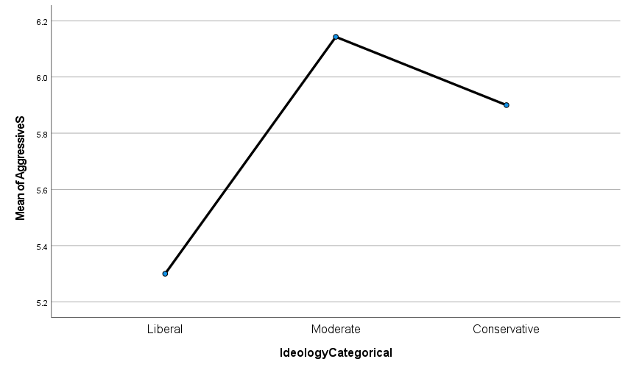
Results
A Political Ideology X Aggressive Perceptions ANOVA found:
A significant effect for Perceived Aggression of Protestors, F (52) = 9.456, p = .000
No significant effect for Perceived Aggression of Police, F (53) = 1.724, p = .189
No significant effect for Perceived Aggression of Situation, F (53) = 2.614, p = .083

Slide 11
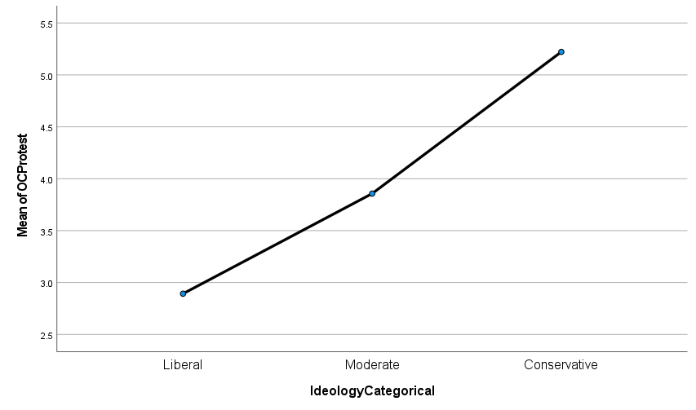
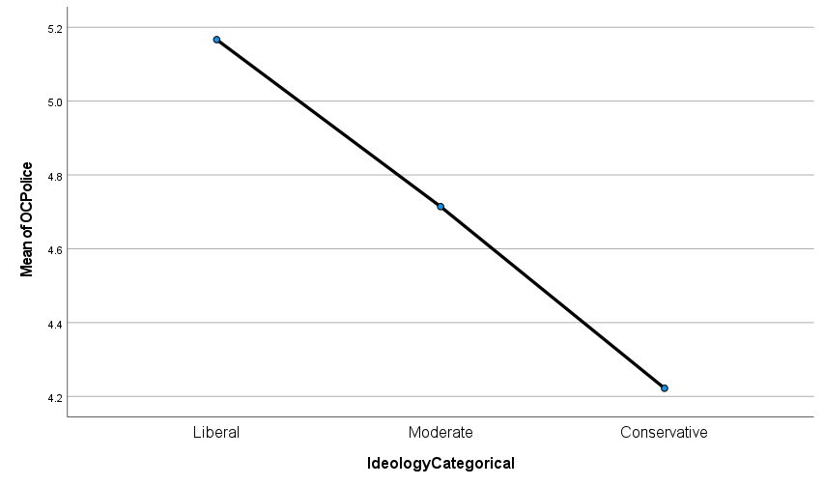
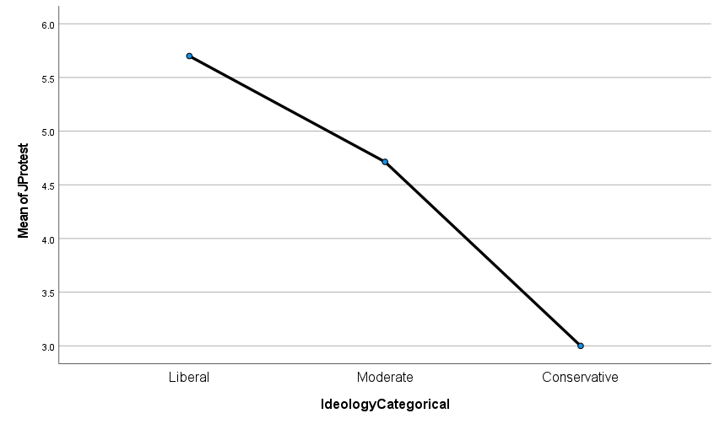
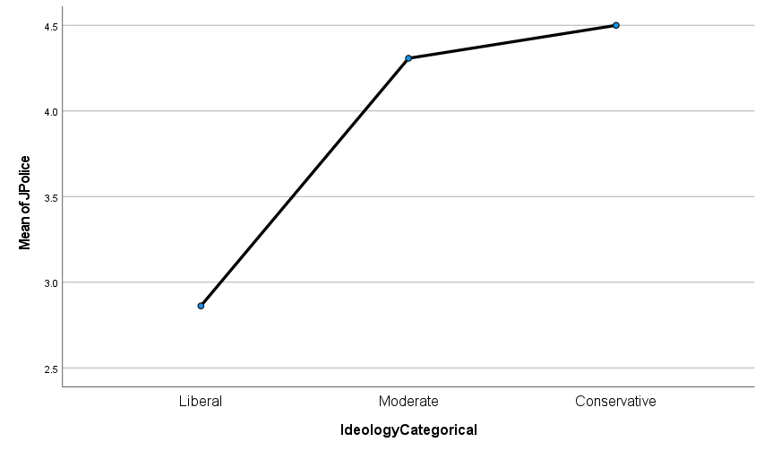
Results Cont.
A Political Ideology X Perceptions of Control/Justification ANOVA found:
A significant effect for Perceived “Out of Control” of Protestors, F (50) = 12.863, p = .000
No significant effect for Perceived “Out of Control” of Police, F (52) = 1.947, p =.153
A significant effect for Perceived Justification of Protestors, F (52) = 10.031, p = .000
A significant effect for Perceived Justification of Police, F (51) = 5.259, p = .009

Slide 12
Results Cont.
An Agreeableness X Aggressive Perceptions Correlation found:
No significant effect for Perceived Aggression of Protestors, r (53) = .234, p = .091
A significant effect for Perceived Aggression of Police, r (54) = .311, p = .022
No significant effect for Perceived Aggression of Situation, r (54) = .70, p = .615

Slide 13
Conclusion
The current study found some of the hypotheses to be supported by the data
Liberals would have a significantly lower Perceived Aggression of Protestors when compared to Conservatives
While there wasn’t a significant effect on Political Ideology on Perceived Aggression of Police, the results did move in this direction, however, the differences were not large enough to significant
The current study also found significant results of other variables supported by the data
Political Ideology had a significant effect on Perceived “Out of Control” of Protestors
Political Ideology has a significant effect on Perceived Justification of both Protestors and Police
Agreeableness had a significant effect on Perceived Aggression of Police

Slide 14
Discussion
The current study has found that there is some evidence of Political Ideology affecting Perceived Aggression, however, not all the data found was significant.
Limitations
Limited population size
Small Conservative size when compared to Liberals

Slide 15
References
Bresin, K., & Robinson, M. D. (2014). You Are What You See and Choose: Agreeableness and Situation Selection. Journal of Personality, 83(4), 452–463. doi:10.1111/jopy.12121
Hastorf, A. H., & Cantril, H. (1954). They saw a game; a case study. The Journal of Abnormal and Social Psychology, 49(1), 129–134. https://doi.org/10.1037/h0057880
John, O. P., & Srivastava, S. (1999). The Big Five Trait taxonomy: History, measurement, and theoretical perspectives. In L. A. Pervin & O. P. John (Eds.), Handbook of personality: Theory and research (p. 102–138). Guilford Press.
Vallone, R. P., Ross, L., & Lepper, M. R. (1985). The hostile media phenomenon: Biased perception and perceptions of media bias in coverage of the Beirut massacre. Journal of Personality and Social Psychology, 49(3), 577–585. https://doi.org/10.1037/0022-3514.49.3.577

