Slide 1
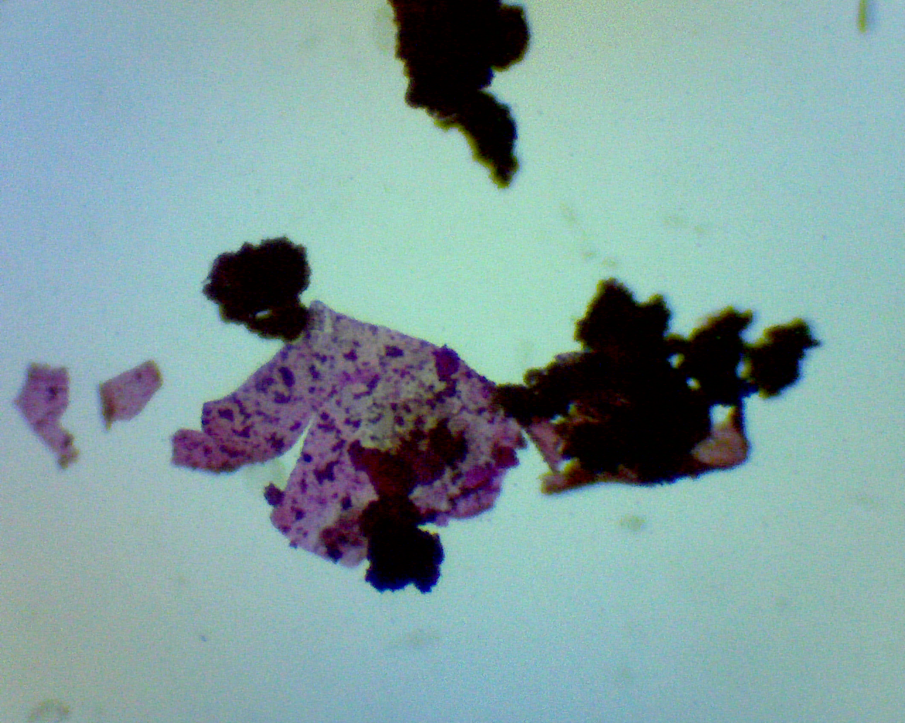
Removal of Microplastics from a Wastewater Treatment System
JAYMI GODFREY
ADVISOR: DR. BANGSHUAI HAN
Department of Environment, Geology, and Natural Resources, Ball State University, Muncie, Indiana 47306
Abstract
“Microplastic” includes tiny plastic fragments that are either resulted from plastic degradation or were manufactured that way. Microplastic waste is an contaminant of emerging concern for river systems, which is among the main sources of human drinking water supply. Previous studies have focused on the prevalence of microplastics within fluvial systems, and how microplastics impact wildlife and human health, mitigation techniques, and the existence in wastewater treatment systems. However, rates and mechanisms of microplastic removal during the wastewater treatment system process are still unclear. The focus of this study will be determining how much microplastics are removed per each stage of the wastewater treatment process, and reveal the temporal variations of the abundance of microplastic entering the Muncie Wastewater Treatment Plant (WWTP). This study will collect biweekly grab samples with duplicates which will be filtered using an assembled stack of sieves with mesh sizes between 400 and 74 µm, as well as using wet peroxide oxidation and density separation techniques to isolate microplastics. This study will also use visual identification to categorize microplastics based on morphology. Findings from this research will help the WWTP evaluate future renovations related to the removal of microplastics as well as contribute to cutting-edge knowledge in the field.
Methods
Wastewater Flux
Density Separation via Centrifuge
Sieves Filtration
Rose-Bengal Coloration
DI Water Rinse
DI Water Rinse
DI Water Rinse
Organics Removal with Fenton Reagent
Oven Drying
Visual Detection under Microscope
Objectives
What is the quantity and types of microplastics present in wastewater influent and at each treatment stage?
Is there a temporal and seasonal variation of the abundance of microplastic entering the Muncie WWTP?
Is there a connection between the temporal pattern of microplastic pollution with local water use patterns and seasonal climate?
Are there relationships between removal efficiency, flow rate, season, and stages of treatment with microplastic pollution?
Anticipated Conclusions
It is anticipated that microplastic pollution and presence within the wastewater treatment plant will increase during the typical time period where humans typically engage in outdoor recreation (i.e., April to October).
Figure: Suspected microplastic piece in wastewater sample.

