Slide 1
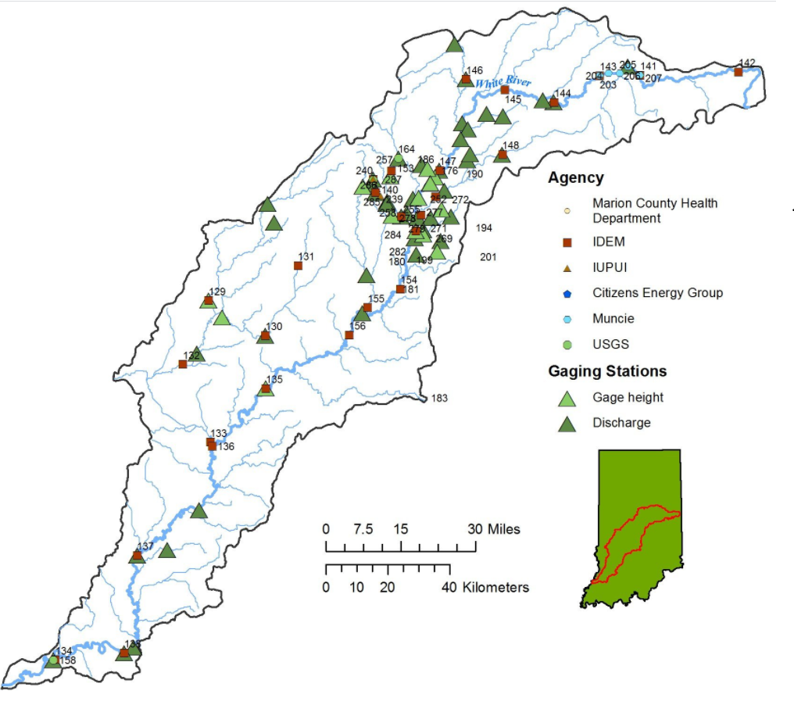
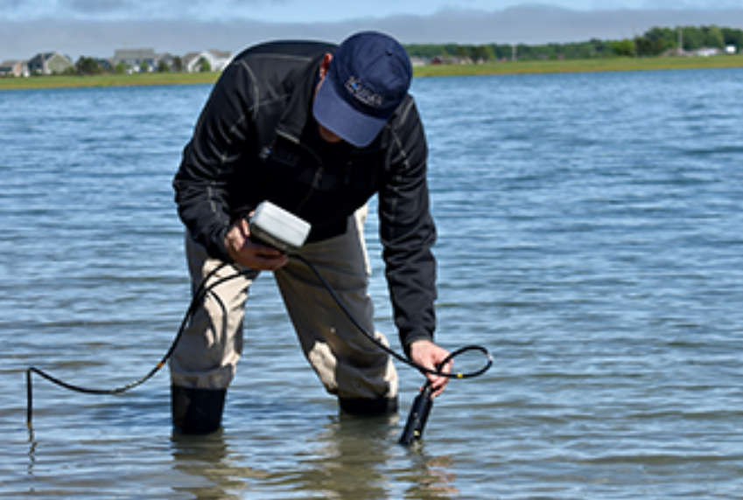
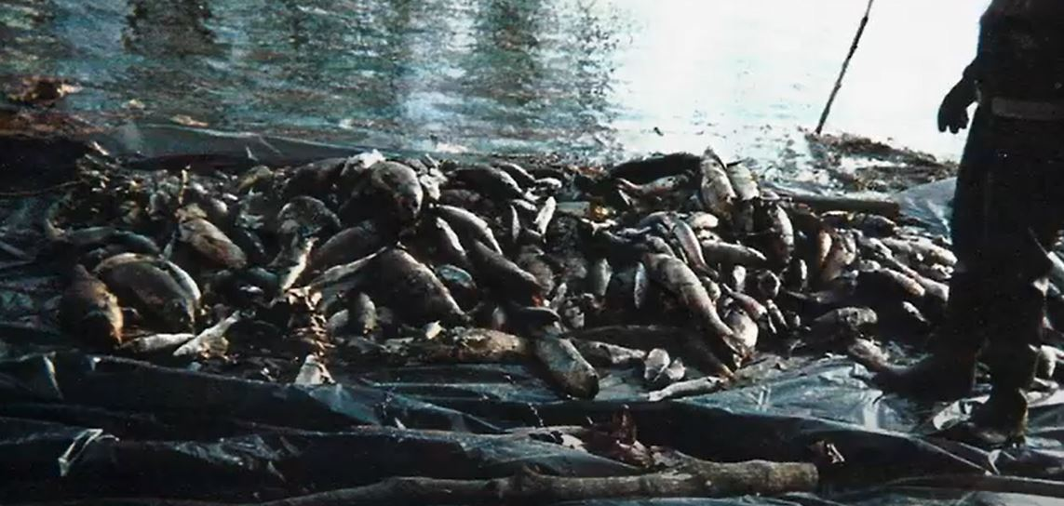
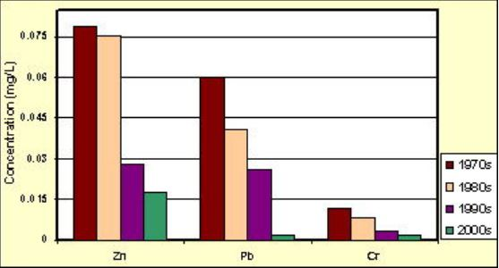
Determining the Effects of Precipitation and Pollution on Fish Communities and Stream Conditions within the West Fork White River
Esther Atutey
Ball State University Muncie, Indiana
Introduction
West Fork White River is located across central and southern Indiana Figure 1. It is 583 km long, and major tributaries include Lick Creek, Fish Creek, Fall Creek, Sand Lick Creek, Limestone Creek, and other streams (Holloway et al., 2018). The river provides many recreational activities, such as fishing, hiking, bird viewing, and many others. The river also provides drinking water to many people (Jacquemin et al., 2013) and habitat for many native organisms.
Abstract
Various human activities such as the use of pesticides and fertilizer products on farmlands, construction, and even waste disposal along the White River have contributed to the significant increase in the river's pollutants. Precipitation has washed these products into streams and water bodies which invariably pollute and affect various aquatic lives such as fish. However, this study aims to determine the effect of precipitation and pollution on fish communities and stream conditions within the West Fork White River. Using a mixed-methods research approach (quantitative data and qualitative data analysis), this study intends to evaluate the health of fish communities, water quality and report the results. The analysis will be conducted using data collected and recorded from the West Fork White River. The summary of the data will be based on water chemistry samples and fish communities. The fish community sample results will be assessed using the Index of Biotic Integrity (IBI), which would determine the fish community's overall health.
Background
In 1997 the White River was diagnosed as a threatened river (Fenelon, 1998) based on impacts from pesticides, fertilizers, untreated waste, and other products. Also, over 10,000 storm drains supply bacteria and nutrients into the White River without treatment. Storm drains direct multiple pollutants that result in a high organic matter load. In 1999 a single discharge event from the Guide Corporation killed over four million fishes (Bowman, 2019). Since that incident serious pollution problems persist. My study will examine the effect of precipitation and pollution on fish communities. The goal is to provide recommendations to protect fish communities of the West Fork White River.
Objectives and Implications
Using a mixed-methods research approach of quantitative and qualitative analyses I plan to :
Conduct research and locate case studies that identify the impact of pollution and precipitation in the West Fork White River since 1970 Figure 2 (bottom).
Identify the current health of fish communities.
Identify the current water quality currently.
Compare current and past data to determine how the West Fork White River has changed.
Methods
Collection of data: Fish data will be collected in spring-summer on sites in the West Fork White River by the Muncie Sanitary District. The Muncie Sanitary District Bureau of Water Quality is responsible for monitoring fish and macroinvertebrate communities and water quality for sites in Delaware County.
Analyses: I will summarize water quality and fish collections for 2021. Water quality analysis Figure 2 (top) are conductivity, water temperature, dissolved oxygen, and nutrient concentrations. Fish analyses will use species abundances, feeding guilds, tolerance traits, body length and weight, reproductive traits, and watershed area. The fish collections will be evaluated using the Index of Biotic Integrity (IBI) a multimetric index used by many management agencies.
Timeline
March 2021: Dissertation committee assignment and approval of the project.
May 2021: Committee review research proposal.
June 2022- August 2022: Data collection and preparation.
September 2022- May 2023: Data analyses.
November 2024: Finalize study report.
Figure 2. Water quality texting. Source: Solitude Lake Management (top), West Fork in 1999 experienced a massive fish kill. Source: So Fly (center), and the graphs below display changes that have taken place as measured just downstream from Muncie. Source: Muncie Sanitary District (bottom).
Figure 1. Map of West Fork White River. Source: Indiana Water Monitoring Council
Conclusion
I will provide recommendations to improve ecological health and water quality.
I will provide insight on how to adapt to impacts from climate change. The White River is expected to experience increased discharge with heavy rain events resulting in flooding.
I will also provide suggestions to limit flooding and maintain reduced nutrient concentrations.
I will seek promote recreational experiences along the waterway.
References
Fenelon, J. M. (1998). Water quality in the White River basin, Indiana, 1992-96 (Vol. 1150). US Geological Survey.
Bowman, S. (2019). Guide Corp. purposely cut corners and discharged toxic chemicals into the White River. Indianapolis Star.
Holloway, D., Doll, J., & Shields, R. (2018). The temporal effects of heavy metal contamination on the fish community of the West Fork White River, Delaware County, Indiana, USA. Environmental monitoring and assessment, 190(12), 1-11.
Jacquemin, S. J., & Doll, J. C. (2013). Long‐term fish assemblages respond to habitat and niche breadth in the West Fork White River, Indiana. Ecology of Freshwater Fish, 22(2), 280-294.

