Slide 1
Bryce Woody, Zach Hoeing, Justin Russell, Jacob Davis, Corbin Curnutt

Slide 2
Full Court Analytics
A subscription-based analytics tool for basketball coaches that provides insight on the efficiency of their team from season performance to game performance. The tool also includes advanced stat tracking, line-up proficiencies, and play-by-play tracking.

Slide 3
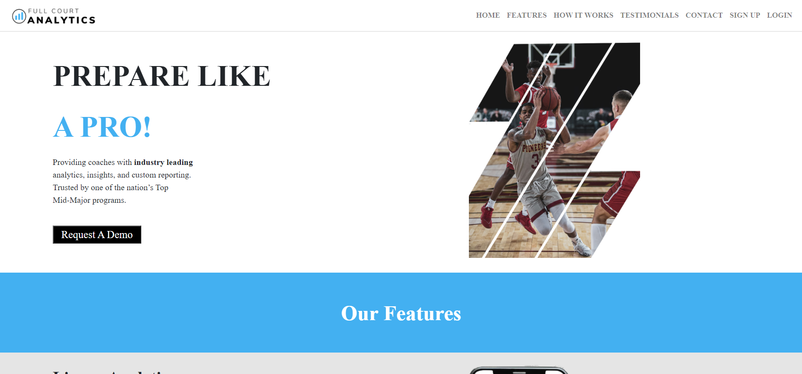

Slide 4
Analyst and Coaches
Coach
Create a roster
Upload a game
View stats from games annotated by an Analyst
Analyst
Watch and annotate games uploaded by a Coach

Slide 5
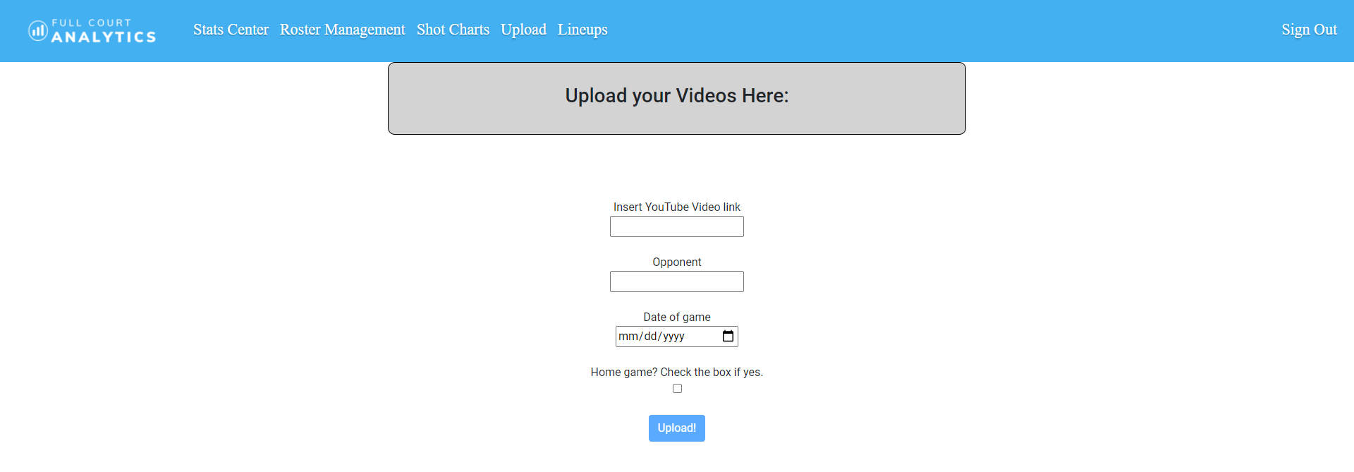
Upload

Slide 6
Upload
On this page a Coach will:
Attach a YouTube link of the game wanted to be annotated
Specify the opponent played
Give the date of the game
State whether the game was Home or Away
Once this process is complete the Analyst may begin annotating the game

Slide 7
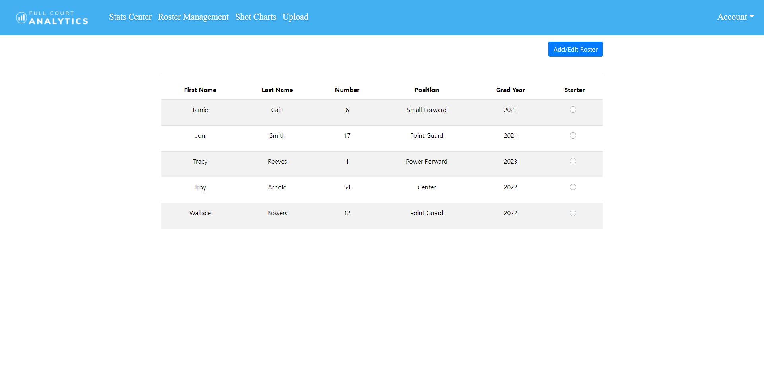
Roster

Slide 8
Roster
On this page a Coach can:
Add players to the team’s roster
Edit/remove players from the roster
Designate the starting 5

Slide 9
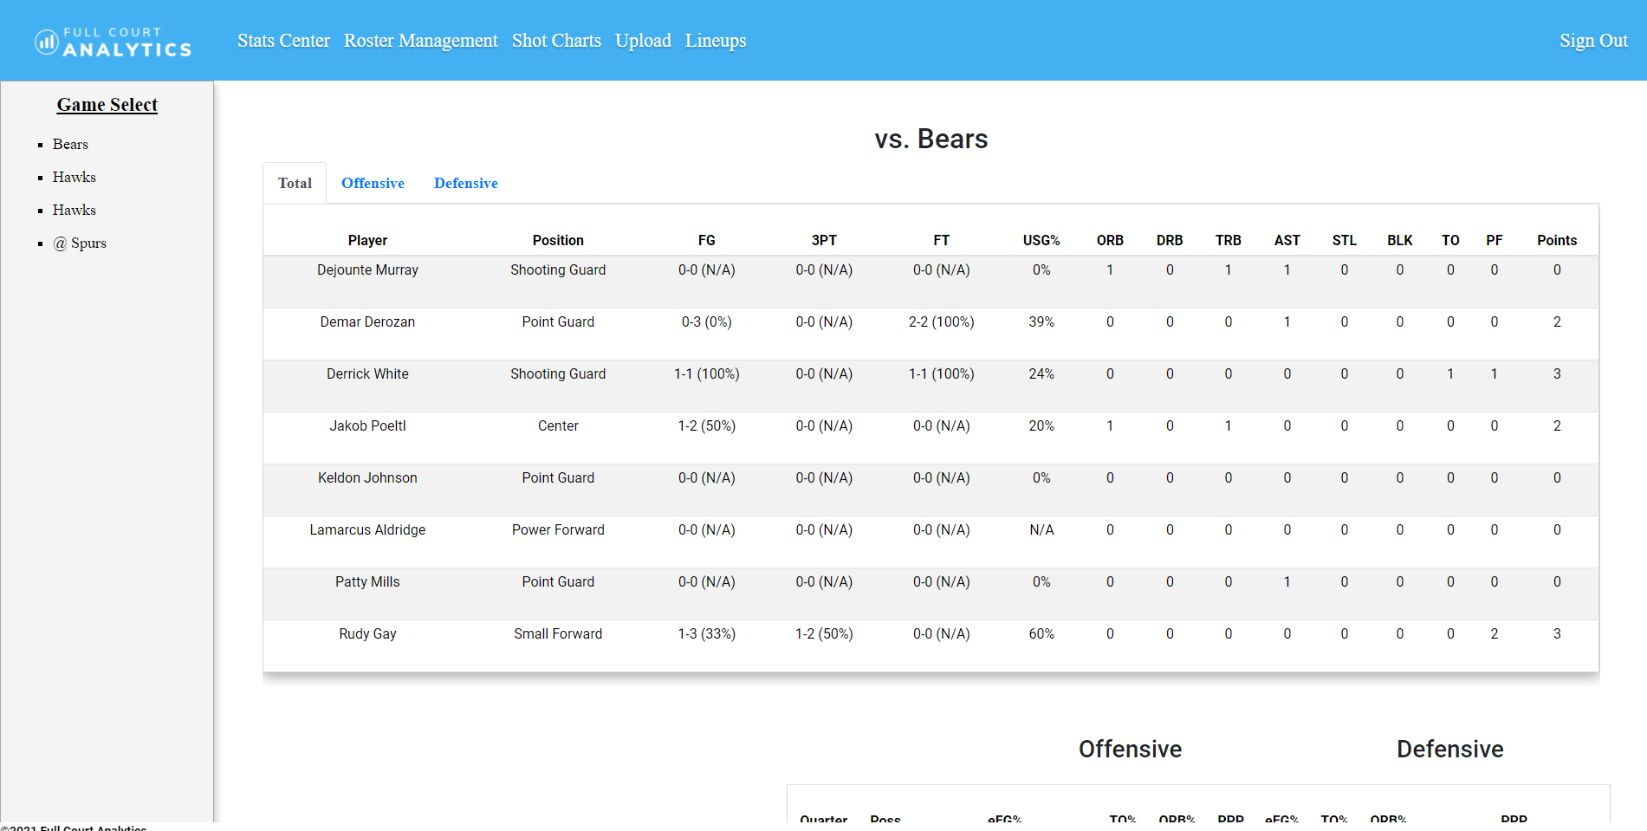
Stats Center

Slide 10
Stats Center
On this page a Coach can view categorical stats:
Classic - basic stats for each player and as a team
Shooting - stats purely based around a player’s and the team’s shooting
Advanced - stats that go more in depth for each individual and team

Slide 11
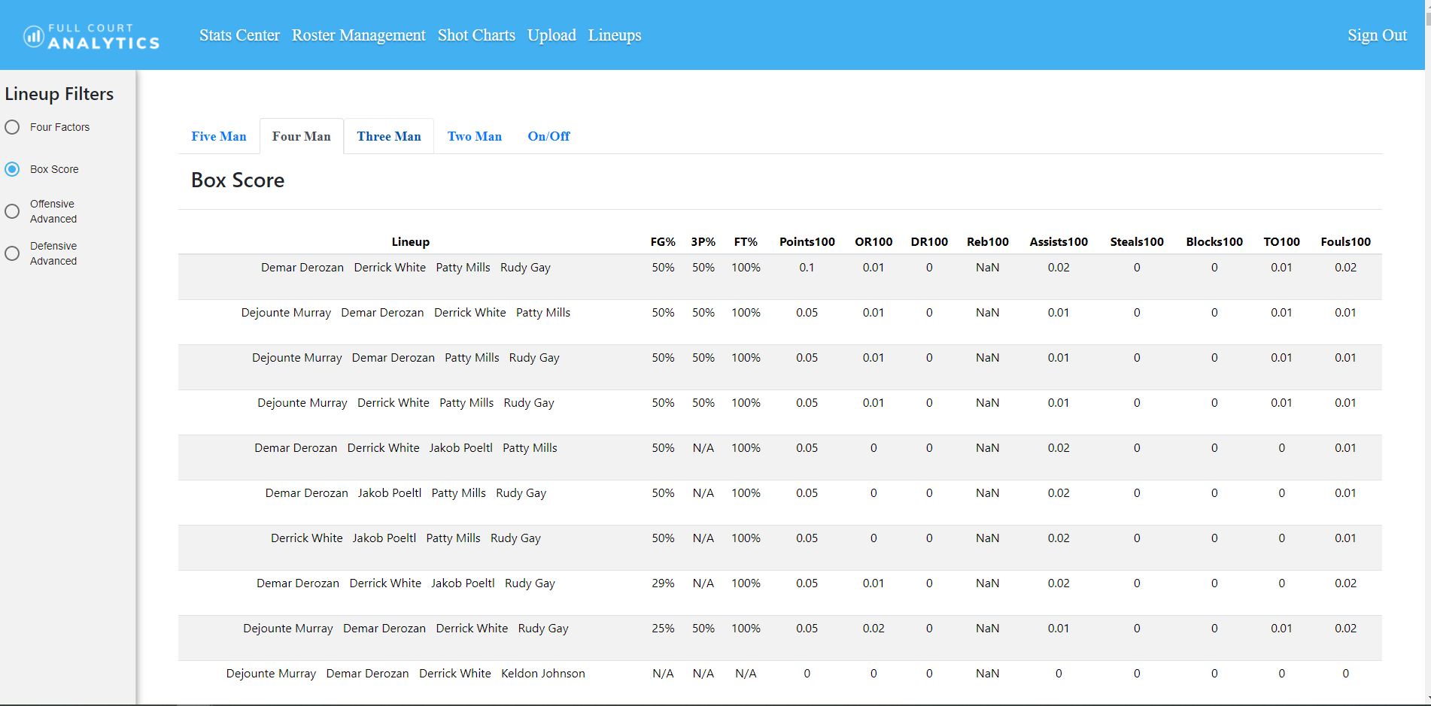
Lineups

Slide 12
Lineups
Here a Coach can:
View the stats between all combinations of 5 players on the court
Filter lineups by Offense, Defense, Box Score, and Four Factors

Slide 13
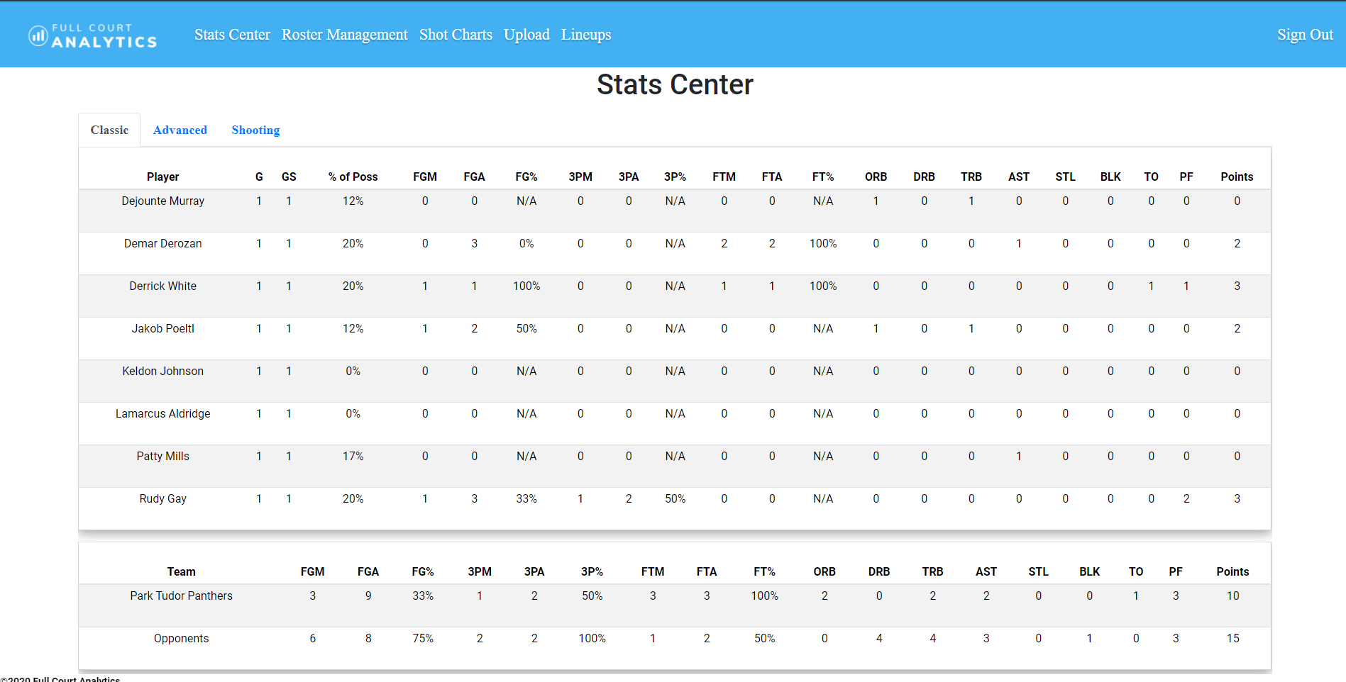
Game Stats

Slide 14
Game Stats
On this page a Coach can view categorical stats for an individual game:
Total - both offensive and defensive stats
Offensive - only the offensive stats
Defensive - only the defensive stats

Slide 15
Analyst Homepage
Here an Analyst will see the game(s) they have been assigned to annotate.

Slide 16
Annotator Page
On this page the Analyst will:
Annotate the uploaded game
Update substitutions
Mark a clip for every play in the game
Once this process is complete the Coach can:
View that stats of the individual game
View the updated Stats Center

Slide 17
