Slide 1
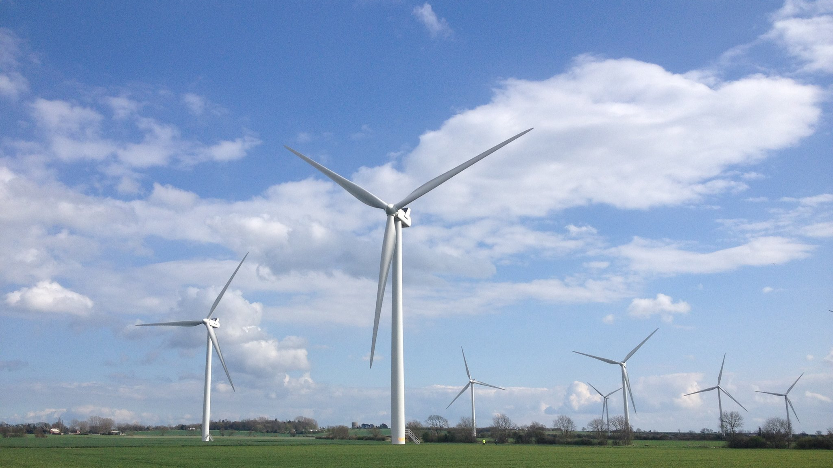
Wind Farms for Muncie
wikipedia.org

Slide 2
PROS
CONS

Slide 3
No Wind Farms in Delaware County?

Slide 4
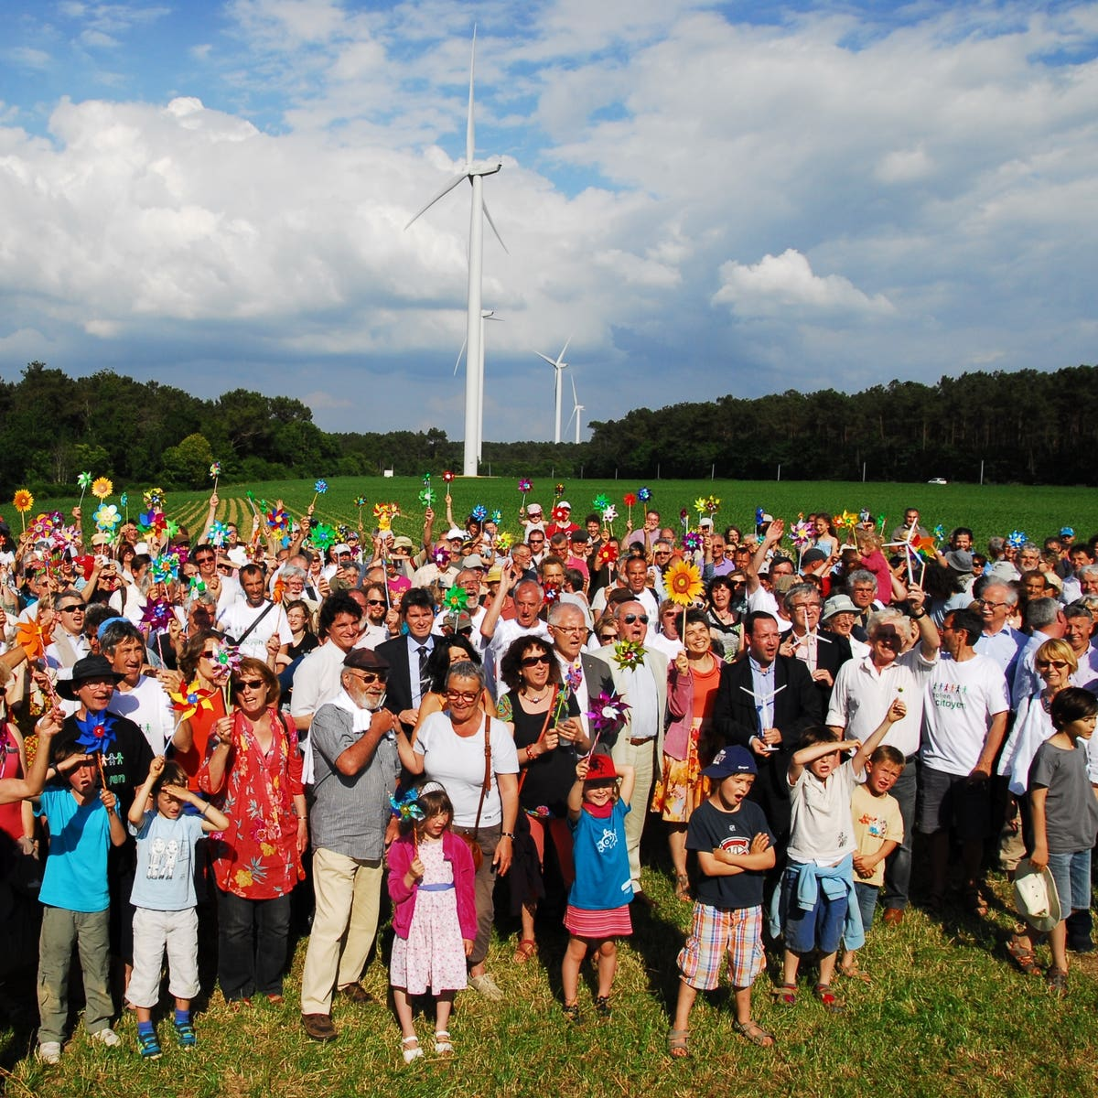
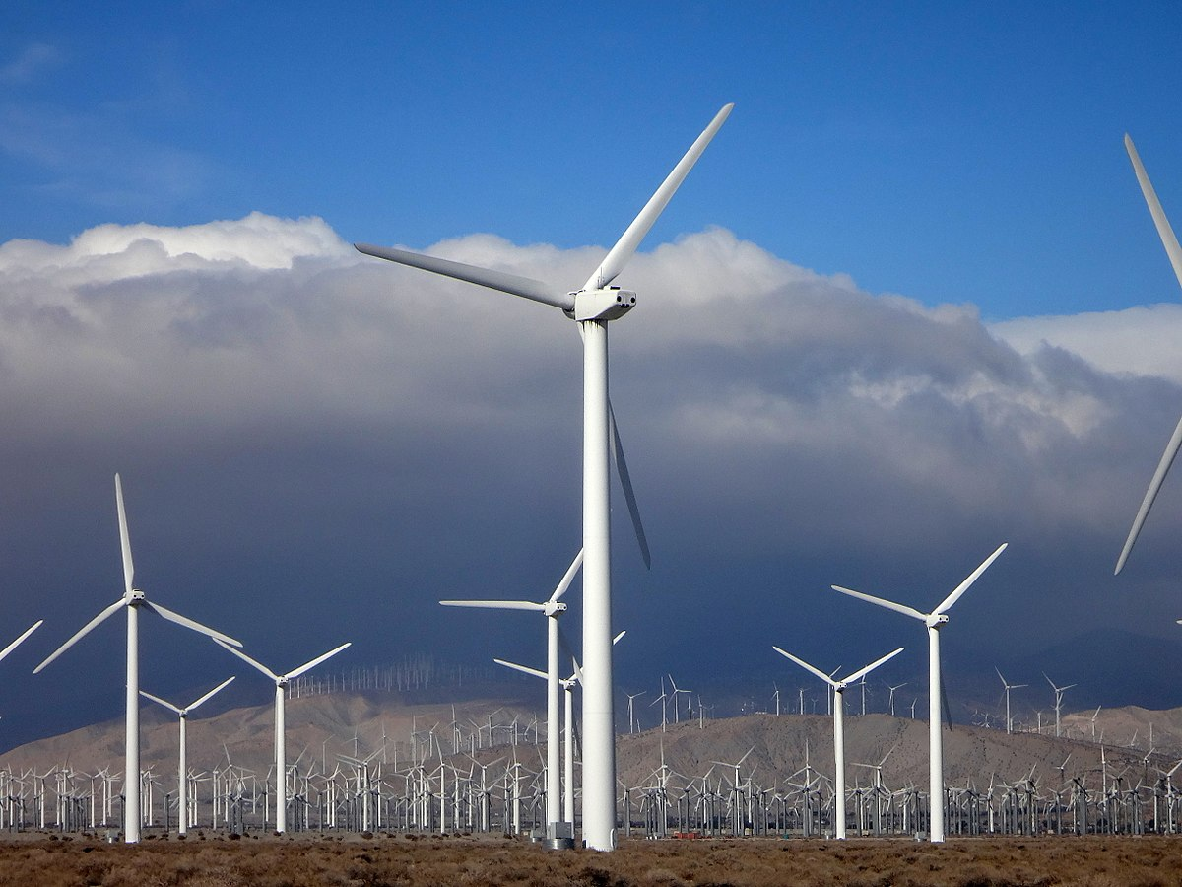
Community Based Wind Farm
Company Based Wind Farm
VS.

Slide 5
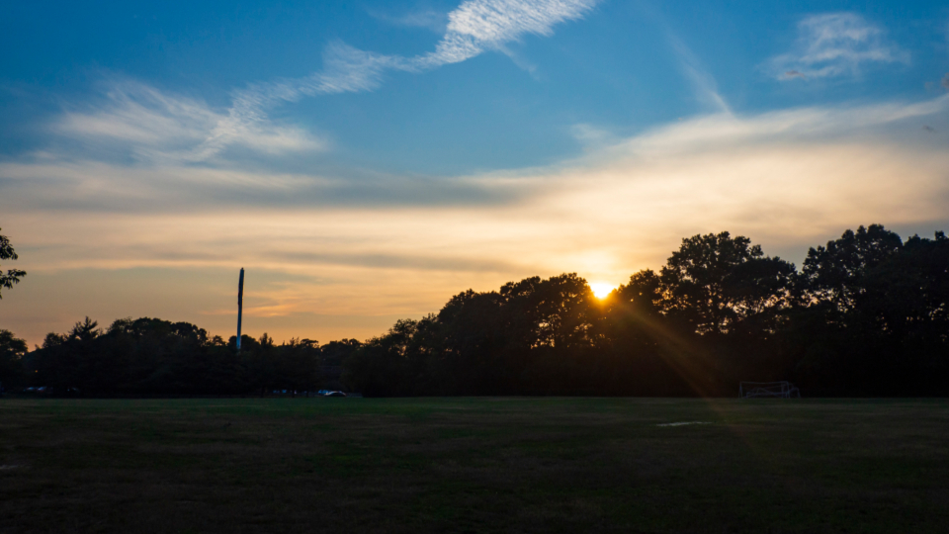
Looking Ahead
stocksnap.io

