Slide 1

Method
Materials/Procedure
  Demographic questions (Age, Gender, Race, Position)
  Four stories (Report Drug, Report Theft, Story Drug, Story Theft)
  3 multiple-choice reading comprehension questions
  4 5-point Likert-scale questions (Guiltiness, Empathy, Justification, Transportation)
  4 general reading questions

Slide 2
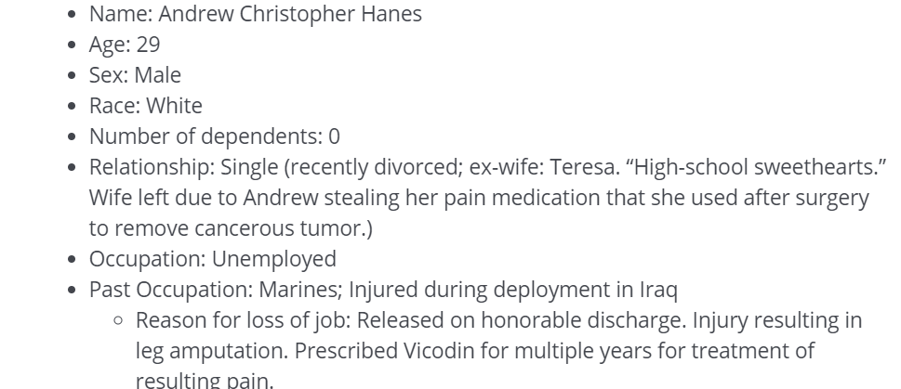
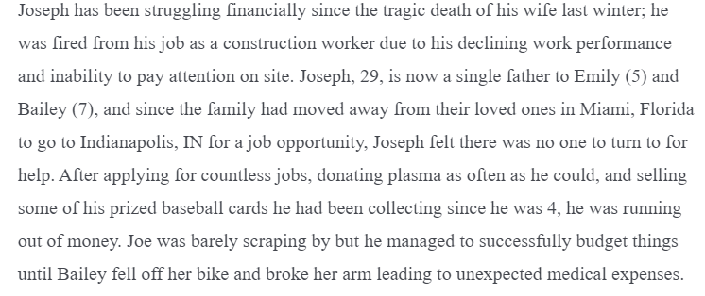
← Report on Drugs
Not shown: Story on Drugs
Story on Theft →
Not shown: Report on Theft
The report and story versions of each texts share the same information

Slide 3
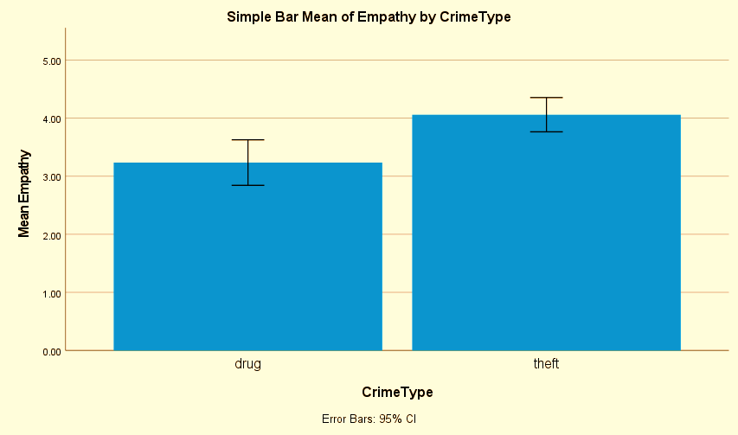
Results
No significant effect of Text Type on guilt, F (1) = 1.68, p = .19 or on empathy, F (1) = .49, p = .48.
No significant effect of Crime Type on participants’ ratings of guilt, F (1) = 2.13, p = .15.
Significant effect of Crime type on empathy, F (1) = 11.20, p < .001.
No significant effect of gender on guilt (between male and female), F (60) = 2.43, p = .12 or on empathy, F (60) = 1.25, p = .27.
Significant effect of gender on justification, F (60) = 5.36, p = .02.
Significant effect of Crime type on justification, F (1) = 4.61, p = .03.
Notes:
There was no significant effect of Text Type on guilt, F (1) = 1.68, p = .19 or on empathy, F (1) = .49, p = .48. Also, Crime Type did not affect participants’ ratings of guilt, F (1) = 2.13, p = .15. However, crime type did affect ratings of empathy, F (1) = 11.20, p < .001.
There was no significant effect of gender on guilt (between male and female), F (60) = 2.43, p = .12 or on empathy, F (60) = 1.25, p = .27, but there was a significant effect of gender on justification, F (60) = 5.36, p = .02.
Crime type significantly effected justification, F (1) = 4.61, - = .03.

Slide 4
Results
Ratings of Empathy for Protagonist, Guilt of Protagonist, and Justification of Protagonists’ Crime According to Text Type and Crime
 | Empathy | Guilt | Justification
Report on Drugs | 3.31 (1.54) | 3.12 (1.21) | 2.46 (1.39)
Report on Theft | 4.16 (.85) | 3.72 (1.17) | 3.00 (1.29)
Story on Drugs | 3.16 (1.25) | 3.68 (1.31) | 2.28 (1.06)
Story on Theft | 3.96 (1.21) | 3.80 (1.29) | 2.88 (1.54)

Slide 5
Results & Discussion
Results
Those previously mentioned
Not all analyses are complete yet
Limitations
Small same size (N = 71)
Text creation
More detail/length = more time needed
Crime type and stigma
Future Research
Larger sample size
Use different crime types
Less stigmatized options
Notes:
Not all of my analyses are complete yet, but some limitations I have noticed so far include the small sample size and the texts included in the study. More detailed texts may have been more effective, but would increase the amount of time needed to take the assessment, which could decrease the number of participants. The two types of crimes analyzed also differed greatly in stigma; so I would likely replace the drug abuse texts with another crime like theft which explains my goals for future research.

Slide 6

References
Available upon request
Notes:
A List of the Fables. (n.d.). Retrieved December 16, 2020, from http://read.gov/aesop/001.html
Agnew, R. (2012). A Revised Strain Theory of Delinquency. Special Forces, 91(1), 33-38.
Alford, D. (2016). Opioid Prescribing for Chronic Pain – Achieving the Right Balance through Education. New England Journal of Medicine, 374(4), 301-303. DOI: 10.1056/NEJMp1512932
Apel R. & Ramakers A.A.T. (2018), Impact of incarceration on employment prospects. In: Huebner B.M., Frost N.A. (Eds.) Handbook on the Consequences of Sentencing and Punishment Decisions. ASC Division on Corrections & Sentencing Handbook Series no. 3 New York: Routledge. 85-104. Doi (van het boek): 10.4324/9780429466380
Aslan, D. & Köksal Akyol, A. (2019). Impact of an Empathy Training Program on Children’s Perspective-Taking Abilities. Psychological Reports, 123(6), 2394-2409. https://doi.org/10.1177/0033294119868785
Bal, M. P., & Veltkamp, M. (2013). How does fiction reading influence empathy? An experimental investigation on the role of emotional transportation. PLoS ONE, 8(1), 1-12. https://doi.org/10.1371/journal.pone.0055341
Berkowitz, M. W. (2002). The science of character education. In W. Damon (Ed.), Bringing in a new era in character education (pp. 43-63). Stanford, CA: Hoover Institution Press.
Berry, M. C., & Wiener, R. L. (2020). Exoffender housing stigma and discrimination. Psychology, Public Policy, and Law, 26(2), 213–232. https://doi-org.proxy.bsu.edu/10.1037/law0000225.supp (Supplemental)
Brown, P., Corrigan, M., Higgins-D’Alessandro, A. (2012). Case Study: Reading For Life. Handbook of Prosocial Education, 2, 186-188. Retrieved from https://books.google.com/books?id=w9Oyfz8UD4kC&pg=PA186&lpg=PA186&dq=Seroczynski+%E2%80%9CCase+Study:+Reading+for+Life.%E2%80%9D&source=bl&ots=KXHNRLawyy&sig=ACfU3U0w5kmHjigzoAyqlq2gmxhaEn5LTA&hl=en&sa=X&ved=2ahUKEwiugcbzjd3oAhWWWc0KHQOoA18Q6AEwAHoECAQQKQ#v=onepage&q=Seroczynski%20%E2%80%9CCase%20Study%3A%20Reading%20for%20Life.%E2%80%9D&f=false
Bzdok, D., Hartwigsen, G., Reid, A., Laird, A. R., Fox, P. T., & Eickhoff, S. B. (2016). Left inferior parietal lobe engagement in social cognition and language. Neuroscience and Biobehavioral Reviews, 68, 319–334. https://doi.org/10.1016/j.neubiorev.2016.02.024
Christofi M, Michael-Grigoriou D and Kyrlitsias C (2020) A Virtual Reality Simulation of Drug Users’ Everyday Life: The Effect of Supported Sensorimotor Contingencies on Empathy. Front. Psychol. 11:1242. doi: 10.3389/fpsyg.2020.01242
Christofi, M. & Michael-Grigoriou, D. (2017). Virtual reality for inducing empathy and edicing prejudice towards stigmatized groups: A survey. 2017 23rd International Conference on Virtual System & Multimedia, 1-8, doi: 10.1109/VSMM.2017.8346252.
Corno, L. & Anderman, E. (2015). Character Education, Moral Education, and Moral-Character Education. Handbook of Educational Psychology, 213-219. Retrieved from https://books.google.com/books?hl=en&lr=&id=cvAsCgAAQBAJ&oi=fnd&pg=PA213&dq=moral+education+and+character+education&ots=I1qZATBunB&sig=tF1_773fVih4YF5XHtHWSzV3e98#v=onepage&q&f=false
Cuzzo, M. S. W., Larson, M. R., Mattsson, L.M. & McGlasson, T.D. (2017). How Do You Effectively Teach Empathy to Students? New Directions for Teaching and Learning, 151, 61-78. https://doi.org/10.1002/tl.20249
Dodell-Feder, D. & Tamir, D. I. (2018). Fiction Reading Has a Small Positive Impact on Social Cognition: A Meta-Analysis. Journal of Experimental Psychology, 147(11), 1713-1727. DOI: http://dx.doi.org/10.1037/xge0000395
Evans, D. N., Szkola, J., & St. John, V. (2019). Going Back to College? Criminal Stigma in Higher Education Admissions in Northeastern U.S. Critical Criminology, 27, 291-304. https://doi.org/10.1007/s10612-019-09443-x
Goodwin, G.P., Piazza, J., & Rozin, P. (2014). Moral character predominates in person perception and evaluation. Journal of Personality and Social Psychology, 106(1), 148- 168. https://doi.org/10.1037/a0034726
Kaufman, G. F., & Libby, K. L. (2012). Changing beliefs through experience-taking. Journal of Personality and Social Psychology, 103(1), 1-19. doi: 10.1037/a0027525
Martinez, A. G., Stuewig, J., & Tangney, J. P. (2014). Can perspective-taking reduce crime? Examining a pathway through empathic-concern and guilt-proneness. Personality & social psychology bulletin, 40(12), 1659–1667. https://doi.org/10.1177/0146167214554915
Pardo-Vazquez, J. L., Padron, I., Fernandez-Rey, J., & Acuña, C. (2011). Decision-Making in the Ventral Premotor Cortex Harbinger of Action. Frontiers in Integrative Neuroscience, 5(54). https://doi.org/10.3389/fnint.2011.00054
Pfattheicher, S., Nockur, L., B öhm, R., Sassenrath, C., & Petersen, M. B. (2020). The emotional path to action: Empathy promotes physical distancing and wearing of face masks during the COVID-19 pandemic. Psychological Science, 31(11), 1363-1373. https://doi.org/10.1177/0956797620964422
Piaget, J. and Inhelder, B. 1956. The Child's Conception of Space, London: Routledge & Kegan Paul.
Pitts-Taylor, V. (2013). I Feel Your Pain: Embodied Knowledges and Situated Neurons. Hypatia, 28(4), 852-869. DOI: 10.1111/hypa.12049
Riess, H. (2017). The Science of Empathy. Journal of Patient Experience, 4(2), 74-77. DOI: 10.1177/2374373517699267
Rizzolatti, G. & Craighero, L. (2005). Mirror Neuron: A Neurological Approach to Empathy. Neurobiology of Human Values.
Rumble, A. C., Van Lange, P. A. M., & Parks, C. D. (2010). The benefits of empathy: When empathy may sustain cooperation in social dilemmas. European Journal of Social Psychology, 40(5), 856–866.
Seidel, E. M., Pfabigan, D. M., Keckeis, K., Wucherer, A. M., Jahn, T., Lamm, C., & Derntl, B. (2013). Empathic competencies in violent offenders. Psychiatry research, 210(3), 1168–1175. https://doi.org/10.1016/j.psychres.2013.08.027
Seroczynski, A., Evans, W., Jobst, A., Horvath, L., Carozza, G. (2015). Reading For Life and Adolescent Re-Arrest: Evaluating a Unique Juvenile Diversion Program. Retrieved from https://www3.nd.edu/~wevans1/working_papers/RFL%20Paper%20for%20NBER.pdf
Stansfield, J., & Bune, L. (2014). The relationships between empathy and reading fiction: Students, 5(3), 9-18. DOI: http://dx.doi.org/10.5334/jeps.ca
Strang, E. (2015). Teaching Compassion in Prison: A Key to Learning. Journal of Prison Education and Reentry. 2(2), 50-59. DOI: 10.15845/jper.v2i2.867
Strelkova, L.P. (2020). Development of Empathy through Stories. Journal of Russian & East European Psychology, 57(2-3), 133-164. https://doi.org/10.1080/10610405.2020.1760763
Van Lissa, C. J., Caracciolo, M., van Duuren, T., & van Leuveren, B. (2016). Difficult empathy: The effect of narrative perspective on readers’ engagement with a first-person narrator. Diegesis, 5(1), 43-63. https://www.researchgate.net/publication/313611409
Zilles, K. (2004). The Human Nervous System (Second Edition). Ch. 27 Architecture of the Human Cerebral Cortex: Regional and Laminar Organization. 997-1055. https://doi.org/10.1016/B978-012547626-3/50028-4

