Slide 1
More Knowledge and Less Sleep: Sleep patterns in nursing students
Camryn S. Zeller

Slide 2
Necessary Terms
Sleep Quantity – Sleep duration or total time asleep
Sleep Quality – Many definitions, but can be conceptualized as how well one sleeps, how awake one feels in the morning, and how long it takes someone to fall asleep.
Sleep Hygiene – Best practices to use to increase sleep quality (i.e., appropriate caffeine consumption, avoiding screen time before bed, etc.)

Slide 3
Study Design
Nursing students were asked to complete the PSQI and Sleep Hygiene Knowledge subsection of the SHAPS to determine their sleep quantity, quality, and hygiene knowledge. Year in the program was collected in the demographics as well as a screening question about the presence or history of sleep disorders. Exploratory data was collected about participation in a clinical rotation to develop future studies about the possible effects that clinical rotations may have on sleep data. Three one-way ANOVAs were conducted to analyze the trends of sleep quantity, quality, and hygiene knowledge separately, and an exploratory analysis of their interactions was included.

Slide 4
Hypotheses and Purpose
Hypotheses:
1) The sleep quantity and quality of students will decrease for every year they are in the program
2) The sleep hygiene knowledge of students will increase for every year they are in the program
Purposes:
1) To provide more evidence for administrative change
2) To gather information on the best time to introduce sleep hygiene training

Slide 5
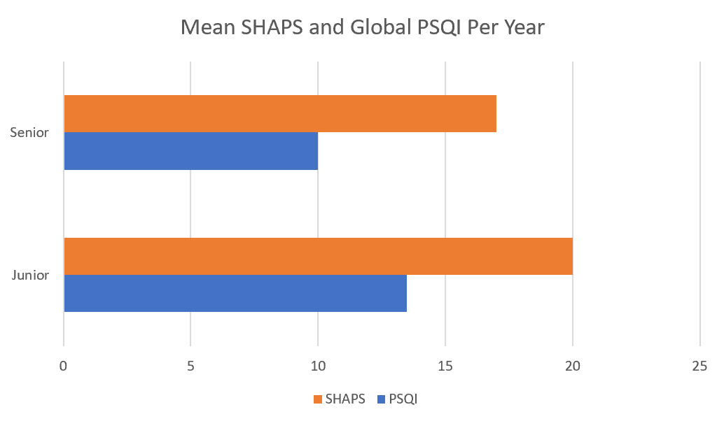
Results
With limited data, we have inconclusive evidence regarding the significance of the results.
It appears, Seniors do have worse quality and quantity sleep, while their hygiene knowledge may be similar or worse.

Slide 6
Discussion
Based on the limited findings, it appears that at the moment sleep quantity and quality may decrease throughout time in the program while sleep hygiene knowledge may not increase.
More data is being collected to further inspect these findings
These numbers were found with three participants.

