Slide 1

The Impact of Grant Funding on Economic Growth in Ohio: A Spatial Approach
Eric Wilken

Slide 2

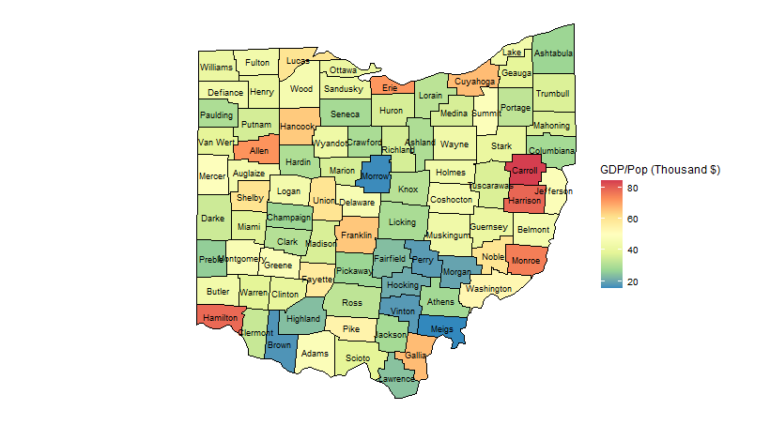
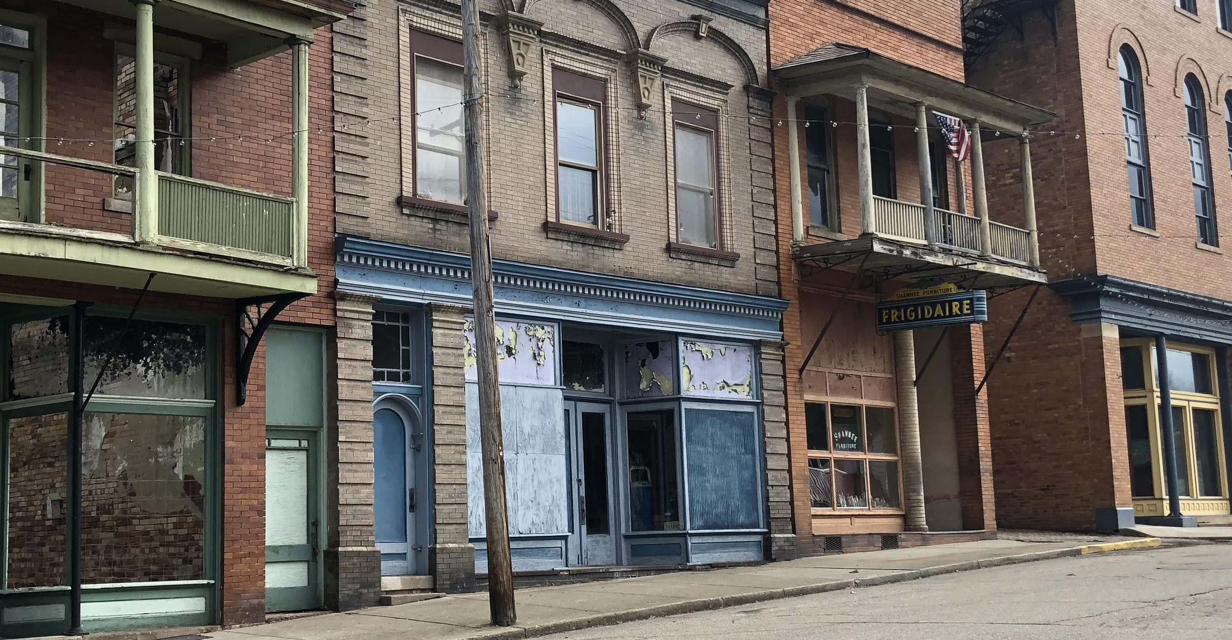
Spatial Inequality

Slide 3
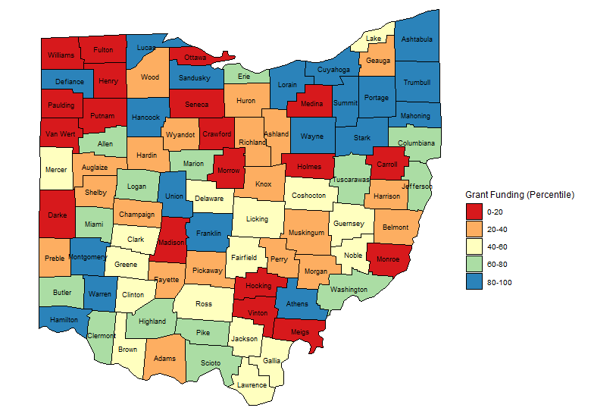
Data Overview
Dependent: Real GDP per Capita
Predictor: Listed in Table
Data retrieved from Census Bureau, Bureau of Labor Statistics, and Bureau of Economic Analysis
Limitations
  No data on Physical Capital
  Operationalization of Human Capital
  Looking at loan in Absolutes and not per capita

Slide 4
Method Overview
OLS Model
  Spatial Autocorrelation present?
Spatial Lag, Spatial Error, and Spatial Durbin Models
Model Comparison
  AIC and BIC

Slide 5
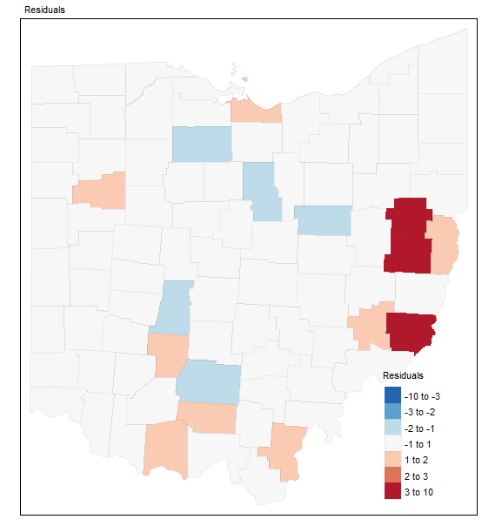
OLS Model
Residuals for 2014
GDP_{t} = β_{1t} + β_{2t}*Rural_{t} + β_{3t}*Edu_{t} + β_{4t}*Emp_{t} + β_{5t}*Race_{t} + β_{6t}*Gender_{t} + β_{7t}*Tax_{t} + β_{8 t}*Grants_{t} + β_{9 t}*Loans_{t} + error _{t}
OLS Results:
  Employment
  Education
  Race
Spatial Autocorrelation
  Robust LaGrange Multiplier Tests
  Moran’s I
    Spatial Autocorrelation present in 2014

Slide 6
Model Comparison
Model | Year | AIC | BIC
OLS | 2010 | 602.17 | 626.94
 | 2011 | 619.03 | 643.81
 | 2012 | 607.64 | 632.41
 | 2013 | 620.12 | 644.90
 | 2014 | 700.42 | 725.19
Spatial Lag | 2010 | 601.02 | 628.27
 | 2011 | 618.25 | 645.50
 | 2012 | 608.42 | 635.67
 | 2013 | 621.92 | 649.17
 | 2014 | 700.00 | 727.25
Spatial Error | 2010 | 604.17 | 631.42
 | 2011 | 621.00 | 648.25
 | 2012 | 608.50 | 635.76
 | 2013 | 620.47 | 647.72
 | 2014 | 696.83 | 724.08
Spatial Durbin | 2010 | 611.34 | 658.41
 | 2011 | 630.73 | 677.80
 | 2012 | 619.37 | 666.44
 | 2013 | 627.20 | 674.27
 | 2014 | 703.14 | 750.21
A difference of 10 between AIC’s
  (Burnham & Anderson, 2002)
A difference of 6 between BIC’s indicate strong evidence towards supporting the lower BIC model
  (Kass & Raftery, 1995)
Burnham, K. P., & Anderson, D. R. (2002). Model selection and multi-model inference: A practical information-theoretic approach. New York: Springer.
Kass, R. E., & Raftery, A. E. (1995). Bayes factors. Journal of the American Statistical Association, 90(430), 773-795.

Slide 7
Conclusions
Use of Spatial Regression
- Model Comparison
- Theoretical Value
Grant Funding had a small and non statistically significant impact on economic growth
Future Research and Questions:
- Spatial non-stationarity of grants
- Spatial Autocorrelation between Ohio Counties after 2014
- Operationalization of Physical Capital at the County Level

