Slide 1
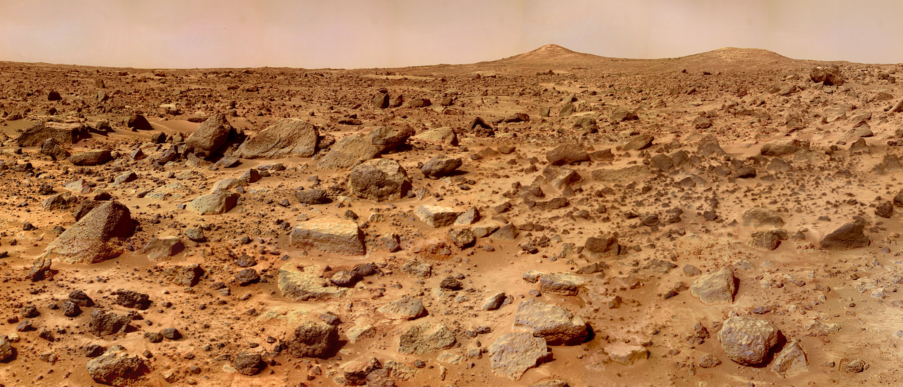
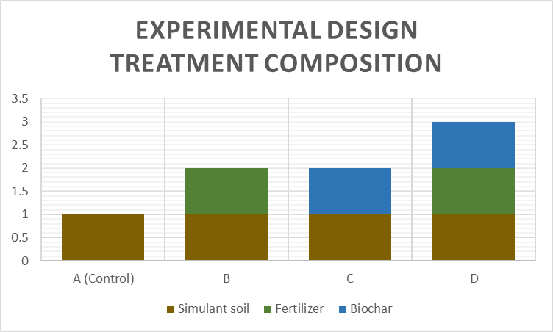
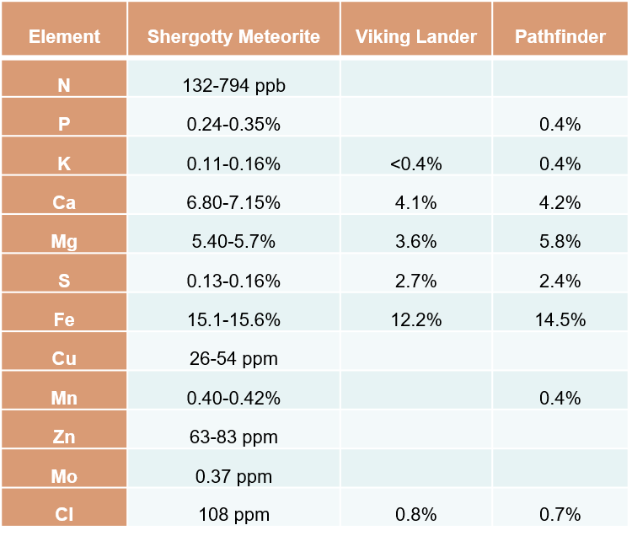
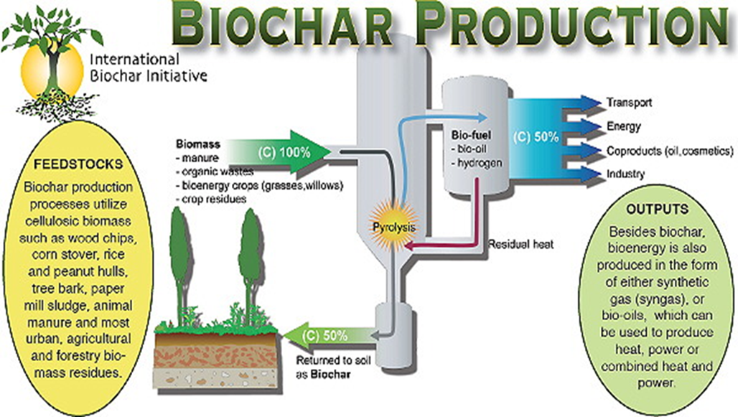
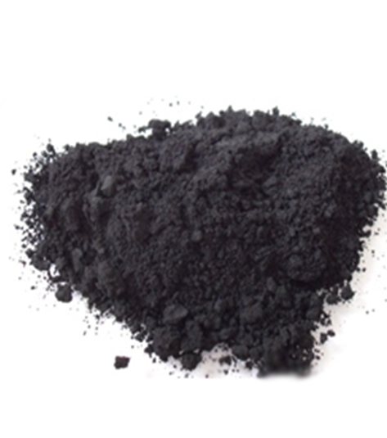
The Effectiveness of Biochar in Agricultural Amelioration of Martian Soil Simulant
D. McFarland and J. Haeft
Department of Environment, Geology, and Natural Resources
Abstract
Introduction
Martian Soil
Methods
Our global population is continuously growing which raises alarm for nutrition and food security. Understanding how to increase food production and efficiency in a sustainable method is becoming increasingly important. Visionaries and advocates of space exploration believe the solution is extraplanetary colonization. Martian soil has been studied for its viability to support agriculture and has been found to support the essential nutrients needed for plants to grow. However, the concentrations of essential nutrients are not suitable to sustain adequate crop yield for humans to survive. To overcome the nutrient deficiency, soil amendments will be required for Martian soil to produce a yield capable of sustaining the population.
Commercially available biochar, produced through incomplete burning in partial or total absence of oxygen, enhances nutrient retention due to its high cation exchange capacity (CEC) and high surface area. The application of biochar to the soil reduces nutrient leaching and increases productivity, crop yield, and soil microbial biomass. This project will study the effects of biochar application on essential nutrient retention in Martian soil simulant, Mojave Mars Simulant 2 (MMS-2). A potted plant experiment will be conducted using soybean plants planted in MMS-2, with and without biochar and fertilizer. It is hypothesized that the application of biochar will increase the benefit of fertilizer used with the simulant.
Transporting enough food to Mars for an extended stay is impractical. Growing additional food after arriving on the planet will be necessary. The addition of biochar as an amelioration to the Martian soil may be a solution to the soil nutrient deficiency challenge facing successful crop growth by a future Martian colony. This study gives further understanding of this challenge and provides possible solutions as we continue to explore and settle throughout the cosmos.
Many challenges face the future of space exploration. Establishing a presence on Mars will be an important first step in that journey. One of these challenges is how to feed the explorers once they arrive. The Martian soil contains all the essential nutrients needed to grow crops albeit at limited concentrations. A means to retain nutrients in the soil is needed to make crop growth sustainable in the long term. Biochar, used as a soil amendment, may be an answer to this problem.
Original research into Martian soil composition was focused on understanding how rovers and landing equipment would interact upon landing on the surface of Mars (Peters et al. 2008). Analysis from Viking and Pathfinder missions determined the composition of Martian soil to contain nearly identical concentrations of Na₂O, MgO, AI₂O₃, SiO₂, SO₃, CI, K₂O, CaO, TiO₂, and Fe₂O₃ throughout the majority of collection sites (Bell et al. 2000). This led to the development of Johnson Space Center Mars 1 simulant (JSC Mars-1) in 1998. Following the discoveries from both Viking and Pathfinder landing sites and the Spirit and Opportunity rovers, researchers at NASA’s Jet Propulsion Lab used basalt from the Mojave Desert to develop Mojave Mars Simulant (MMS) in 2007 (Peters et al. 2008). The next iteration of the simulant, MMS-2 was developed by adding Fe₂O₃, SiO₂, MgO, and CaO to adjust the Al₂O₃ to Fe₂O₃ ratio, bringing to a better than 90% chemical match for actual Martian soil (The Martian Garden, www.themartiangarden.com/mms2).
Data from the Mars Viking and Pathfinder missions has shown that Martian soil contains concentrations of the plant essential nutrients N, P, K, Mg, Ca, S, Fe, Mn, Cu, B, Cl, Zn, and Mo (Table 1) (Schuerger et al., 2002, Stoker et al., 1993). Furthermore, a study completed by Wamelink et al., 2014 showed that plants will grow in Martian soil simulant. In an experiment with 14 species of plants grown in Martian and moon soil simulants, the plants did well in the Martian soil simulant. All species in the study germinated, grew leaves, flowered, and produced seeds. This study noted that further research was needed on the physical characteristics of the soil simulant, particularly the water holding capacity, as it was not determined in their study how it impacted the results. Their experiment also highlighted the need for nitrogen fixers to create a balance of nutrient availability.
Part 1
The first part of the study will consist of characterizing the Martian soil simulant prior to the experiment. The soil will be analyzed for organic matter, cation exchange capacity (CEC), sodium bicarbonate, total and available phosphorus, exchangeable potassium, magnesium, calcium, iron, copper, boron, manganese, sulfur, zinc, and pH. Samples will be sent to A&L Great Lakes Laboratories in Ft. Wayne, IN, where analysis will follow the procedures outlined in “Recommended Chemical Soil Test Procedures for the North Central Region” (North Central Regional Research Publication No. 221, Revised, January 1998). Based on the findings of the soil analysis, the agricultural soil specialists at G&L will provide recommendations for the best fertilizer treatment to be used in the next phase of the project.
Part 2
Having determined the best fertilizer treatment for the experiment, the second part of the study will consist of growing soybeans in the Martian soil simulant employing four treatments with four replicates. The control will consist of the Mars soil simulant without any additions. There will be individual treatments of simulant with 1) fertilizer, 2) biochar, and 3) fertilizer and biochar (Figure 1). Soil samples will be analyzed for the same elements aforementioned in Part 1. Plant material will also be analyzed for nutrient uptake. Statistical analysis of nutrient sample data will use ANOVA to determine any statistically significant differences. Samples will be sent to A&L Great Lakes Laboratories in Ft. Wayne, IN, where analysis will follow the procedures outlined in “Recommended Chemical Soil Test Procedures for the North Central Region” (North Central Regional Research Publication No. 221, Revised, January 1998).
Biochar
Biochar is a stable carbon-rich by-product synthesized through pyrolysis/carbonization of plant- and animal-based biomass. Archaeological evidence indicates that biochar has been used for thousands of years. Relics dating back more than 7000 years, including black pottery mixed with charcoal, were discovered in Hemudu, China. The Hemudu people mixed charcoal into the pottery to reduce the cohesion of the clay (Chen et al. 2019). Its origins of use as a soil improvement can be traced back to the soils of the Amazon region, the best known of which are the “Terra-Preta” soils (Kambo and Dutta, 2015). These dark and fertile artificial soils, also called “Amazonian dark earth”, were developed by farming communities as early as 450 BCE. The Terra-Preta soil was created by mixing charcoal, shards of broken pottery, animal feces, and other organic matter into the soil. In addition to the well-known Terra-Preta soils in the Amazon, archeologic discoveries show that Japan also has a long tradition of using charcoal in soil (Joseph et al. 2014). Examination of traditional methods from Brazil and Japan provides long-term evidence of biochar being used for improving soils.
Biochar has been used extensively as a soil amendment to improve soil fertility and remediation of environmental pollutions (Hussain et al. 2016) Its benefits also include use in carbon sequestration and waste management (Bezerra et al. 2016). Biochar is produced through incomplete burning in the partial or total absence of oxygen, has a high cation CEC, porous structure, and surface area which enhances nutrient retention in soil (Lehmann, J. 2007). The CEC of various types of biochar will have distinct properties determined by the biomass used and specific pyrolysis procedures used in production (Suliman et al. 2016). The difference in pyrolysis production, particularly temperature variation, also effects the water-holding capacity of the biochar (Shinogia and Kanri 2003). The micropores and specific surface area of biochar, which is typically 1.5-500m²g⁻¹ (Li et al. 2018) will also be affected by the temperature maintained during the production process. The porous structure of biochar will also vary depending on the material used in production. The cellulose and lignin content of the biomass used will affect the micropore size in the final structure (Lehmann 2007), and therefore affecting the biochar’s performance. As the characteristics of variously produced biochar will not be compared in this study, a commercially available mass-produced agricultural biochar will be used.
Table 1. Elemental compositions of Martian soil sampled at the Shergotty
Meteorite, Viking and Pathfinder landing sites in %, ppm and ppb by weight.
Research Objectives
Analyze the physical characteristics of Martian soil simulant and determine best application of fertilizer.
Examine effectiveness of biochar at retaining nutrients contained in Martian soil.
Examine the differences in the physical and chemical characteristics of biochar amended Martian soil simulant.
Examine plant nutrient uptake in biochar amended Martian soil simulant.
Figure 2. Composition of experimental treatments to be used in this study.
References
Ahmad, M., Rajapaksha, A.U., Lim, J.E., Zhang, M., Bolan, N., Mohan, D., Vithanage, M., Lee, S.S., Ok, Y. S. (2014). Biochar as a sorbent for contaminant management in soil and water: A review. Chemosphere. 99, 19-33.
Bell III, J.F., McSween Jr., H.Y., Crisp, J.A., Morris, R.V., Murchie, S.L., Bridges, N.T., Johnson, J.R., Britt, D.T., Golombek, M.P., Moore, H.J., Ghosh, A., Bishop, J. L., Anderson, R. C., Brückner, J., Economou, T., Greenwood, J.P., Gunnlaugsson, H.P., Hargraves, R. M., Hviid, S., Knudsen, J.M., Madsen, M.B., Reid, R., Rieder, R., Soderblom, L. (2000). Mineralogic and compositional properties of Martian soil and dust: Results from Mars Pathfinder. J. Geophys. Res., 105(E1), 1721-1755. DOI:10.1029/1999JE001060.
Bezerra, J., Turnhout, E., Vasquez, I.M., Rittl, T.F., Arts, B., and Kuyper, T.W. (2019). The promises of the Amazonian soil: shifts in discourses of Terra Preta and biochar. Journal of Environmental Policy & Planning. 21(5), 623-635. DOI: 10.1080/1523908X.2016.1269644
Chen, W., Meng, J., Han, X., Lan, Y., and Zhang, W. (2019). Past, present, and future of biochar. Biochar. 1, 75–87. DOI: 10.1007/s42773-019-00008-3
Fackrell , L.E., Schroeder, P.A., Thompson, A., Stockstill-Cahill, K., Hibbitts, C.A. (2021). Development of martian regolith and bedrock simulants: Potential and limitations of martian regolith as an in-situ resource. Icarus. 354, 114055. 10.1016/j.icarus.2020.114055.
Hussain, M., Farooq, M., Nawaz, A., Al-Sadi, A. M., Solaiman, Z. M., Alghamdi, S., & Siddique, M. (2017). Biochar for crop production: potential benefits and risks. Journal of Soils and Sediments, 17(3), 685–716.
Joseph, S., P. Taylor. (2017). The production and application of biochar in soils, Advances in Biorefineries, 525-555. DOI: 10.1533/9780857097385.2.525
Kambo, H.S., and Dutta, A. (2015). A comparative review of biochar and hydrochar in terms of production, physico-chemical properties and applications. Renewable and Sustainable Energy Reviews. 45, 359-378.
Lehmann, J., Gaunt, J., & Rondon, M. (2006). Bio-char sequestration in terrestrial ecosystems–a review. Mitigation and adaptation strategies for global change, 11(2), 395-419.
Lehmann, J. (2007). A handful of carbon. Nature 447, 143–144.
Peters, G.H., Abbey, W., Bearman, G.H., Mungas, G.S., Smith, J.A., Anderson, R.C., Douglas, S., and Beegle, L.W. (2008). Mojave Mars simulant—Characterization of a new geologic Mars analog. Icarus. 197. 470-479. DOI: 10.1016/j.icarus.2008.05.004.
Schuerger A.C., Ming D.W., Newsom H.E., Ferl R.J., McKay C.P. (2002). Near-term lander experiments for growing plants on Mars: requirements for information on chemical and physical properties of Mars regolith. Life Support Biosph Sci. 8(3-4):137-47. PMID: 12481805.
Shinogia Y. and Kanri Y. (2003). Pyrolysis of plant, animal, and human waste: physical and chemical characterization of the pyrolytic products. Biores Technol 90, 241–247.
Stoker , C., Gooding, J., Roush, T., Banin, A., Burt, D., Clark, B. Flynn, G., Gwynne, O. (1993). The physical and chemical properties and resource potential of Martian surface soils. Resources of near-earth space. Tucson, AZ. University of Arizona Press, 1993:659-707.
Suliman W., Harsh J.B., Abulail N.I., Fortuna A., Dallmeyer I., Garciaperez M. (2016) Infuence of feedstock source and pyrolysis temperature on biochar bulk and surface properties. Biomass Bioenergy 84, 37–48.
Wamelink G.W.W., Frissel J.Y., Krijnen W.H.J., Verwoert M.R., Goedhart P.W. (2014) Can Plants Grow on Mars and the Moon: A Growth Experiment on Mars and Moon Soil Simulants. PLoS ONE 9(8): e103138. DOI: 10.1371/journal.pone.0103138
Images
https://www.nasa.gov/image-feature/marss-twin-peaks
https://biochar-international.org/
Conclusion
Biochar has a variety of applications with agricultural and environmental benefits. Potential biochar applications include carbon sequestration, soil fertility improvement, pollution remediation, and agricultural by-product/waste recycling (Ahmad, et al., 2014). The soil on Mars contains the essential nutrients for plant growth (Schuerger et al., 2002, Stoker et al., 1993) but not in concentrations great enough to sustain long-term, repeated growth of crops to serve as a food source for future colonists (Wamelink et al., 2014). Biochar can enable soils to retain nutrients, increase capacity to hold water, and aid in waste management (Bezerra et al. 2016). It stands to reason that the amendment of Martian soil with biochar will yield similar results as seen in Earth soils. We have seen the advantages of integrating biochar into these applications on Earth, and the next evolution is applying it to uses beyond our planet.
Contact Information
Figure 1. Biochar production cycle (left). Biochar finished product (right).
David McFarland
Email: dmmcfarland2@bsu.edu
Notes:
This one is set up to yield an 84x42” (7x3.5’) horizontal poster when we print it at 200%.

