Slide 1
Cognitive Effects of Individual Differences in Sensory Processing Sensitivity
Primary Investigator:
Alexandria H. Epperly
Thesis Advisor:
Dr. Dan Nardi,
Assistant Professor of Psychological Science, Ball State University

Slide 2
Introduction

Slide 3
Background: What is Sensory Processing Sensitivity?
Sensory processing sensitivity (SPS) refers to the genetic predisposition for a subset of the population to exhibit greater sensitivity to both their internal and external environments (Aron & Aron, 1997).
This trait is a component of the Environmental Sensitivity Theory, or the idea that differences in environmental responsivity may be explained by individual differences in sensitivity to the environment (Pluess, 2015).
Sensory processing sensitivity is characterized by four key features (Aron & Aron, 1997; Greven et al., 2019):
An awareness of environmental subtleties
Increased emotional reactivity
Empathy
Ease of overstimulation

Slide 4
Background: What is the connection between Sensory Processing Sensitivity and Memory?
Variability in these characteristics is hypothesized to have arisen due to individual differences in depth of processing, which has been supported by functional MRI studies that have shown increased activation in individuals scoring high for SPS (Greven et al., 2019).
Depth of processing refers to the level at which stimuli are being processed, ranging from shallow to deep, and depends on the aspects of the stimuli that are being attended (Craik & Lockhart, 1972, as cited in Ekuni, Vaz, & Bueno, 2011).
Greater depth of processing is correlated with stronger memory traces, with more deeply processed information being processed by more areas of the brain, therefore allowing for greater recall due to the number of pathways that may be associated with the memory (Craik, 2002).

Slide 5
The Current Study
Previous research concerning environmental sensitivity has focused on questions regarding the evolutionary, neurophysiological, and personality-based aspects of sensory processing sensitivity (Acevedo et al., 2017, 2018; Aron & Aron, 1997, Ellis et al., 2011).
To the knowledge of the researcher, no studies have looked specifically at how this trait may be associated with individual differences in cognitive capacities such as memory.
The present study aimed to address this gap in the literature by examining whether a relationship exists between individual differences in sensory processing sensitivity, measured with the Highly Sensitive Person Scale (Aron & Aron, 1997), and episodic memory, measured by the number of words participants recalled following an incidental learning task.

Slide 6
Hypotheses
Sensory processing sensitivity will correlate positively with episodic memory recall, such that as one’s sensitivity increases, so will the number of words they recall from the incidental learning task.
This hypothesis is based on the characteristic quality of increased depth of processing in those scoring high for sensory processing sensitivity on the Highly Sensitivity Person Scale (Aron & Aron, 1997), as well as the understanding that as stimuli are processed more deeply, one's ability to accurately recall these stimuli increase (Craik & Lockhart, 1972).
It is also expected that the sensitivity scores for this sample will be normally distributed, replicating previous findings that sensory processing sensitivity follows a normal distribution (Aron & Aron, 1997).

Slide 7
Method

Slide 8
Participants
31 participants were recruited for this study
24 PSYS 100 students from the Psychological Science Department SONA Subject Pool
7 Ball State Students that accessed the study from an anonymous link sent through Ball State’s Communication Center
9 participants were excluded due to insufficient data, leaving a total sample size of n = 22 (60.1% female, mean age = 20.86).
All participants were Ball State students and were at least 18 years of age
Participants from the subject pool received 0.5 credits for their participation; the remaining participants did not receive any incentives to participate.

Slide 9
Materials & Procedures
Participants first completed an incidental learning task. They rated the pleasantness of 30 words on a 7-point scale ranging from extremely pleasant to extremely unpleasant. Each question was displayed for only 5 seconds before moving on.
Immediately following this task, participants completed a distractor task to clear their working memory and reduce recency effects in the following task. This involved listing as many of the United States as they could in 5 minutes.
Participants then completed the recall task that asked them to list as many words from the pleasantness-rating task as they could in 5 minutes.
Next, participants completed the Highly Sensitive Person Scale (Aron & Aron, 1997; Cronbach’s alpha = 0.894 for this sample), followed by a series of demographics questions including age, gender identity, and race.
Finally, participants were fully debriefed about the specific goals of the study.

Slide 10
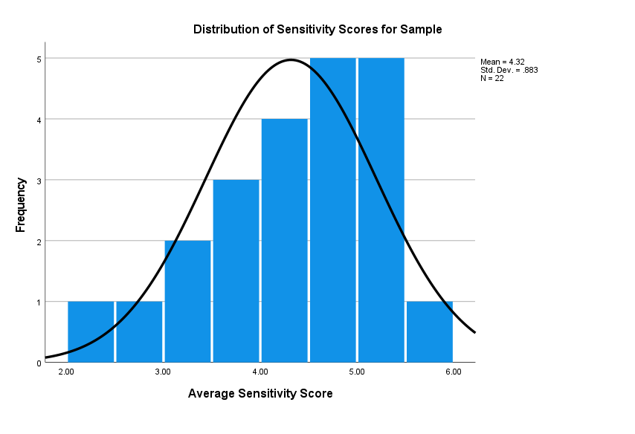
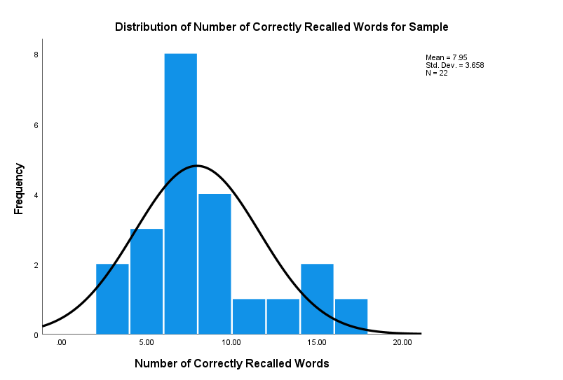
Results
Recall scores were concentrated on the lower end of the distribution with only a few high performing participants.
The average number of words recalled for this sample was 7.95, SD = 3.658.
The distribution of sensitivity scores was negatively skewed, with a mean of 4.32, SD = 0.883.

Slide 11
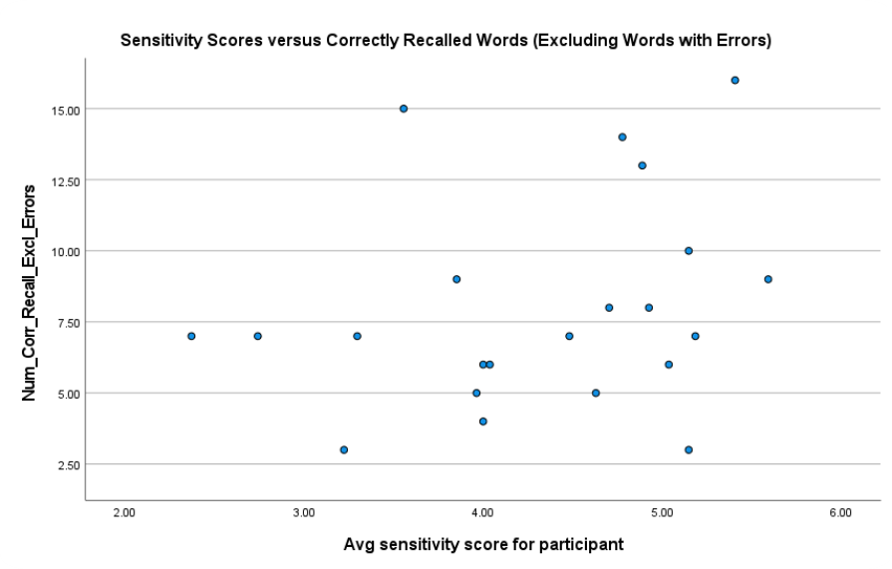
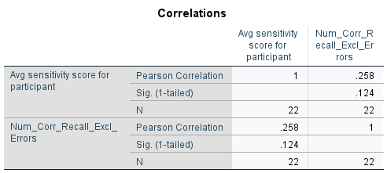
Results Cont.
A correlational analysis was conducted between the average sensitivity scores for participants, measured by the HSP scale, and the number of words they correctly reported during the recall task.
No significant relationship emerged from this analysis.

Slide 12
Discussion
The hypothesis that participants’ sensitivity scores would be significantly and positively correlated with their recall scores was not supported.
Sensitivity scores for this sample did not align with the expected normal distribution commonly seen in earlier studies.
Limitations:
Small sample size (n = 22)
Sample may not be reflective of the larger population of Ball State students
Large proportion of psychology students (77.4%)
Word recall scores were low on average – could be measuring effort rather than ability
Future studies should aim to investigate this relationship with a larger, more representative sample and collect data in a more controlled setting to better control the confounds of participant engagement or confusion with the recall task.

Slide 13
References
Acevedo, B. P., Jagiellowicz, J., Aron, E., Marhenke, R., & Aron, A. (2017). Sensory processing sensitivity and childhood quality’s effects on neural responses to emotional stimuli. Clinical Neuropsychiatry: Journal of Treatment Evaluation, 14(6), 359–373.
Acevedo, B., Aron, E., Pospos, S., & Jessen, D. (2018). The functional highly sensitive brain: A review of the brain circuits underlying sensory processing sensitivity and seemingly related disorders. Philosophical Transactions of the Royal Society B: Biological Sciences, 373(1744), 20170161. doi:10.1098/rstb.2017.0161
Aron, E. N., & Aron, A. (1997). Sensory-processing sensitivity and its relation to introversion and emotionality. Journal of Personality and Social Psychology, 73(2), 345-368. doi:10.1037/0022-3514.73.2.345
Bradley, M. M., & Lang, P. J. (1999). Affective norms for English words (ANEW): Stimuli, instruction manual and affective ratings. Technical report C-1, Gainesville, FL. The Center for Research in Psychophysiology, University of Florida.
Craik, F. I., & Lockhart, R. S. (1972). Levels of processing: A framework for memory research. Journal of Verbal Learning & Verbal Behavior, 11(6), 671–684.

Slide 14
References (Cont.)
Craik, F. I. (2002). Levels of processing: Past, present... and future? Memory,10(5-6), 305-318. doi:10.1080/09658210244000135
Ekuni, R., Vaz, L. J., & Bueno, O. F. (2011). Levels of processing: The evolution of a framework. Psychology & Neuroscience, 4(3), 333-339. doi:10.3922/j.psns.2011.3.006
Ellis, B.J., Boyce, W.T., Belsky, J., Bakermans-Kranenburg, M.J., Van IJzendoorn, M.H. (2011). Differential susceptibility to the environment: an evolutionary-neurodevelopmental theory. Development and Psychopathology, 23(1), 7-28.10.1017/s0954579410000611
Greven, C. U., Lionetti, F., Booth, C., Aron, E. N., Fox, E., Schendan, H. E., Homberg, J. (2019). Sensory Processing Sensitivity in the context of Environmental Sensitivity: A critical review and development of research agenda. Neuroscience & Biobehavioral Reviews, 98, 287-305. doi:10.1016/j.neubiorev.2019.01.009
Pluess, M. (2015). Individual Differences in Environmental Sensitivity. Child Development Perspectives, 9(3), 138-143. doi:10.1111/cdep.12120

