Slide 1
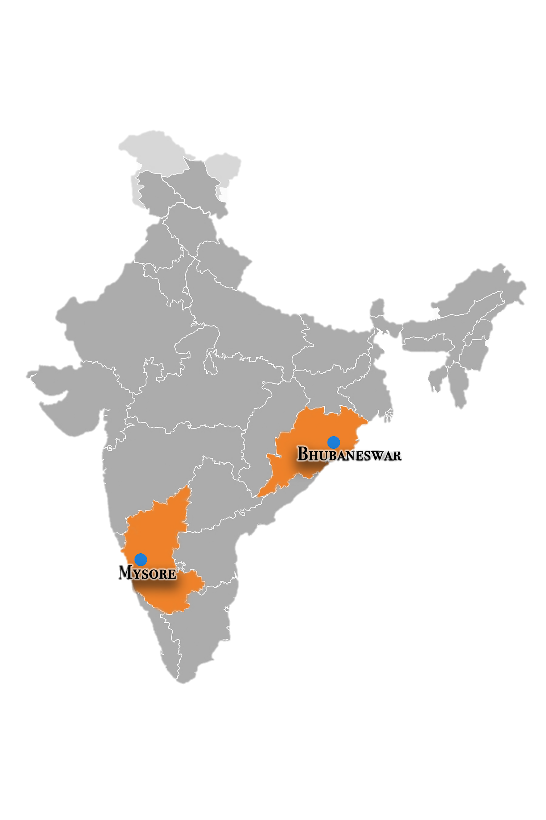
Pregnancy Fasting in India
Lynn Rollins and Caitlyn Placek, PhD
Introduction
Across cultures, pregnant women engage in dietary abstention for a variety of reasons. In one region of south India, women decrease their food intake and fast with the aim to have a smaller baby (1). On the other hand, pregnant Muslim women from western Asia partake in fasting during Ramadan because of their desire to be perceived as honorable (2). Few studies have compared women’s perceptions of fasting across cultures using systematic methods.
The aim of this study was to investigate why pregnant Hindu and Muslim women fast in two subregions of India.
Study Populations
Analysis
Free-list responses were first inductively coded by C.P. to generate a list of themes. Next, C.P. and L.R. blindly coded response data, and then found consensus. Final codes are presented in Table 1.
C.P. analyzed the data in R version 3.6.1 (2019-07-05). Free-list data were analyzed using salience analysis, a method used to determine the primary items within a cultural domain. Salience analysis accounts for both frequency and order of mention (Quinlan 2015), and was computed using Anthrotools in R (Lane & Purzycki 2017). A Smith's S score of 0.10 and above was used as the cut-off for salience in each population.
Table 2. Positive consequences of pregnancy fasting by location.
CODE | BH | MH | MM
General Well-being | X
Child Religiosity | X
Child Development | X | X
General Health | X
Religious Belief | X | X | X
Mother-infant health |  | X | X
Delivery |  | X | X
Infant Gender |  | X
None |  | X
Results
On average, participants were 31.14 years old, they had 9.87 years of education, and 1.83 children.
In total, participants listed 264 positive phrases and 193 negative phrases associated with consequences of pregnancy fasting.
This research was conducted in 2019 in Mysore, Karnataka, and Bhubaneshwar, Odisha. Mysore district has over 900,000 living in the urban area (Census of India 2011), and the urban population of Bhubaneshwar is
Table 3. Negative consequences of pregnancy fasting by location.
CODE | BH | MH | MM
Child Development | X |  | X
General Health | X | X | X
General Well-being |  | X | X
Pregnancy Symptoms |  | X
Maternal-infant health |  | X | X
None |  | X
Table 1. Codes and descriptions of pregnancy fasting consequences. Examples from raw data are provided with each code.
843,402 (Census of India 2011). Both Mysore and Bhubaneshwar are predominately Hindu (73.65% and 95.21%, respectively). People in both regions speak Hindi and English, but also Kannada (Mysore) and Odia (Bhubaneshwar), and Urdu (Muslims). This research included a population of Hindus and Muslims in Mysore and a population of Hindus in Bhubaneshwar.
Code | Description | Example
Child Development | After delivery, fasting impacts the infant or child in non-religious ways | Infant weakness
Work Motivation | Fasting improves ability and increases desire to work | Increase interest in work
Religious Belief | Any religious or spiritual effect of fasting not related to childhood | Double deeds
Pregnancy Symptoms | Nausea, vomiting, not including tiredness | Vomiting, increase nausea
Maternal-infant Health | Any effect of fasting on the mother, infant (in womb), or both | Negative impact during first 5 months of pregnancy
Child Religiosity | Fasting impacts the spirituality or religiosity of the fetus/infant/child | Baby becomes aware of Islam in belly
Conflict Diffuser | Fasting reduces interpersonal conflict | Removes difficulties from home
Delivery | Fasting influences delivery | Easy delivery
Don't Know | Participant says they are unsure or don't know the effects of fasting in pregnancy | N/A
Family Wellbeing | Fasting has an impact on the husband or collective family unit | For husband’s health
General Health | Fasting has an impact on health outcomes not specific to pregnancy | Headache
General Wellbeing | Fasting has an impact on psychological or general welfare not specific to pregnancy | Mental peace
Infant Gender | Fasting is viewed to impact the biological sex of the baby | Get boy baby if fasting after 6 months of pregnancy
Miscellaneous | A range of effects of fasting that might combine multiple categories
Reproduction | The impact of fasting on the ability to conceive, or be a cure for infertility
Weight Loss | Fasting leads to weight loss in the mother and infant
None | Participant doesn’t notice any effects of fasting
Methods
This study was a cross-sectional design. Surveys were translated and back-translated surveys to ensure reliability. Interviews were conducted in the local languages.
Participants (N=90) completed a survey that consisted questions focusing on demographic information and cultural norms of fasting and personal fasting behaviors.. In total, the survey took approximately 30-45 minutes to complete.
Conclusion
Across all cultures, all viewed fasting as having positive effects on their religious beliefs, and all viewed fasting as having a negative effect on their general health. However, the three groups varied across the other codes.
Future research will exam birth outcomes to explore the adaptive significance of fasting in pregnancy.
References
1. Nichter, M. (1989). The ethnophysiology and folk dietetics of pregnancy: a case study from South India. In Anthropology and international health (pp. 30-56). Springer, Dordrecht.
2. Ziaee, V., Kihanidoost, Z., Younesian, M., Akhavirad, M. B., Bateni, F., Kazemianfar, Z., & Hantoushzadeh, S. (2010). The effect of Ramadan fasting on outcome of pregnancy. Iranian Journal of Pediatrics, 20(2), 181.

