Slide 1
Jazz & civil unrest: miles davis, the civil rights movement, and the illusion of life
By: Zack Hansen

Slide 2
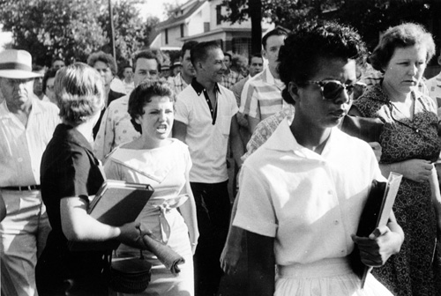
Courtesy of NAACP

Slide 3
Courtesy of Columbia Records

Slide 4
Key Terms
Illusion of Life
Poses that music can act as communication and rhetoric
Virtual Time
Intensity Patterns & Release Patterns
Virtual Experience
Portrayal of experience through music
Collaborative Representation
Kind of Blue as inspired by, as well as a part of, the Civil Rights Movement

Slide 5
Analysis
Focus on “So What”
Virtual Time
Actual time of the song is just over nine minutes, and there is heavy emphasis on tension and release (virtual time)
Virtual Experience
No lyrics for analysis of virtual experience, so the overall emotion/mood of the solos was used instead

Slide 6
Report Findings
Kind of Blue drew heavily on organization approaches of the Civil Rights Movement
Miles Davis had personal experience that acted as a direct link between the movement and his music
These ties, both direct and indirect, can be observed throughout the album

Slide 7
Conclusion
While revolt, protest, and fighting for change are not essentially unique to any one time period in American history, the Civil Rights Movement of the late 1950s certainly exists as a unique case. Beyond the movement itself, Miles Davis’s Kind of Blue effectively acted as a collaborative representation of the movement, being engaged in both reflecting and participating. The Sellnow’s illusion of life methodology lays a solid foundation for analyzing and understanding the complex interactions within and around music as a form of communication and rhetoric, which has in turn allowed for my rhetorical criticism of Davis’s album.

