Slide 1
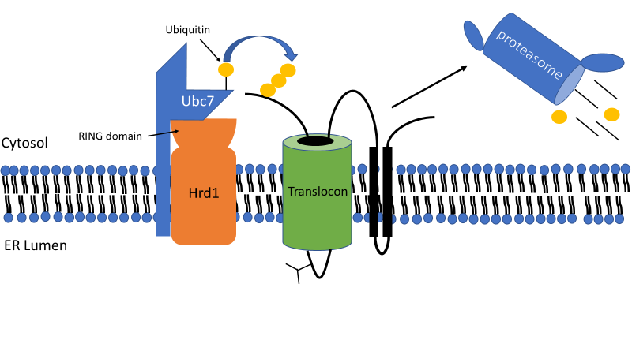
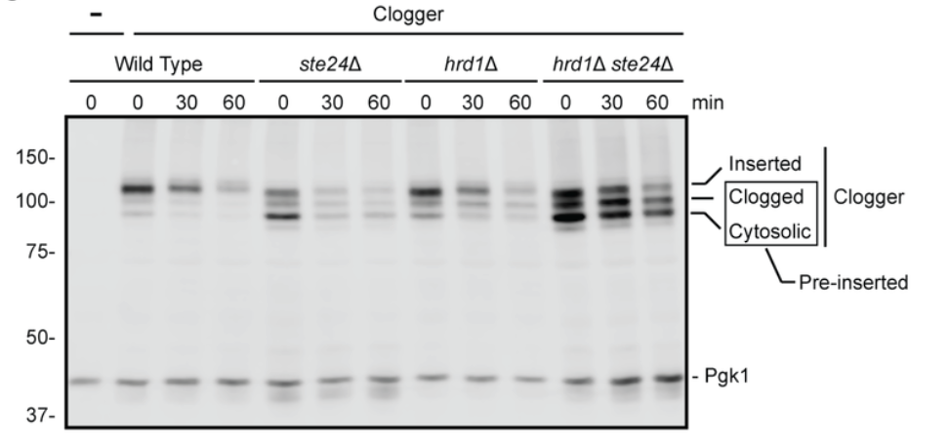
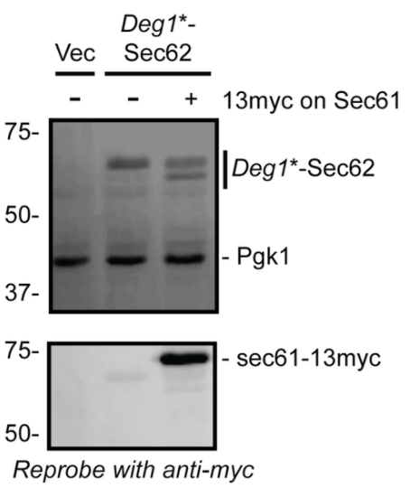
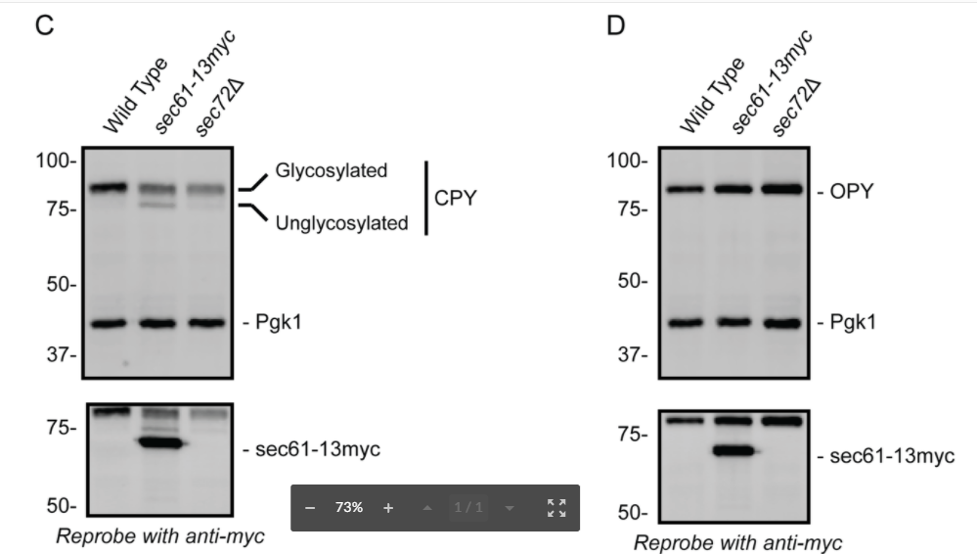
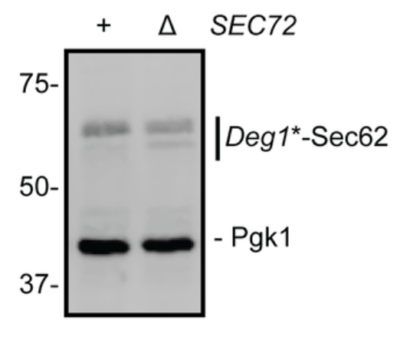
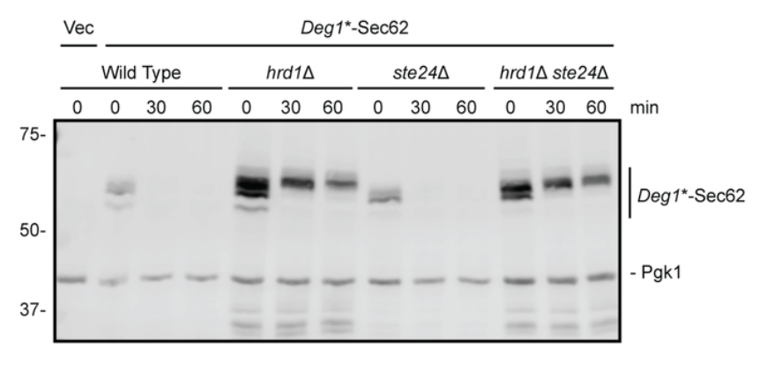
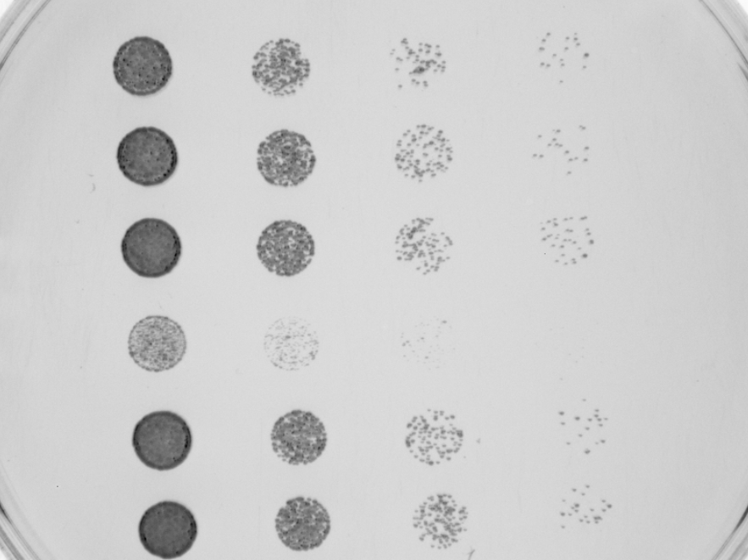
Endoplasmic Reticulum Translocon Perturbation Modulates Toxicity Associated with Impaired Protein Quality Control
Kyle A. Richards, Avery M. Runnebohm, Molly K. Dolan, Halie E. Vitali, Eric M. Rubenstein
ABSTRACT
The endoplasmic reticulum (ER) is the entry point for the majority of eukaryotic proteins functioning in the endomembrane system. Most proteins enter the ER via the translocon. Translocon dysfunction can block access into the ER, which is detrimental to cellular health. Translocon structure and function are highly conserved and have been intensely studied in Saccharomyces cerevisiae. We found that a tag on central translocon pore, previously suggested not to impair translocon function, subtly impairs ER translocation in yeast cells. Strikingly, this tag also suppresses a phenotype associated with defective protein quality control, indicating a novel link between translocation and quality control. Ongoing work includes characterizing the effects of epitope tags on different translocon subunits, with the goal of identifying tags which least impede translocon function.
Hrd1 targets translocon-clogging proteins for degradation by the proteasome
Ste24 protease cleaves translocon clogging proteins
Ste24
Translocon
Ste24
Translocon
Hrd1 and Ste24 contribute to degradation of model translocon-associated substrate Clogger
C-terminal extension of Sec61 and knockout of SEC72 reduces extent of aberrant translocon engagement by Deg1*-Sec62
C-terminal extension of Sec61 and knockout of SEC72 selectively impair post-translational translocation
Conclusions
Hrd1 and Ste24 exhibit functional redundancy in translocon quality control.
Cells lacking Hrd1 and Ste24 exhibit a synthetic growth defect.
sec61-13myc and sec72Δ selectively impair post-translational translocation and aberrant engagement by Deg1*-Sec62.
Translocation impairment by sec61-13myc and sec72Δ reduces cellular reliance on protein quality control mechanisms at the ER at the translocon.
Vec
Clogger
Deg1*-Sec62
Wild Type
ste24Δ
hrd1Δ
hrd1Δ ste24Δ
Sec61-13myc
Sec61-13myc
0
0
30
60
0
30
60
0
30
60
0
30
60
min
Vec
SEC72
Wild Type
sec72Δ
Wild Type
sec72Δ
13myc on Sec61
100-
Glycosylated
CPY
100-
-OPY (Glycosylated)
150-
Inserted
Clogger
75-
Deg1*-Sec62
75-
Deg1*-Sec62
75-
Unglycosylated
75-
100-
Clogged
50-
50-
75-
Cytosolic
50-
-Pgk1
50-
-Pgk1
-Pgk1
Pre-Inserted
37-
-Pgk1
37-
37-
50-
-Pgk1
75-
-sec61-13myc
37-
75-
-sec61-13myc
75-
-sec61-13myc
37-
50-
50-
50-
100
39
17
100
46
29
100
71
50
100
69
39
Percent Clogger remaining (%)
Reprobe with anti-myc
Reprobe with anti-myc
Reprobe with anti-myc
Translocation assay of Deg1*-Sec62 protein in yeast strains containing translocon modification. Deg1*-Sec62 , sec61-13myc and Pgk1 were detected via immunoblotting. Sec62 is the pore-forming unit of the translocon. Sec72 is a component of the translocon. The appearance of a second, faster migrating (unglycosylated) Deg1*-Sec62 band indicates impaired translocation.
Analysis of translocation of model post-translationally translocated protein (CPY) and co-translationally translocated protein (OPY) in yeast strains containing indicated translocon modification. CPY, OPY, and Pgk1 were detected via immunoblotting. Sec61 is the pore-forming unit of the translocon. Sec72 is a component of the post-translational translocon. The appearance of a second, faster migrating (non-glycosylated) band indicates impaired translocation.
.
Cycloheximide chase of Clogger protein in indicated yeast strains. Clogger and Pgk1 were detected via immunoblotting.
Hrd1 plays major role in degradation of model translocon-associated substrate Deg1*-Sec62
hrd1∆ ste24∆ and ubc7∆ ste24∆ yeast exhibit synthetic growth defect
Mutations that impair post-translational translocation rescue hrd1Δ ste24Δ synthetic phenotype.
Future Directions
Determine if Hrd1 and Ste24 function in the same or parallel mechanisms
Determine if loss of Hrd1 and Ste24 function at the translocon is due to loss of translocon-related or other function.
Identify and characterize natural proteins that clog the translocon under physiological conditions.
Vec
Deg1*-Sec62
Wild Type
Wild Type
Wild Type
hrd1Δ
ste24Δ
hrd1Δ ste24Δ
Wild Type
Wild Type
Sec61-13myc
hrd1Δ
75-
0
0
30
60
0
30
60
0
30
60
0
30
60
min
hrd1∆
ubc7∆
ste24Δ
Deg1*-Sec62
ste24∆
ste24∆
hrd1Δ ste24Δ
hrd1Δ ste24Δ
50-
hrd1Δ ste24Δ
ubc7Δ ste24Δ
hrd1Δ ste24Δ
sec61-13myc
sec72Δ
-Pgk1
hrd1Δ ste24Δ sec72Δ
37-
Funding: NIH Grant GM111713 (EMR) and Ball State University ASPiRE Student Research Grants (KAR, AMR, MKD)
100
8
4
100
49
34
100
14
6
100
69
54
Growth assay of yeast strains possessing the indicated modifications. Sec61 is the pore-forming unit of the translocon. Sec72 is a component of the post-translational translocon. Cells were grown on rich growth media overnight at 30ºC.
Cycloheximide chase of Deg1*-Sec62 protein in indicated yeast strains. Deg1*-Sec62 and Pgk1 were detected via immunoblotting.
Yeast of the indicated genotype were serially diluted and cultured on rich yeast growth medium at 30C.

