Slide 1
Trait anxiety and assessment of ambiguous emotions
Anna Himes

Slide 2
Introduction/Background
Universality of facial expressions (Ekman, 2006)
Anxiety Errors in emotion recognition (Demenscue et al., 2010)

Slide 3
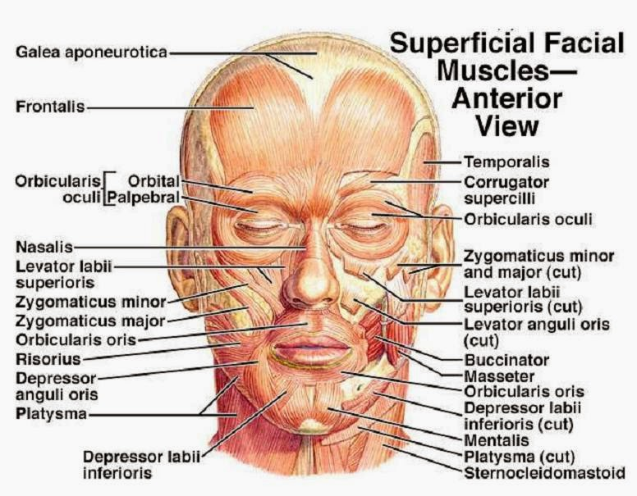
Intro./Background cont.
Embodied Simulation Theory and Facial Feedback Hypothesis (Argaud et al., 2016)(Strack et al., 1988)
Facial muscles (orbicularis and zygomaticus) (Argaud et al., 2016)

Slide 4
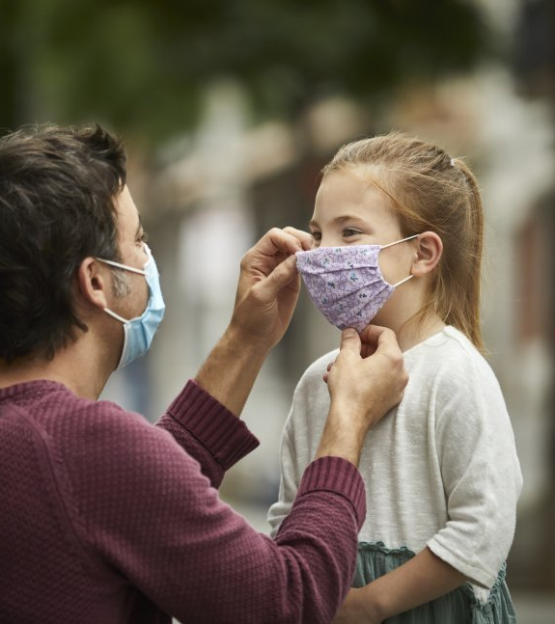
relevance

Slide 5
Current Research
Purpose: add to the existing archives of studies which examine the ways in which trait anxiety may affect one’s ability to accurately assess the emotions of facial expressions with the new added element of ambiguity using surgical masks.

Slide 6
Hypotheses
Participants with higher trait anxiety will be less accurate at identifying masked and unmasked emotions than participants with lower trait anxiety overall
Participants with high trait anxiety will misclassify non-threatening masked and unmasked emotions (happy, clam, neutral) as threatening emotions (anger, disgust, fear, sadness) more often than participants with low trait-anxiety.
Participants with high and with low trait anxiety will perform more accurately in assessing unmasked emotions than in assessing masked emotions.

Slide 7
Method
Participants
63 English speaking undergraduate students
18 – 25 years old
51 White, 3 Multiracial, 4 Black/African American, 2 American Asian/Pacific Islander, 1 Hispanic/Latino/a, 1 Native /Indigenous, 1 Other
51 Female, 10 Male, 2 Other
Given SONA class credit upon completion

Slide 8
Method cont.
Materials
Recruitment email
Consent form
Demographic Questions
Trait Anxiety Questionnaire (IPIP)
Emotion recognition task (Assays & tools, 2020; Conley et al., 2018)

Slide 9
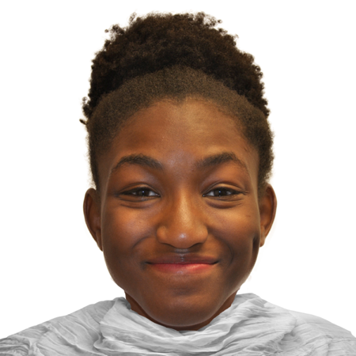
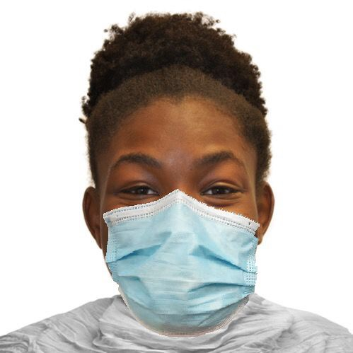
Stimuli examples: Unmasked/Masked “happy” black female

Slide 10
Method cont.
Procedure
Qualtrics
Tasks counterbalanced
Stimuli randomized
Five seconds to view and then multiple-choice question (anger, fear, disgust, happiness, neutral, calm, or sadness)
Likert Scale (1 = “Strongly Disagree” to 5 = “Strongly Agree”)
Example trait anxiety questionnaire question: “I fear for the worst.””

Slide 11
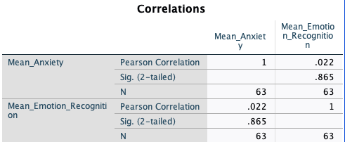
Results
Hypothesis 1
(Pearson Correlation) No significant correlation: r = .022, p >.05
* All tests performed using SPSS

Slide 12
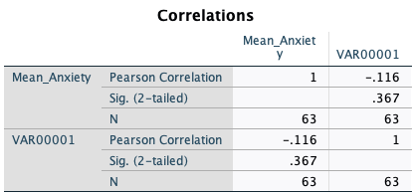
Results cont.
Hypothesis 2
(Bivariate Correlation) No significant correlation: r = -.116, p >.05

Slide 13
Results cont.
Hypothesis 3
Unmasked scores > Masked scores
Further Analyses needed to determine significance

Slide 14
Discussion
Conclusions and Limitations
No significant correlations were found in testing.
Trait Anxiety vs. Generalized Anxiety Disorder (Saviola et al., 2020)(Demenescu et al., 2010).
Lack of diversity
Participant number (N = 63)
Future Research should address these limitations

Slide 15
References
Alphabetical index of 274 labels for 463 IPIP scales. (2019).
https://ipip.ori.org/newIndexofScaleLabels.htm
Am-medicine.com. (2015). Muscles of the face– superficial facial muscles – human anatomy diagram. https://am-medicine.com/muscles-of-the-face-superficial-facial-muscles/
Argaud, S. et al. (2016). Does facial amimia impact the recognition of facial emotions? An EMG study in Parkinson’s Disease. PLoS ONE 11(7). DOI:10.1371/journal.pone.0160329
Assays & tools. (2020). Fablab: Fundamentals of The Adolescent Brain Lab.
http://fablab.yale.edu/page/assays-tools

Slide 16
References cont.
Demenescu, L. R., Kortekaas, R., den Boer, J.A., & Aleman A. (2010). Impaired attribution of emotion to facial expressions in anxiety and major depression. PloS ONE, 5(12). https://doi.org/10.1371/journal.pone.0015058
Ekman, P. (2006). Darwin and facial expression: A century in review. Los Atlos, CA: Academic Press, Inc.
Saviola, F., Pappaianni, E., Monti, A., Grecucci, A., Jovicich, J., & Pisapia, N. (2020). Trait and state anxiety are mapped differently in the human brain. Scientific Reports, 10(11112). https://doi.org/10.1038/s41598-020-68008-z
Usnews.com (2021). These states have COVID-19 mask-mandates. Getty Images. https://www.usnews.com/news/best-states/articles/these-are-the-states-with-mask-mandates

