Slide 1


Between a Rock and a Hard Place: How Transportation into Stories Representing Protagonist’s Criminal Behavior Affects Reader’s EmpathY
Cailon Nicoson

Slide 2
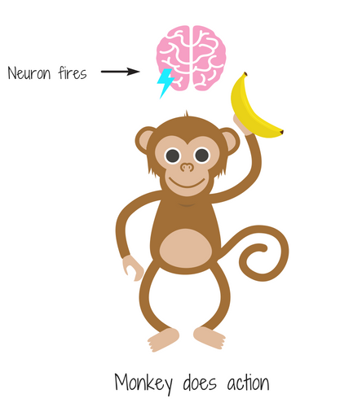
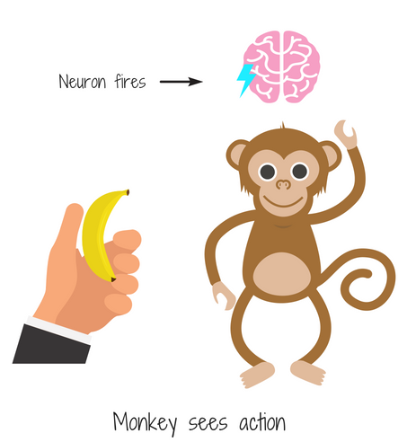
Background Information
[Monkey Mirror Neurons]. (2020, July 20). Mirror Neurons: We Learn Through Human Interaction. https://blog.360learning.com/en/mirror-neurons-we-through-human-interaction/
Basics of Empathy
  Subcategories
    Affective
    Cognitive
    Trait/State
  Origin
    Neurology
    Taught/Learned
    Transportation
Benefits of Empathy
  Better situational awareness and understanding
  Better cooperation with others
  More altruistic behaviors
Notes:
The subcategories of empathy are important pieces of background information to know about the topic.
Affective – feeling another’s emotions
Cognitive – Putting oneself into another’s shoes and understanding how they feel
Trait – individual’s baseline empathy level
State – current level of empathy
The origin of empathy is also important. Neurology explains that empathy is an innate experience; studies have shown that many of the neurons that fire when completing a behavior also fire when watching someone else completing the behavior. This is what the images provided exemplify; these neurons are called mirror neurons and help us relate to others more easily. Individuals can also develop empathy by learning from peers and life experiences, as well as through transportation, which typically involves putting oneself into the shoes of a fictional character and sharing their experiences.

Slide 3
Previous Research
General Strain Theory
Empathy Interventions for Inmates
  Reading for Life
  Teaching Empathy through reading
Notes:
Some previous research has focused on General Strain Theory, which is a criminological theory that claims that individuals are more likely to engage in crime if they face strain, such as poverty, in order to fulfill their needs. Other studies have also shown the use of empathy intervention programs like Reading for Life, which is a juvenile treatment program based in IN that has youth read fictional novels in order to learn empathy, prosocial behaviors, and morals from the protagonists.

Slide 4
Previous Studies
Focused on the empathy of those who have committed crimes (correctional inmates) towards non-inmates
Current Study
Study the empathy of non-inmates towards those who have committed crimes

Slide 5
Hypotheses
Empathy towards offenders can be increased by reading text that allow the reader to “transport” themselves into the offender’s shoes.
Empathy is higher when reading narratives compared to report-styled texts.

Slide 6
Method
Participants:
  73 (Reduced to 71) participants recruited from Ball State University and various social media sites
  Demographics:
    Age: (N = 68) mean age of 34.5 (SD = 17.81)
    Race: (N = 67); 82.1% White/Caucasian
    Gender: (N = 67); 67.2% Female, 25.4% Male
    Position: (N = 66); 53% Community Member, 36.4% Undergrad
Notes:
There were 71 participants in my study after accounting for 2 participants that had to be excluded due to missing reading comprehension questions. They were recruited from BSU and social media. The mean age of participants was 34.5 and the main demographics present in study were those who were white, women, and community members followed by undergraduate students.

