Slide 1
Computerized Analysis of Linguistic Style Differences Between Offenders of Mass Shootings
Ky bray

Slide 2
Introduction
The purpose of this study was to determine whether offenders of mass shootings had different linguistic styles depending on whether they died by suicide during their attack.
Past linguistic style research indicates:
Suicide notes tend to show less linguistic complexity than other expressive writing (Kim et al., 2019)
Those who die by suicide tend to use more references to time, religion, death, and self references compared to those who do not complete suicide (Handelman & Lester, 2007; Stirman & Pennebaker, 2001).
Men preferentially focus on the perpetrators of real or perceived transgressions (Kowalski, 2000)

Slide 3
Present Study
The present study compared style differences between offenders who did and did not survive their attack.
Hypotheses:
Offenders who died by suicide were expected to make more references to time, religion, death, and self-references.
Offenders who died by suicide were predicted to use less categorical language compared to those who survived.
Offenders who survived were expected to use higher rates of third person pronouns compared to those who died by suicide.

Slide 4
Methods
Writing samples by offenders who survived (N = 8) and did not survive (N = 16) were harvested from the online database, schoolshooters.info.
Writing samples were then submitted to Linguistic Inquiry and Word Count (LIWC) (Pennebaker et al., 2015).
Writing samples were compared based on word categories that often demonstrate differences in suicide notes.

Slide 5
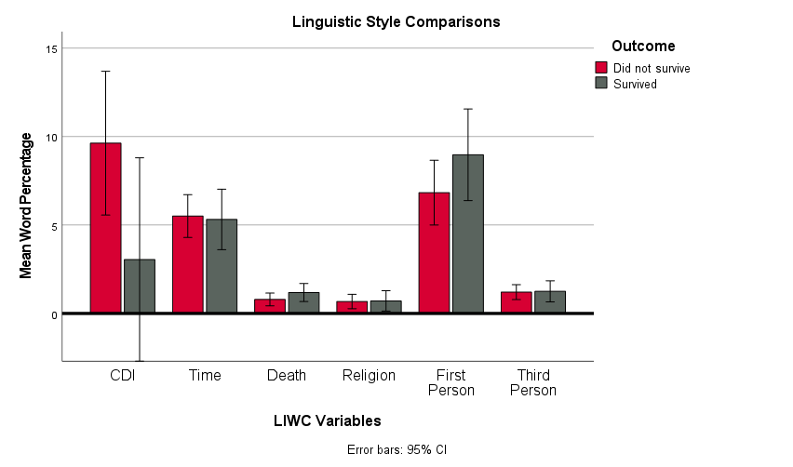
Results
Table 1
Offenders who did not survive (compared to those who did):
Had marginally higher CDI scores, t(22) = 1.94, p = .066, d = .84
See Table 1

Slide 6
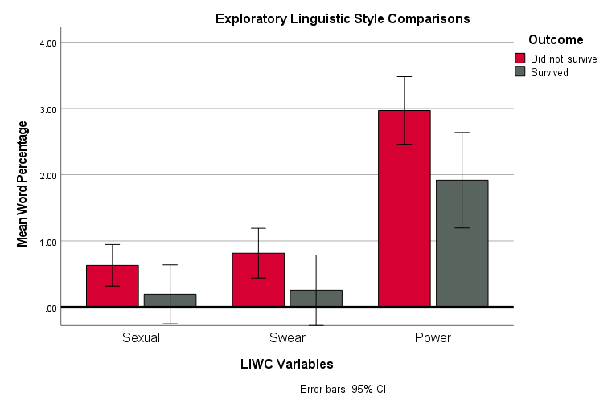
Results
Table 2
Exploratory Analyses
Offenders who did not survive used:
Higher rates of sexual words, t(18.68) = 2.27, p = .036, d = .72
Higher rates of swear words, t(20.05) = 2.38, p = .028, d = .77
Higher rates of power words, t(22) = 2.47, p = .022, d = 1.07

Slide 7
Discussion
Overall:
No differences were found between offenders in terms of their focus on time, religion, their self, or others
Offenders who died by suicide:
Used more complex organization of things and ideas
Discussed power more frequently
Interestingly
Offenders who died by suicide made more sexual references. This is analogous to comparisons of suicide notes between those who did or did not complete suicide (Handelman & Lester, 2007).

Slide 8
Limitations & Future Directions
Limitations
Did not control for writing type
Small sample size (data collection ongoing)
Future Directions
Consider using other language dictionaries
Compare offenders of mass shooting to other types of violent behavior

Slide 9
References
Handelman, L. D., & Lester, D. (2007). The content of suicide notes from attempters and completers. Crisis: The Journal of Crisis Intervention and Suicide Prevention, 28(2), 102–104. https://doi.org/10.1027/0227-5910.28.2.102
Kim, K., Choi, S., Lee, J., & Sea, J. (2019). Differences in linguistic and psychological characteristics between suicide notes and diaries. Journal of General Psychology, 146(4), 391-416. https://doi.org/10.1080/00221309.2019.1590304
Kowalski, R. M. (2000). “I was only kidding!”: Victims’ and perpetrators’ perceptions of teasing. Personality and Social Psychology Bulletin, 26(2), 231-241. https://doi.org/10.1177/0146167200264009
Pennebaker, J. W., Booth, R. J., Boyd, R. L., & Francis, M. E. (2015). Linguistic inquiry and word count: LIWC 2015. Austin, TX: Pennebaker Conglomerates. Retrieved from www.LIWC.net
Stirman, S. W., & Pennebaker, J. W. (2001). Word use in the poetry of suicidal and nonsuicidal poets. Psychosomatic Medicine, 63(4), 517-522.

