Slide 1
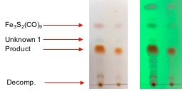
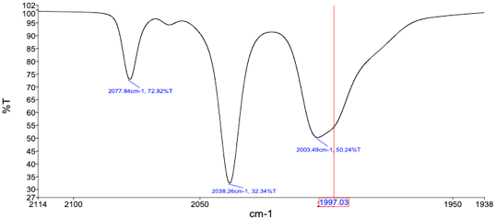
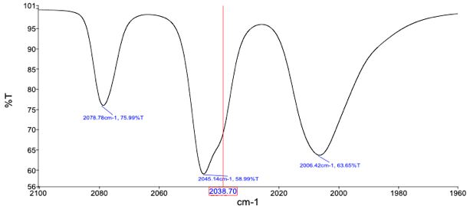
Overcoming Synthetic Challenges with Single-Atom Linked Dithiolate Bridged [Fe-Fe]-hydrogenase Mimic Compounds
Jacob Wade, Dr. Jesse Tye*
Ball State University, Department of Chemistry, Muncie, IN.
Abstract and Introduction
Results and Discussion
Results and Discussion
Due to their high catalytic turnover frequency, [Fe-Fe]-hydrogenase mimic compounds have been suggested as potential replacements for platinum in the catalytic reduction of water into hydrogen for fuel cells which has fueled significant research into these compounds. The natural enzyme is believed to be a three-atom azadithiolate (adt) linked complex. There is an abundance of literature for the two-atom or larger linked mimic compounds, however only a relatively small amount exists which covers the single-atom linked compounds. Through thorough study of the literature, we have been able to successfully synthesize two single atom linked compounds: methanedithiolate (mdt) diironhexacarbonyl and diphenylmethanedithiolate (dpmdt) diironhexacarbonyl, with hopes to apply these routes to synthesize novel compounds. Though we have successfully synthesized these compounds, we have had difficulty with purifying them, always obtaining impure material from the silica gel column. We have successfully replicated the synthesis of these compounds in adequate yields with multiple side-products but have received inconsistent results during purification. One major challenge with these compounds is that these compounds are extremely non-polar, quickly eluting with 100% pentane/hexanes. These compounds are highly soluble in these solvents which complicates attempts at recrystallization. The presentation herein highlights the challenges which we have faced, and the steps taken to successfully synthesize and purify these compounds and plans to apply the learned techniques to synthesizing novel compounds including: di-2-pyridylmethanedithiolate (dpymdt) diironhexacarbonyl and the nitrogen based aminodithiolate (ndt) diironhexacarbonyl.
Image 1 shows the chromatography of the mdt complex. There is a noticeable amount of an intermediate Fe₃S₂(CO)₉ complex (right) and a few unknown compounds. By Thin Layer Chromatography (TLC), the compounds should separate, however as seen in Image 2, the various compounds tend to co-elute together with the peaks running into each other. There is also some amount of decomposition seen on the TLC plate.
The current attempt involves isolating the Fe₃S₂(CO)₉ intermediate. A facile route⁴⁻⁶ in high yields should get to the “super-nucleophile” Fe₂S₂(CO)₆²⁻ which is extremely reactive and could lead to the successful synthesis of all desired single-atom lined dithiolate complexes. The proposed schemes (below) highlight show the proposed route to this reactive species.
Target:
Scheme 6:
Image 1
Image 3 shows the chromatography of the dpmdt complex. There appears to be more of the Fe₃S₂(CO)₉ intermediate and a few unknown compounds. Like the mdt complex, the peaks tend to co-elute upon column chromatography.
Fe3S2(CO)9 intermediate
Conclusions and Future Work
Conclusions:
We have been able to synthesize and isolate the methanedithiolate and diphenylmethanedithiolate diiron hexacarbonyl compounds successfully. The purification of these compounds has made it difficult to determine purity absolutely with errant peaks showing up in the TLC but not in other data (Nuclear Magnetic Resonance [NMR], and IR). The difficulty in separation could be due in part to the fact that these compounds are extremely non-polar and essentially fly off the silica gel column. Using traditional gravity column chromatography could allow these compounds to diffuse through the silica gel medium which widens the bands and causes the peaks to merge and co-elute as they are extremely soluble in the non-polar solvent used to purify them. Flash chromatography shows some improvement as the compounds are not sitting in the medium for too long and have less time to diffuse throughout the silica gel. There does however seem to still be some issues with compounds co-eluting, even on flash chromatography.
Future Work:
The next phase of the project is to apply the synthetic routes to synthesize the following compounds (below): di-2-pyridylmethanedithiolate diiron hexacarbonyl (dpymdt), aminodithiolate diironhexacarbonyl (ndt), 2-pyridylaminodithiolate diironhexacarbonyl (pyndt), and 2-pyrimidineaminodithiolate diironhexacarbonyl (pydndt). To supplement these syntheses, we also plan to run computational analyses on these compounds to determine relative energies, bond length, electrochemical properties, and model mechanisms. The computational chemistry calculations could help to unlock information into the synthetic likelihood and overall stability of each of the four below molecules as well as the methanedithiolate (mdt) and diphenylmethanedithiolate (dpmdt) compounds.
Image 3
mdt-Fe₂(CO)₆
dpmdt-Fe₂(CO)₆
dpymdt-Fe₂(CO)₆
ndt-Fe₂(CO)₆
Scheme 3:
Scheme 4:
Schemes 3 and 4 are two additional route tried in order to synthesize the mdt complex. Both attempts were unsuccessful with only traces of product observed with significant decomposition and side products. To date the most successful route is the methanedithiol route as illustrated in Scheme 1.
Methods
According to the literature,¹⁻³ there have been successful attempts at the synthesis of both the methanedithiolate (mdt) and diphentylmethanedithiolate (dpmdt) complexes.
For the mdt complex, the most straightforward synthesis involved a gemdithiol route:
To a 100 mL Schlenk flask containing degassed toluene (20 mL) was added triirondodecacarbonyl (1.000g, 1.98 mmol, Strem: A6261049). The solution was stirred for ~5 min yielding a dark green solution. Methanedithiol (0.314 g, 3.92 mmol) was added to the flask and the reaction mixture was heated to 80ºC and stirred overnight. The RM was cooled to room temperature and was purified through a plug of silica gel (elution with 100% pentane). A brownish red peak was collected and concentrated under reduced pressure to yield a reddish solid.
For the dpmdt complex, the most straightforward synthesis in involved a similar route starting with the thioketone and forming a dithiol in situ:
To a 100 mL RBF containing a solution of freshly prepared thiobenzophenone (assumed 0.797g, 4.00 mmol) in toluene (15 mL) was added triirondodecacatbonyl [Fe₃(CO)₁₂] (0.672g, 1.33 mmol). The solution was stirred at RT for ~5 minutes to ensure that the triirondodecacarbonyl solids dissolved completely before the solution was heated to 80ºC-100ºC for ~5 minutes. The reaction was cooled and concentrated in vacuo to afford a brown-black solid. The solid was purified over silica gel (elution with 100% hexanes). A reddish orange peak was collected and concentrated under reduced pressure to yield a red-orange solid.
Image 2
As seen in Image 4, successful synthesis of the mdt complex using the route in Scheme 1 was observed and the Infrared Spectroscopy (IR) was consistent with the desired product reported in the literature.¹ The spectrum in Image 4 was taken after purification of the compound by chromatography (above) with shaving fractions to only include the purest material.
Image 4
dpymdt-Fe₂(CO)₆
ndt-Fe₂(CO)₆
dpyndt-Fe₂(CO)₆
dpydndt-Fe₂(CO)₆
Results and Discussion
Scheme 5:
Scheme 5 shows the failed attempt to isolate a 1,2,4-trithiolane intermediate which should react in moderate to high yields with the iron source Fe₃(CO)₁₂ to give the desired product.
References
The issues with these syntheses are that they only produce moderate yields and have not been able to be consistently isolated.
Scheme 1:
The synthesis of the gemdithiol is very stinky and the gemdithiol itself is very reactive and rapidly polymerizes. This makes it very difficult to keep and therefore must be freshly prepared and reacted.
Scheme 2:
The synthesis of the thiobenzophenone intermediate is very straightforward with Lawesson’s Reagent acting as the thiolating reagent, however thiobenzophenone is very unstable in air and must be used immediately before it decomposes to the starting material benzophenone and elemental sulfur.
Lin, A.; Ulloa, O. A.; Rauchfuss, T. B.; Gray, D. L. Diiron Azamonothiolates by the Scission of Dithiadiazacyclooctanes by Iron Carbonyls. Eur. J. Inorg. Chem. 2014, 4109-4114.
Alper, H.; Chan, A. S. K. Sulfur-Donor Ligans Ortho-Metalated Complexes Derived from Thiobenzophenones. A Simple Approach to Isobenzothiophene Heterocycles. J. Am. Chem. Soc. 1973, 95, 4905-4913.
Daraosheh, A. Q.; Apfel, U-P.; Görls, H.; Friebe, C.; Schubert, U. S.; El-khateeb, M.; Mloston, G.; Weigand, W. New Approach to [Fe-Fe]-Hydrogenase Models Using Aromatic Thioketones. Eur. J. Inorg. Chem. 2012, 318-326.
Lorenz, I.-P.; Messelhäuser, J.; Hiller, W.; Conrad, M. Schwefelmonoxid Als Brückenligand In Zwei- Und Dreikern-Komplexen Von Mangan Und Eisen. Journal of Organometallic Chemistry 1986, 316, 121-138.
Kaiser, M.; Knör, G. Synthesis, Characterization, and Reactivity of Functionalized Trinuclear Iron-Sulfur Clusters- A New Class of Bioinspired Hydrogenase Models. Eur. J. Inorg.Chem 2015, 4199-4206.
Eveland, J. R.; Whitmire, K. H. Synthesis and Characterization of the Carbide Cubane Cluster [Fe₃(CO)₉Te₄(μ₃-CTeBr₄)] with an Unusual Tetrahedral CTe₄ Unit. Angew. Chem. Int. Ed. Engl. 1997, 36, 1193-1194.
As seen in Image 5, successful synthesis of the dpmdt complex using the route in Scheme 2 was observed and the Infrared Spectroscopy (IR) was consistent with the desired product reported in the literature.³ The spectrum in Image 5 was taken after purification of the compound by chromatography (above) with shaving fractions to only include the purest material.
Acknowledgements
Image 5
The presenters would like to thank Dr. Jesse Tye for his guidance and meaningful discussions which really propelled the project forward. We would also like to thank the Department of Chemistry at Ball State University for the use of the equipment and laboratory space.

