Slide 1
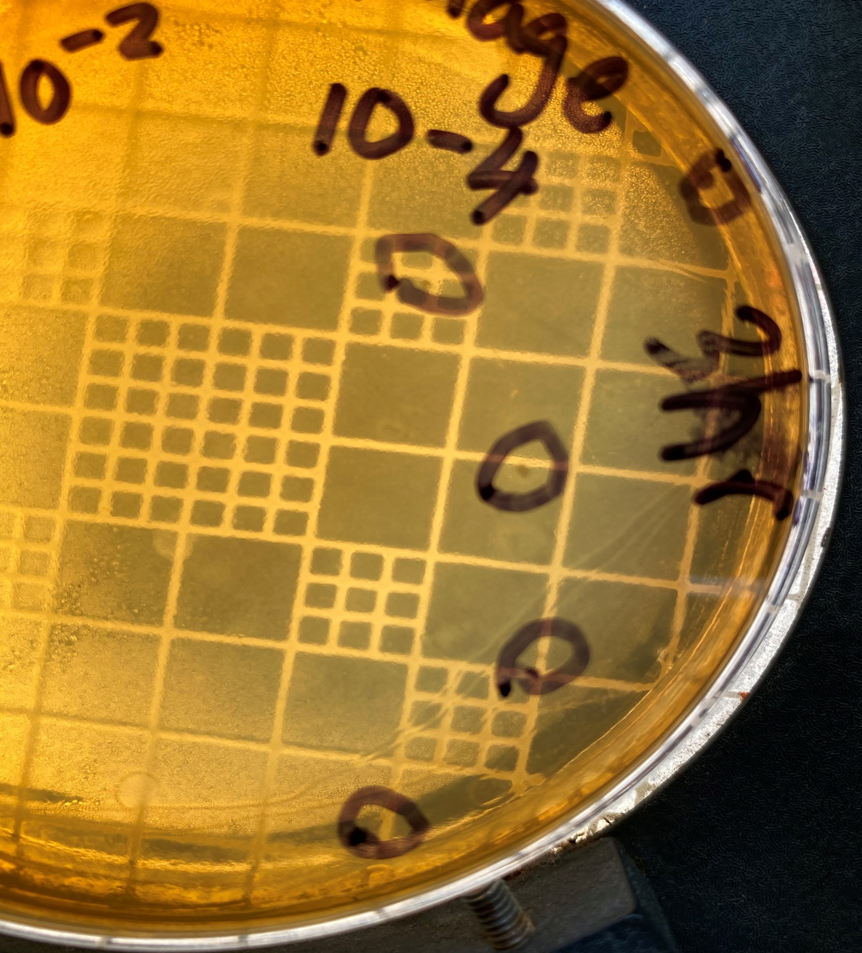
Bacteriophage control of Salmonella enterica in pasteurized milk
Airhenvbahihea Edionwe*, Victoria M. Blake, & John L. McKillip
Department of Biology* Ball State University
Abstract
Results
Conclusions
Salmonella spp. are the number one causative agent of foodborne illnesses in the United States each year. Salmonella spp. have been isolated from various food matrices including eggs, poultry, milk, and beef. Bacteriophage are viruses of bacteria. Bacteriophage, also known as phage, insert their genetic material into their hosts, hijacking their DNA synthesis machinery in order to produce more phage inside the host cell. Bacteriophage have been considered an alternative to antibiotics because of this lytic ability to kill their hosts. The goal of this study is to identify novel Salmonella bacteriophage from raw dairy milk and assess the ability to infect its host. For this experiment, three bacteria were used; Salmonella enterica subsp. Enteriditis, Salmonella enterica subsp. Pullorum, and S1 (an uncharacterized Salmonella species isolated from raw dairy milk. Salmonella enterica subsp. Enteriditis was used as the host for the novel bacteriophage. Upon phage isolation, enrichment is performed to increase phage titers. The phage is then added to various densities of bacteria to assess its ability to control growth under optimal conditions. Results from this experiment will lead an insight into better biological control methods.
We expect the bacteriophage to infect the natural dairy Salmonella isolate S1 at higher levels compared to Salmonella enterica. Recovery of S1 phage plaques will be quantified and show higher plaque-forming units (pfu) occur compared to pfu from Salmonella enterica phage infection.
Broad impact -A great sense of urgency exists to implement creative approaches for food protection and security, including control of important bacterial pathogens such as Salmonella. The use of bacteriophage for food protection (phage therapy) shows great promise. This study addressed the potential of a commercially available phage to control a natural isolate of Salmonella (S1) from raw milk compared to a reference strain. The effect of this phage on both strains of Salmonella appears to be similar, although more replicates need to be completed, along with comparative growth curves over a ~24h duration, to ascertain and quantify the specific effects of the phage and to analyze any differences on growth rate and survival using appropriate statistical measures
Introduction
The bacterial genus Salmonella is comprised of over 2,500 serovars between two species: Salmonella enterica and Salmonella bongori. The two species are also known as typhoidal and non-typhoidal species. Non-typhoidal Salmonella can be transferred to humans through other animals and may also be transferred from human-to-human. Typhoidal Salmonella are only transferred from human to human. The species S. enterica commonly causes Salmonellosis. Salmonellosis is a gastrointestinal infection causing diarrhea, fever, abdominal cramps, and vomiting. Salmonella enterica serovar Typhimurium commonly causes gastroenteritis. The goal of this project is to isolate and characterize bacteriophage from a raw milk environment to use as a biological control of Salmonella enterica contamination of food products. We hypothesize that the bacteriophage used in raw dairy milk will infect a naturally isolated strain of Salmonella (S1) more efficiently than Salmonella enterica Enteriditis and Salmonella enterica subsp. Pullorum.
Methodology
Collection of raw samples: Raw milk and soil samples were collected from All Wright Farms (Muncie, IN) during the summer season. Raw milk was obtained from randomly selected cows and maintained at refrigeration temperature until processing in the laboratory (within 24h). Soil samples were obtained from three specific locations at the farm: adjacent to the feeding troughs, water trough, and the parlor area. Soil was placed in a 4-ounce specimen collection cup and stored on ice until arrival at the lab. The samples were placed in a -20°C freezer box until analyzed.
Isolation and Enrichment of Salmonella phage: Salmonella enterica and S1 were subcultured every 48h at 32°C in 8.0 mL of tryptic soy broth (TSB). After 48h, 100µL of culture and 2.0 mL was subcultured into new TSB. Samples were incubated overnight at 32°C. The next day, aliquots were made of 1 mL suspension into 1.5 mL centrifuge tubes. Tubes were centrifuged at 10,600 rpm for 15 min. to pellet any unwanted material. Eluates (supernatant) were dispensed into a filter syringe (0.2µm filter) and filtered into a sterile 1.5 mL centrifuge tube. These tubes were centrifuge at 10,600 rpm for 10 min. Aliquots of 100µL of each eluate was mixed with 100µL of new culture and incubated for 3h at 32°C. Samples were poured into TSA top agar and poured over prepared TSA plates and incubated for 24h at 32°C . Plates were assessed for plaque formation and stored at 4°C until needed.
Alteration to Methods: Bacteriophage were not able to be isolated from raw dairy milk. Although this has been done in our lab in the past, we were unable to reproduce those results. Bacteriophage was obtained from the American Type Culture Collection (ATCC, Manassas, VA) as per my contingency plan.
Inoculation of milk with Salmonella and S1: Pasteurized, 1% cows' milk was obtained at local retail. Milk samples were placed onto salmonella shigella agar (SSA) to screen for Salmonella spp. present in the milk. The milk samples were placed in autoclave safe containers to be sterilized before use and then stored in a sterile 4°C environment until used. Salmonella enterica and S1 were inoculated into 8mL of TSB and allowed to grow for 48h at 30°C. A 100µL aliquot of each bacteria was separately added to 10 mL of sterile, 1% pasteurized milk at densities of 10², 10⁴, 10⁶, and 10⁸ . The samples were stored at 4°C overnight to stimulate the storage environment of dairy milk. For each salmonella/milk bioassay 10µL of phage was added for each dilution for each hour, (2h, 3h, and 4h).
Recovery of Salmonella and S1: Recovery of Salmonella and S1 was performed in TSA. From the enriched milk, 1 mL was spread plated and incubated for 24 hours 37°C. Overall growth was assessed. Aliquots of the enriched milk were diluted and spread plated onto TSA, all incubated for 24h before colony and density determination.
Figure 1: Typical phage plaques counted as pfu on TSA (center) and SSA plates (left and right).
Acknowledgements
TRIFOLD AREA – THIS GUIDE WILL BE REMOVED BEFORE PRINTING – TRIFOLD AREA – THIS GUIDE WILL BE REMOVED BEFORE PRINTING – TRIFOLD AREA – THIS GUIDE WILL BE REMOVED BEFORE PRINTING – TRIFOLD AREA – THIS GUIDE WILL BE REMOVED BEFORE PRINTING – TRIFOLD
TRIFOLD AREA – THIS GUIDE WILL BE REMOVED BEFORE PRINTING – TRIFOLD AREA – THIS GUIDE WILL BE REMOVED BEFORE PRINTING – TRIFOLD AREA – THIS GUIDE WILL BE REMOVED BEFORE PRINTING – TRIFOLD AREA – THIS GUIDE WILL BE REMOVED BEFORE PRINTING – TRIFOLD
2hrs | TSA | SSA
S1 10⁻² | 2 | 0
S1 10⁻⁴ | 1 | 0
S1 10⁻⁶ | 0 | 1
SE 10⁻² | 0 | 0
SE 10⁻⁴ | 1 | 1
SE 10⁻⁶ | 0 | 1
3hrs | TSA | SSA
S1 10⁻² | 1 | 5
S1 10⁻⁴ | 0 | 0
S1 10⁻⁶ | 0 | 0
SCE 10⁻² | 0 | 1
SE 10⁻⁴ | 2 | 3
SE 10⁻⁶ | 0 | 0
Lab members: Victoria Blake, Gabriella G. DeValeria. Gabriella Fluhler, and Nick Church
Alan Wright (All Wright Farms, Muncie, IN)
Funding provided by BSU LSAMP and BSU Department of Biology
Dr. Anita Gnezda, Dept of Chemistry, Director of BSU LSAMP
References
1. Geiser, P., Di Martino, M. L., Samperio Ventayol, P., Eriksson, J., Sima, E., Al-Saffar, A. K., . . . Sellin, M. E. (2021). Salmonella enterica Serovar Typhimurium Exploits cycling through epithelial cells to Colonize human AND MURINE ENTEROIDS. MBio, 12(1). doi:10.1128/mbio.02684-20
2. Grade “A” Pasteurized Milk Ordinance. U.S. Department of Health and Human Services, 2015.
3. Food and Pesticides. United States Environmental Protection Agency, 2019, https://www.epa.gov/safepestcontrol/food-and-pesticides. Accessed 21 Oct. 2019.
4. Hazards and Controls Guide for Dairy Foods HACCP. U.S. Food and Drug Administration, 2007.
5. Farmers Assuring Responsible Management. National Dairy FARM, 2019, https://nationaldairyfarm.com/. Accessed 1 Oct. 2019.
6. Dairy Animal Care Quality Assurance. National Dairy Herd Information Association, 2009.
7. “Pasteurization.” International Dairy Foods Association, 2019, https://www.idfa.org/news-views/media-kits/milk/pasteurization. Accessed 1 Oct. 2019.
8. Current Research, Technology and Education Topics in Applied Microbiology and Microbial Biotechnology, 2010. (2): p. 1096-1102.
9. Foodborne Diseases, 2018. 15: p. 433-440.
10. Andino, A, and I Hanning. Salmonella enterica: survival, colonization, and virulence differences among serovars. The Scientific World Journal vol. 2015 (2015): 520179. doi:10.1155/2015/520179
11. Scallan, Elaine et al. Foodborne illness acquired in the United States--major pathogens. Emerging Infectious Diseases 17:1 (2011): 7-15. doi:10.3201/eid1701.p11101
Table 1 (above): Comparative plaque-forming units (pfu) present in TSA and SSA-plated Salmonella S1 and S. enterica (SE) at 2h, 3h (top right), and 4h (bottom right) and at different dilutions.
4hrs | TSA | SSA
S1 10⁻² | 1 | 0
S1 10⁻⁴ | 1 | 1
S1 10⁻⁶ | 4 | 0
SE 10⁻² | 0 | 0
SE 10⁻⁴ | 3 | 0
SE 10⁻⁶ | 0 | 2

