Slide 1
Problem
Providing customers of the Indianapolis Airport customer service without sacrificing a healthy environment in the boarding process.

Slide 2
Solution
A heat map accessible on a mobile phone/kiosk that tells where people are located in the airport.

Slide 3
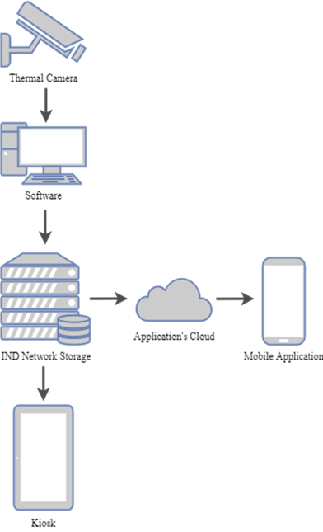

Slide 4
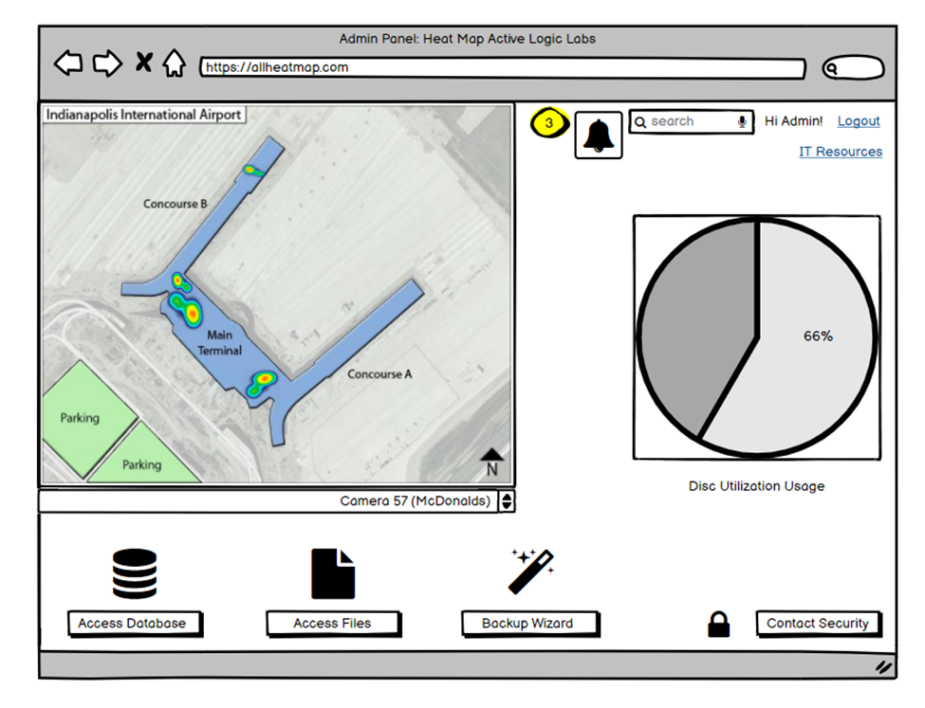

Slide 5
